Slide 1
HCI Design Challenge
Group 21
Adam Bass, Zi Yuan Chen, Harrison Hughes, Matvey Shchetinin, Zakk Withers

Slide 2
Brainstorming
Initially we began by meeting up to brainstorm the possible issues given the design challenge topic which is cycling.

Slide 3
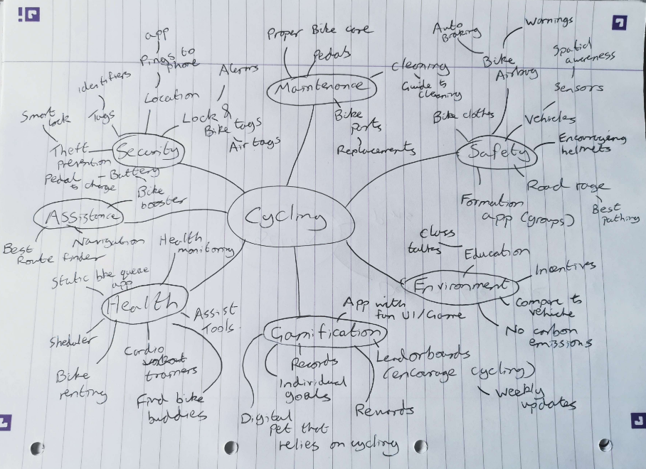
Mind Map of Ideas
Main focus was cycling which then branched off into 7 main categories. Then we proceeded to find specific issues and the possible IoT solutions as an initial starting point for our product.
By using a separation of the different branches from cycling we were able to come up with more unique ideas. This means they were more tailored their area rather than only having general ideas for cycling as a whole.

Slide 4
Mind Mapping
We decided to use a mind map so that we could come up with a wide range of ideas and to ensure that nothing gets forgotten. By using a mind map we were able to decide on key areas that were relevant to cycling and proceed by establishing further issues that would need a IoT solution. This initiated discussions and arguments about what was of interest and what would not make a good IoT solution. Everyone came up with ideas and contributed to the mind map so we had a wide range of cycling related problems and solutions. This would then lead us to focus on areas of interest.
During the mind mapping, we managed to isolate the areas we found had the most potential to create useful IoT solutions. Our aim was to focus on more novel ideas that would be useful and feasible with modern technology. The target market we wanted to achieve is for the general public as cycling is an all inclusive sport/transport.
After evaluating our mind map, we realised that a lot of issues were common among cycling and certain products already exists for some of our ideas. As we wanted to have more of a novel idea, we rejected the basic ideas and ones that already exists which is discussed later.
A mind map was a good way to initiate communication in the group and meant that we are able to emphasise with our target group, in this case it was cyclists, and to help define problems and solutions. So in doing so we are able to follow the user centered design to gain a greater understanding for our concepts.

Slide 5
Initial Ideas
We generated a list of all our ideas and began exploring the possible categories of interest based on our knowledge and experience with cycling.

Slide 6
Idea Discussion
Looking through our mind map, we went through ideas and talked through their positives and negatives and kept the ones that had the most potential which can be found listed here:
https://docs.google.com/document/d/12DdqhwvVxykI7QO3PATvAKs4Ysw8HAfx12lksa6U1RY/edit?usp=sharing
As we met again to continue our discussions, these ideas were generated by focusing on each of the categories on the mind map and figuring possibilities for products that may assist or terminate the issues involved. Through the different sections, our main focus was on the security section and a way to motivate non-cyclists. We believed this was the best focus as: it involved larger target groups, security is needed for any cyclist, and motivation would help non-cyclists.
After deciding the areas that are of interest and with our initial ideas, we spent some time researching existing products to enable us to evaluate what we have and to see whether there were similarities or ideas that could be improved upon. A couple examples were the google glasses that provides a heads up display for the user whilst its on or a variety of apps that helps user in different ways such as training, goal setter, exercise time management and guide to biking. We took these ideas into account and considered if they can be incorporated into our generated ideas or enhance them.

Slide 7
Autoethnography
To assist with coming up with an idea, we utilised autoethnography by seeing what areas of cycling we personally had issues with. Following discussion, a list was compiled of particular pains:
When travelling to town it’s frustrating to locate an area to leave one’s bike, as it could lead to being late for appointments or locking up a bike in an alley with poor visibility
A member of the group knew someone who had their bike stolen, and the bike couldn’t be located because it wasn’t tracked in any way
Some roads leading into cities are very busy during rush hours, making cycling on them dangerous without a cycle lane
Cycling during winter can be dangerous, as frequently used roads can suddenly ice up and become a hazard
Unless the bike lock can be attached to the bicycle, it can be easily forgotten at home
This list has been concatenated to include only the issues that seemed to have the most potential for a solution within the scope of this module. These frustrations became the basis of our main ideas, as figuring out a solution for problems that affected our daily lives was an effective motivator. Furthermore, it turned out that it was easier to start discussions regarding troubles that had annoyed us previously, as those situations ended up being memorable and could be extrapolated into a potentially innovative idea.

Slide 8
Rejected ideas
Through consideration of the different areas of cycling, there was generally less focus on areas such as the environmental impacts of cycling or the maintenance of the bike. This was due to the fact that we believed there were better areas that our product could be created from which would provide greater help to our target groups. Through self reflection by using our autoethnography, certain ideas were rejected early on.
Reviewing our list of ideas, we critiqued each one to help us choose which idea should be removed. Some of the ideas we rejected early on were:
Spatial Awareness Sensors - Sensors for the bike to ensure the biker is aware of oncoming vehicles/obstacles. This was rejected due to the infeasibility of the idea.
Auto Braking - Brake system that helps the biker to brake or to stop when it detects a dangerous object. We rejected this due to the braking possibly throwing the biker off.
Specialised Cardio Trainer - An app that helps the biker improve on their cardio by setting goals and giving recommendations. Rejected as similar apps already existed.
Even though these were ideas that were rejected, given better technology or modifications, these can still be made into beneficial products for their users.

Slide 9
Main Ideas
After discussion sessions, we considered and decided upon the main ideas that we wanted to focus on. The basic ideas that we were interested in were:
A better lock system for the safety of the bike
Power assistance for the bike
Pathfinding and Bike Rack finder
Bike gear advisory system
Crowd-sourced, geolocated cycling information app
With lots of possible ideas that we have come up with and areas that we want to further explore such as types of locks for the bike, different devices that assist the biker and a variety of different apps, we designed a questionnaire to help us in collecting more information that we will require for our product.
The goal of our questionnaire was to create a picture of what our target group are like and their biking habits. By doing this, we would be able to further develop our ideas and modify them more specifically to what they may need.

Slide 10
Research
We look to other users and gather information from them to empathise with the target audience as well further defining the problems of cycling.

Slide 11
Questionnaire
We created a questionnaire with the hope of focusing our brainstorming and highlighting any areas of cycling that we hadn’t considered already. The survey we developed is structured to gather some demographic information about the respondent and then depending on if they actively ride a bike in any form:
Questions about cycling habits including safety & security measures, apps used, accidents, general monetary spend etc
Questions about why they don’t cycle, including: history and future anticipation of cycling, whether they own a bike, why they don’t ride a bike more often.
We then piloted the questionnaire with a few people, in person and specifically looked for issues or comments in the following areas:
Question flow - is the order of questioning logical?
Total time to complete the survey plus any questions that were time consuming in their current form
Confusion: are any questions difficult to understand, phrased poorly or are there any questions you want to skip?
Are there any questions where the permitted answer type doesn’t best suit the answer you’re trying to give?
The feedback received across the five pilots we conducted raised two main points:
Hours of exercise/cycling per week questions were confusing since they used a time field which required a 24 hour clock type time
Some combined questions such as ‘have you had a bike (or part of) stolen and if so which part?’ should be separated
We fixed these issues and then circulated the questionnaire to capture as many responses as we were able to before our next meeting.

Slide 12
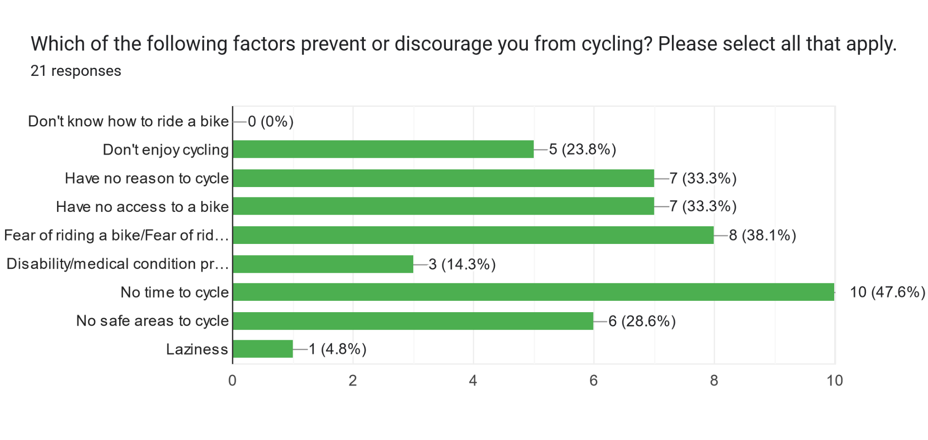
Questionnaire Result Analysis
The questionnaire was answered by 42 people and produced interesting results, such as that:
38% of non-cyclists didn’t cycle because they are afraid of cycling in public, while another 28% have no safe areas to cycle
29% of cyclists have had their bike or part of their bike stolen
62% of cyclists used their bikes as a form of transport, or use them to commute to work
20% of cyclists use a cycling app
44% of cyclists do not have a set route to follow when cycling
Depending on whether or not the user cycles, they were taken to different areas of the questionnaire so that the relevant questions can be asked. Surprisingly, 50% of our respondents don't cycle and 50% do. A major reason of not cycling seems to be related to time and certain issues such no access, no safe routes and no reason to cycle. So we see that based on the responses, we are aiming to reduce the number of non cyclists by designing something that encourages more users to cycle as well as to make their life easier and simpler. By aiming to design something to assist in cycling, this should reduce the time needed for new cyclists to get set up and out cycling which was a key issue that prevents them from doing so.

Slide 13
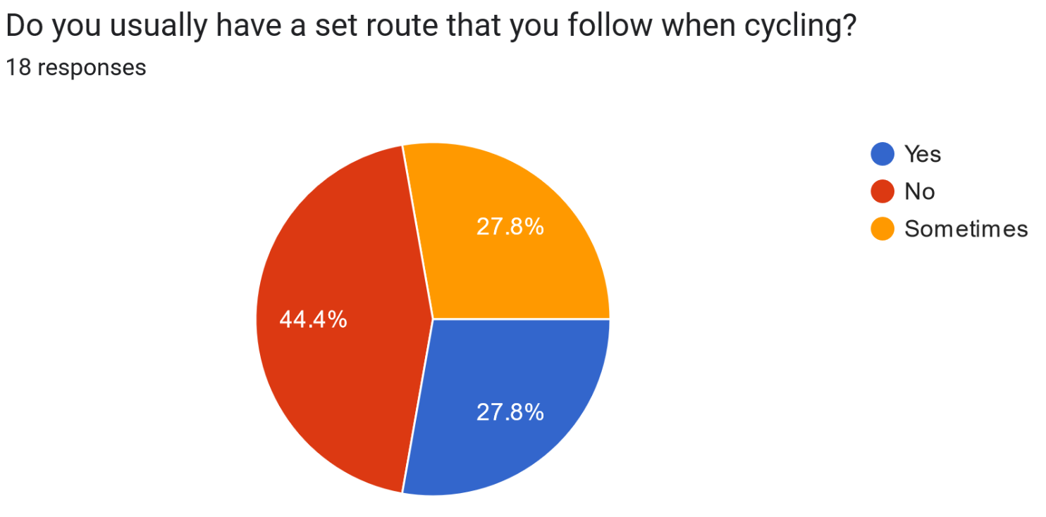
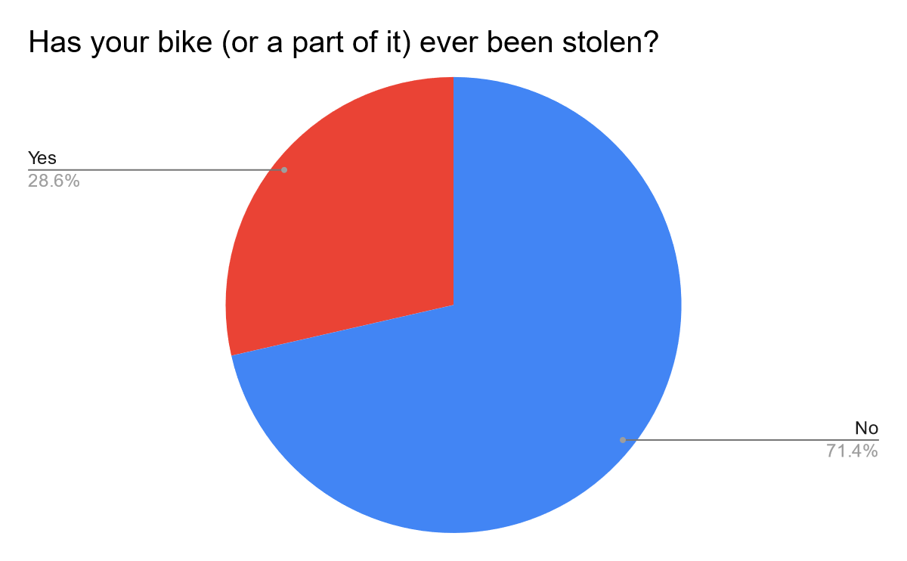
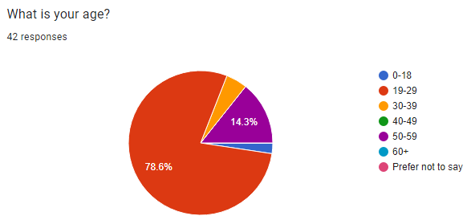
Questionnaire Result Analysis cont.
These answers shown on the right were of interest, as they demonstrated that security and navigation are two areas that could be improved for the questionnaire recipients.
The high rate of bike theft and large demographic that use their bike for transport (and presumably have to leave their bike unattended after they reach their destination) mean that an innovative security device could be desirable for improving their cycling experience.
The same could be said for navigation as: many people are afraid of cycling in public, do not set a route to follow when cycling, and do not use a cycling app. This means that a high percentage of people could be willing to try out an app that assists with setting routes and seeing where they can safely cycle.
To better understand the requirements of our target audience, we will now conduct interviews. This will also help reinforce what we have found on our questionnaire or whether or not their may be outlying data. Then we will create personas based on the demographic of which we received from this questionnaire with each persona containing the issues and habits based on the information that was displayed here. This will give us a more specific target audience that we can work with as it will help us better visualise how our product will help them.

Slide 14
Interviews
Leading on from our questionnaire, we concluded that more qualitative research would give us the opportunity for a more in depth assessment, of why more people didn’t cycle regularly. We conducted a series of short, informal, one-to-one interviews from a range of people including students, a commuting professionals, and a stay-at-home parents.
The questions included some about general cycle usage as well and delving into further detail with regards to the subject’s experience with bike safety (including products, experiences and general thoughts) as well as navigation. This is in response to these being key themes highlighted by both the questionnaire and the autoethnography.
We chose to record their responses in voice notes on a phone so that no detail was missed, the interviewer could focus on the responses and subject rather than transcribing and also to avoid any nerves or intimidation by a more intrusive recording method. For the interview to remain on track we outlined a brief set of questions to prompt the interviewee when needed. This allowed the person being interviewed to lead the conversation and elaborate on their answers, while also ensuring this provided the information we required, having analysed the questionnaire responses. Some of these questions/prompts are included below:
Tell me about any times you’ve got lost while cycling.
How do you use your bike? (i.e. where, when and why)
Have you ever been worried about your bike being stolen or damaged? (If yes: “why?”)
What safety measures do you use? And why have you chosen these?
In addition to these formal structured interviews, we regularly held informal conversations with others, who we perceived to be our target end user at multiple stages in the design process.

Slide 15
Interview Findings
From our interviews we observed the following:
The greatest barrier to more frequent bike users, was that of an issue of security. This could be due to either the location to which they would store their bike, or the specific lock they would use to secure their bike. This aligned with our questionnaire results, as after personal reasons, a question of safety was the next issue preventing more people from riding. There was a general lack in trust of some areas to store your bike due to sporadic theft being reported. While even some bike locks are strong enough to deter this, the thought of leaving your bike for several hours was off-putting for most.
It was expressed that some routes simply weren’t practical for riding a bike and that access needed to be improved, to encourage more bike use. Quieter routes for less able cyclists was brought up in conversation, as most mobile route apps frequently direct users down busy/main roads. This can discourage the people who wish to cycle who aren’t as confident as other road users.
One of our interviewees described how she would be motivated to cycle more, if she had someone to cycle with.
It was also a common theme that while cycling is an active mode of transport there are limitations, such as if a large amount of items are needed to be brought along. This makes cycling tiresome and impractical, especially for someone who commutes.
These responses were encouraging: aligning with the questionnaire results gave us confidence that we were heading in the right direction. Additionally it reduced the problem space, allowing for later ideation that was more focused.

Slide 16
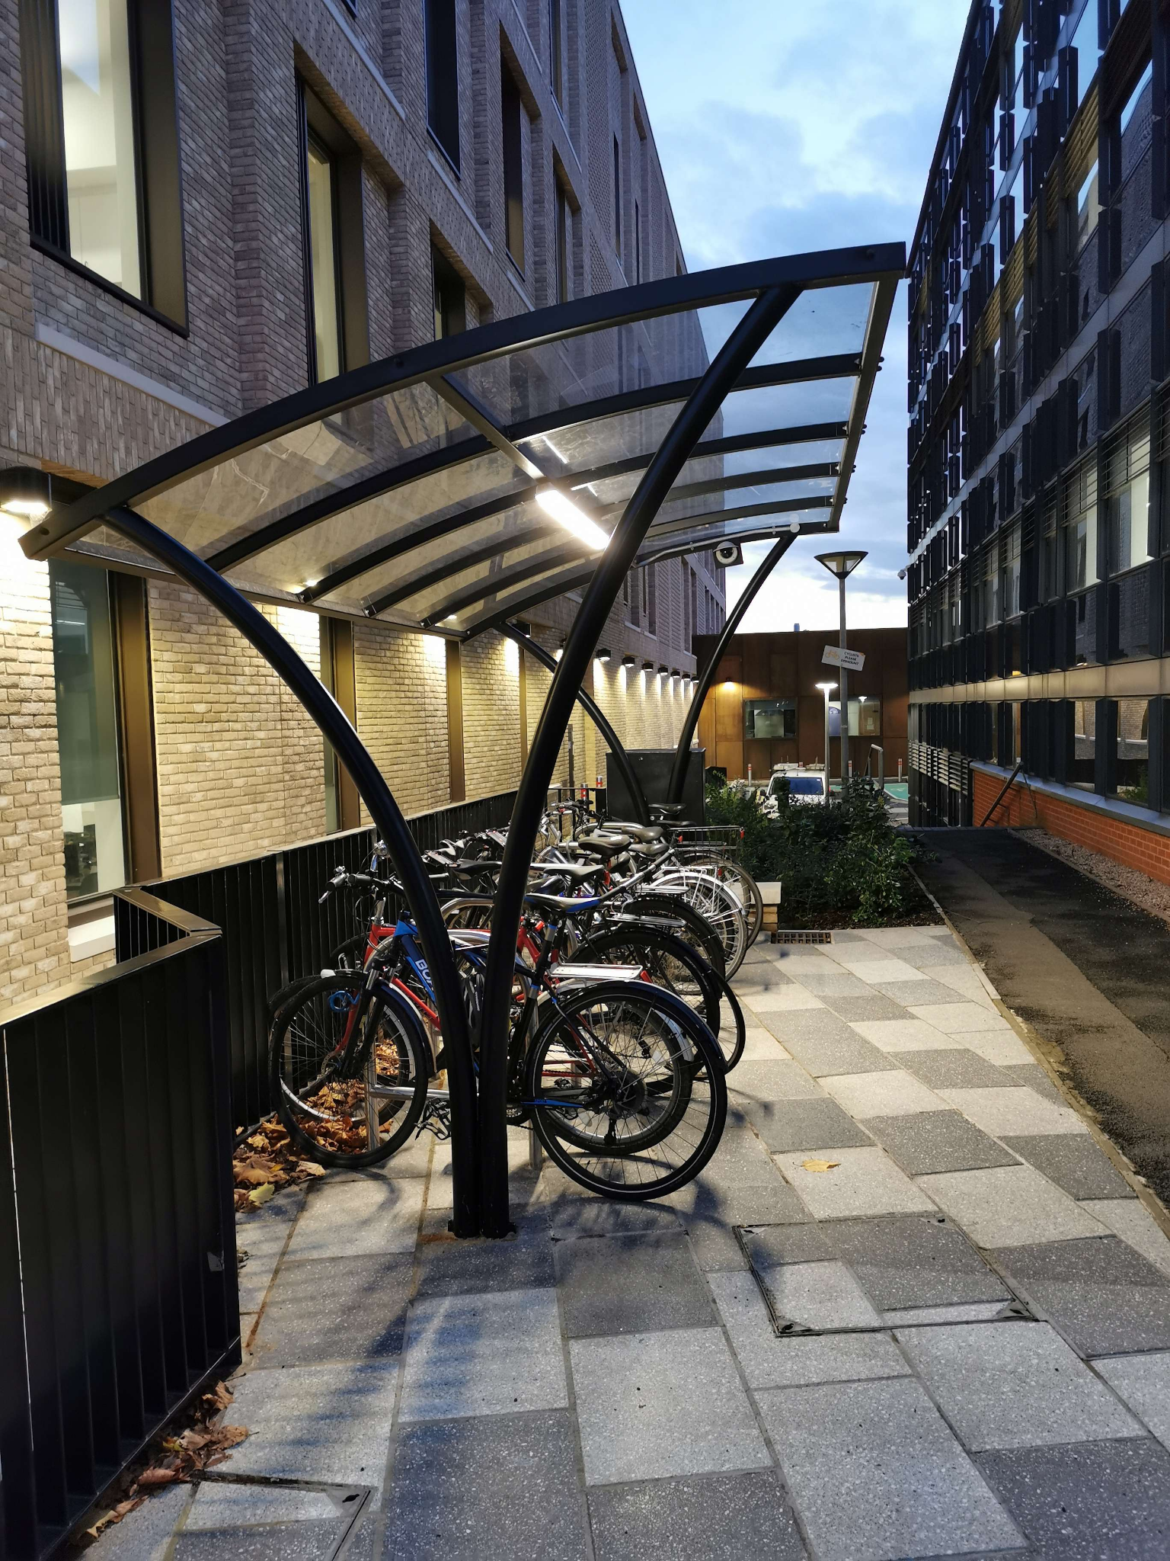
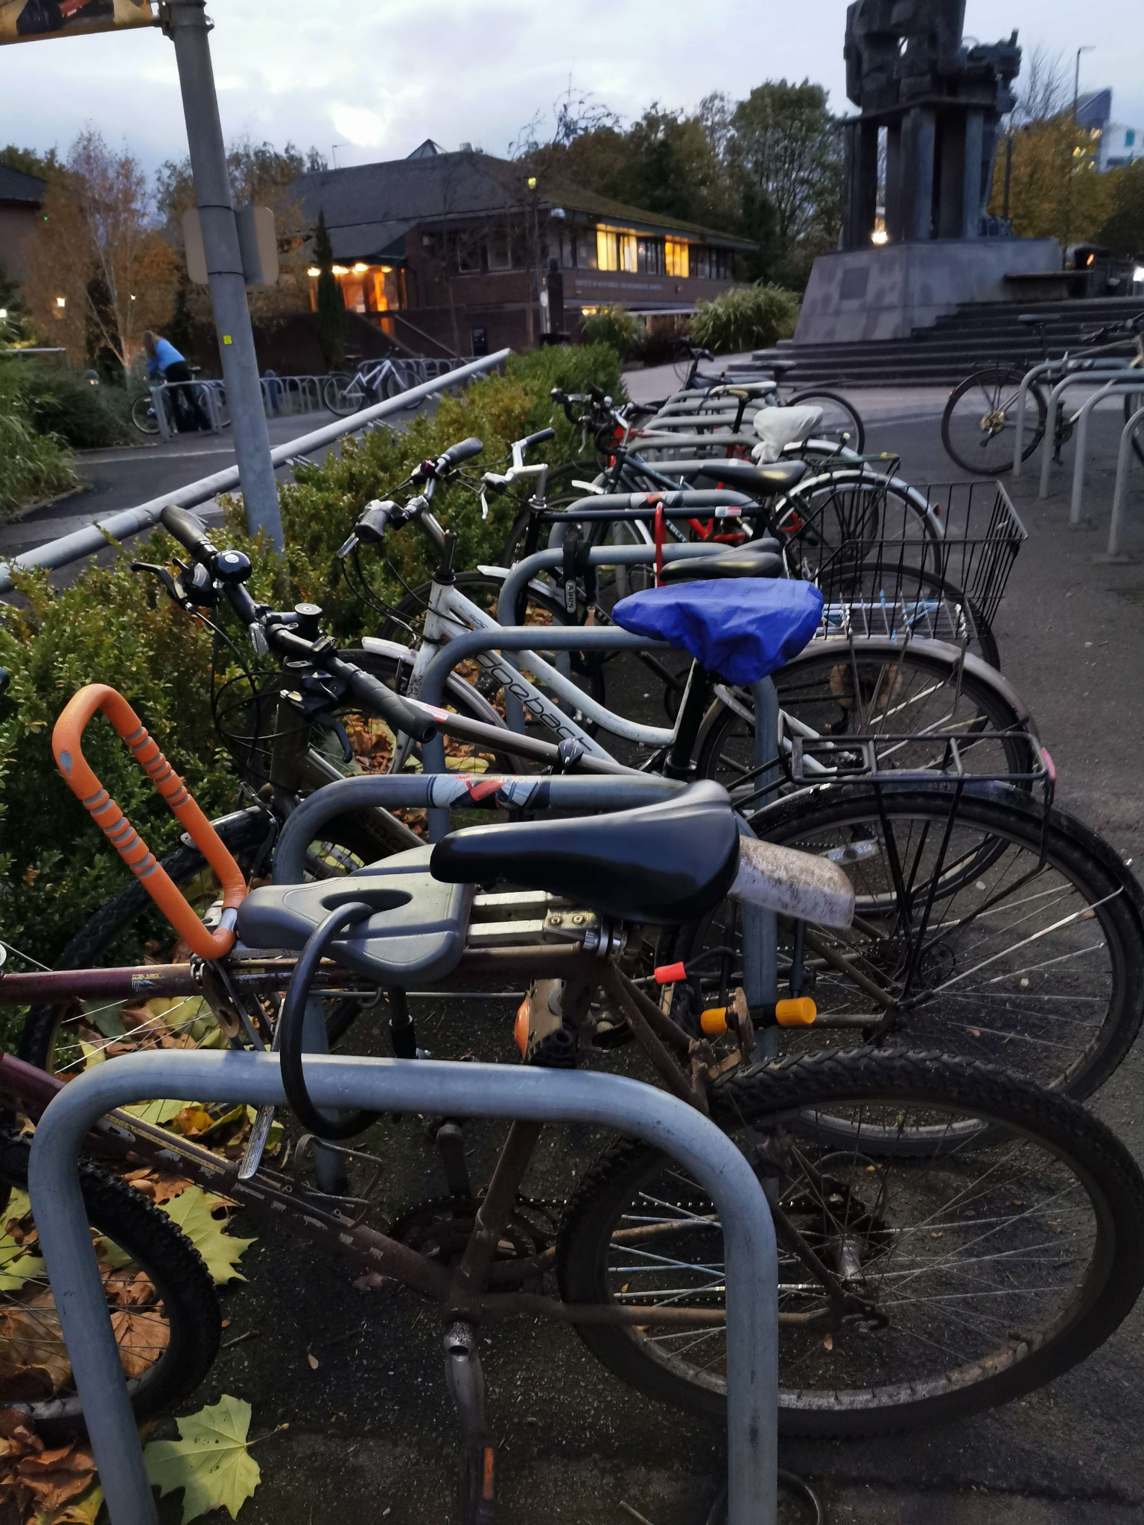
Ethnography
During one of our meetings, we decided to sit at a table near the bike racks so that we could observe any bikers that go through or stop to lock up their bikes. This was done at the University of Birmingham, so many of the cyclists were students or lecturers commuting home or to lectures.
We observed that of those who stopped to lock their bikes, there were a variety of different bike locks that were used. Along with some people who use 2 different type of locks for extra security. Almost all the bikers we saw had a helmet on which is more than we expected as in our questionnaire, 47.6% said that they don't wear a helmet.
There are also a variety of different types of bike racks with some seemingly more secure and safe to others. At the uni, the bike racks seems to be in more public places to provide more security and some had roofing as they were more modern.

Slide 17
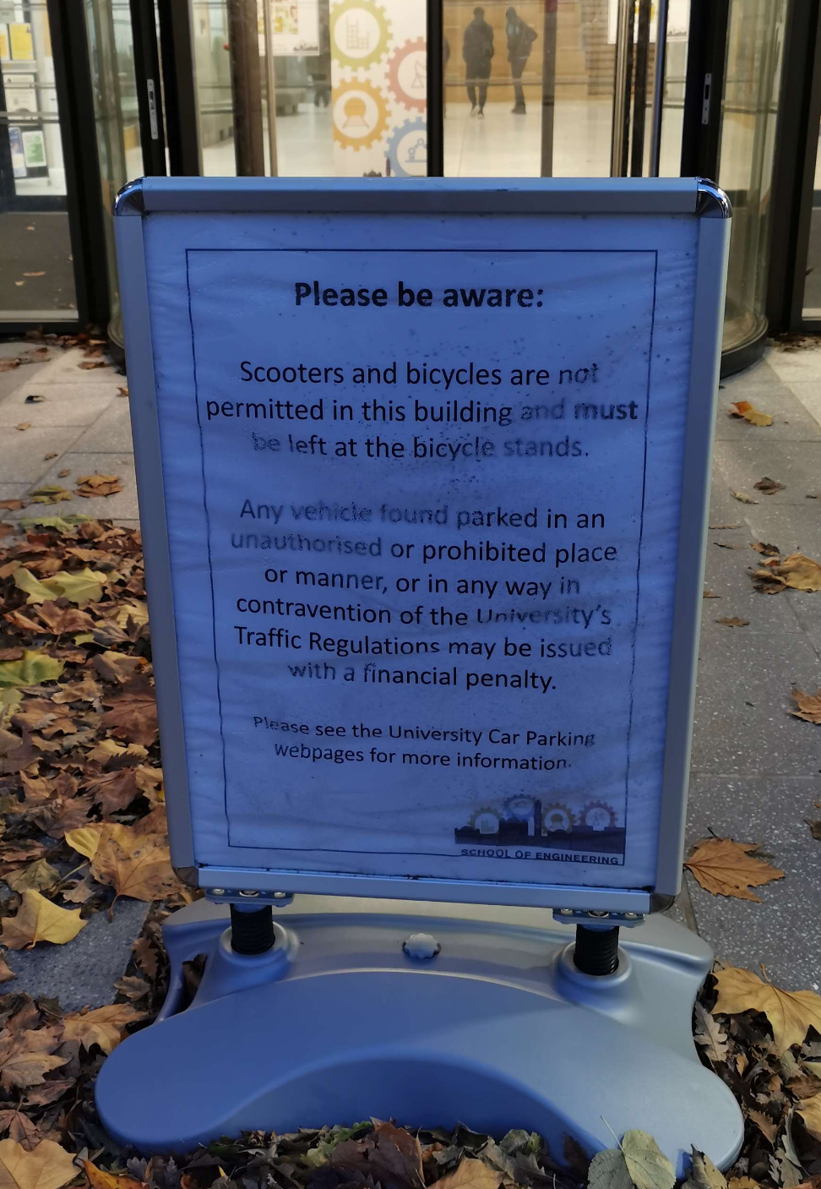
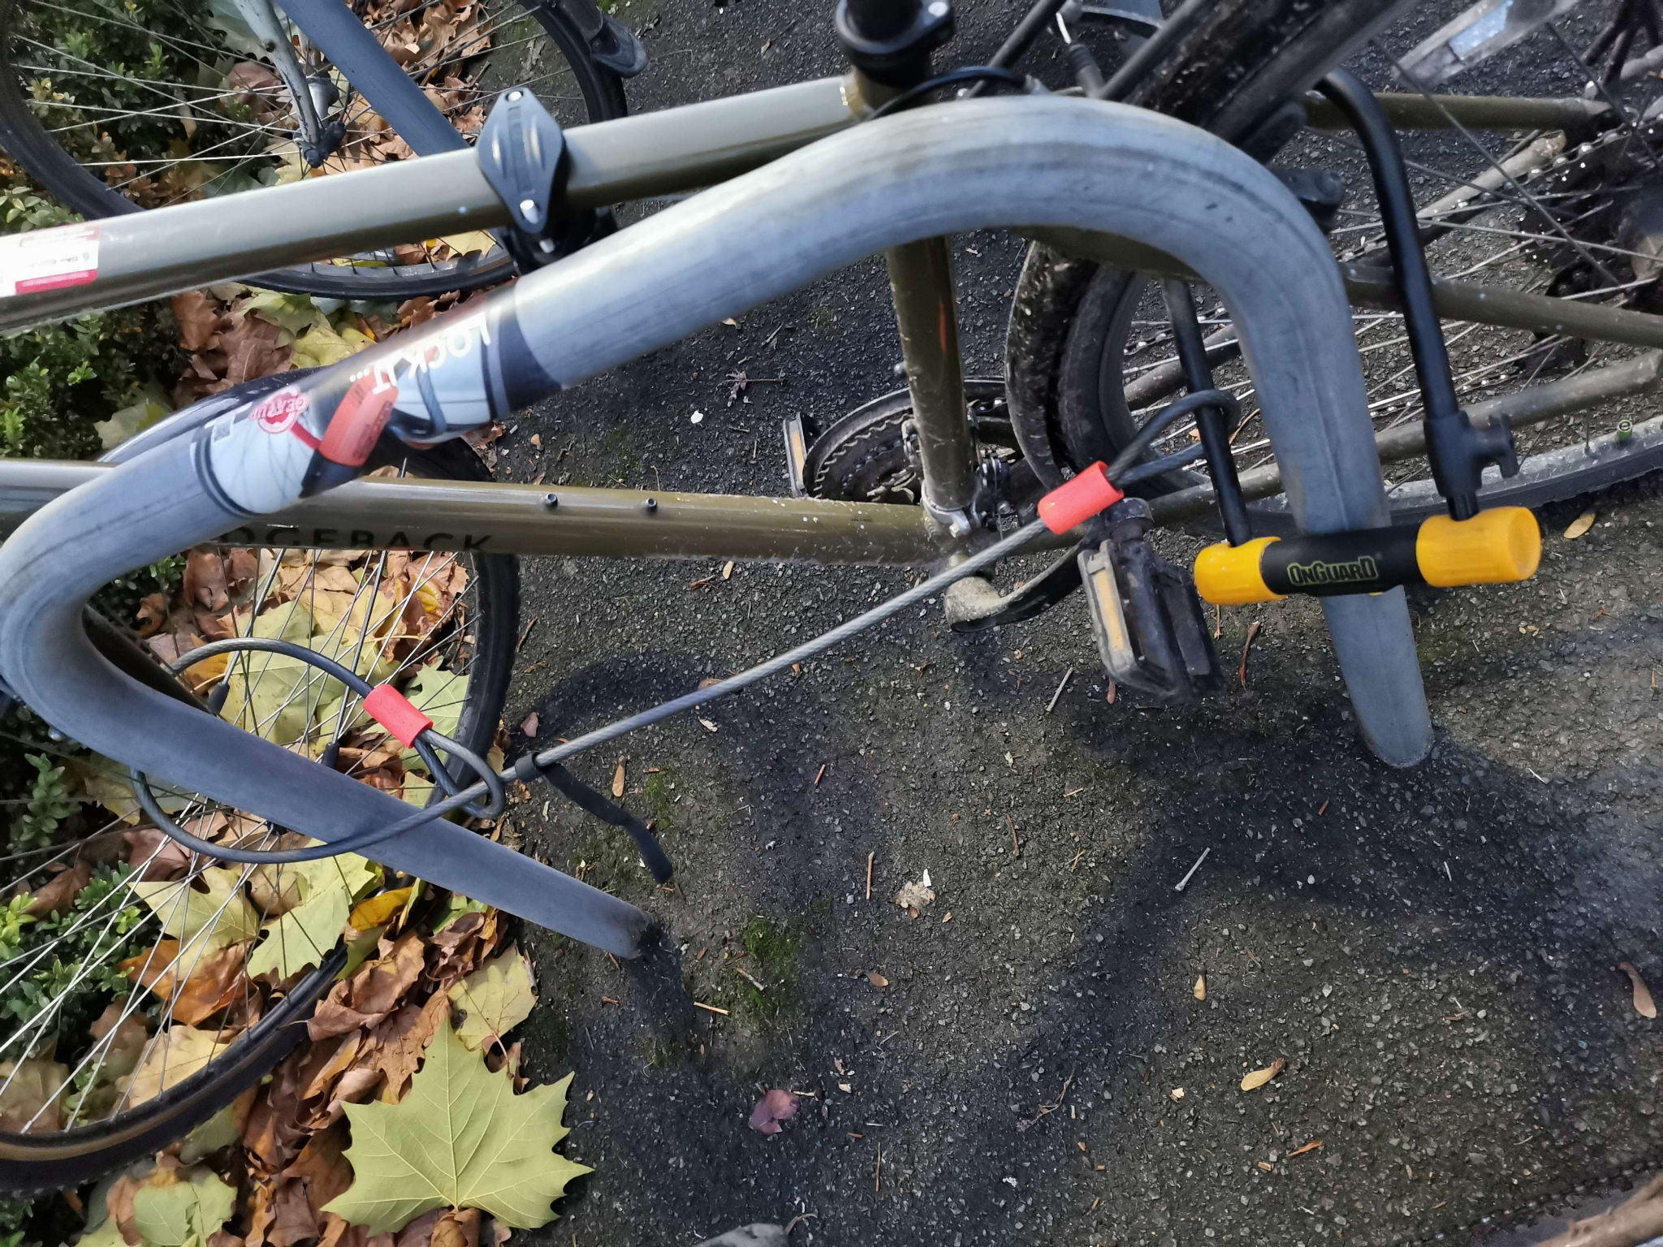
Ethnography cont.
The few bikes that had a double bike lock system use different locks, usually a cable lock and a U-lock like the one shown in the image. From what we saw, this was a lot more time consuming for the biker compared to the ones who only had one lock. Many of the bikers stored their locks in their rucksack or something similar which may be a hassle.
Along with this, we observed a sign by a building which stated that bikes aren’t allowed to be brought in meaning that bikers will have to look for someplace to secure their bike onto which can be time consuming especially if there isn't an obvious one nearby.
Thus, based on the ethnography, we believe the main focus of our design should be for the security of cycling. For example a better lock system would be appropriate for the bikers and reduces their need to used a double bike lock.

Slide 18
Online Research
We were unable to find any relevant research papers that were not behind a paywall. However, articles/websites that detailed popular cycling accessories and other benefits of cycling were found to be useful. The former helped to identify popular accessory types for cyclists, which assisted in figuring out our project ideas. The latter helped in a similar fashion, as we could single out ideas on topics that enticed others to begin their cycling journey. There was a wide array of various tools that assist the biker which shows that there is a large market so due to this, we wanted to come up with a product that has more benefits to the biker rather than just a simple tool that only has one function such as a speedometer, lights, bottle holder and battery assisted booster.
Examples of websites used:
Article on benefits of cycling: https://www.bicycling.com/training/a36174134/benefits-of-cycling-for-fun/
Cycling-related gift ideas: (looking at popular gifts related to cycling could be used to identify areas of potential innovation for project idea)
https://www.cyclist.co.uk/buying-guides/677/gifts-for-cyclists
Website chronicling the “best” cycling related gear (“Best bike locks”, “best bike lights”, etc):
https://www.bicycling.com/bikes-gear/
Article on best cycling accessories for improving cycling experience: https://www.gq-magazine.co.uk/lifestyle/gallery/best-cycling-accessories

Slide 19
Personas
After reviewing the data gathered from the questionnaire, interviews and ethnography we have identified key themes and categories within the set of respondents and determined that five personas would be ideal to represent the interests of the whole group. These were created based on the demographic of our questionnaire to better represent our target audience. This is to ensure that we are able to ideate solutions for our personas.

Slide 20
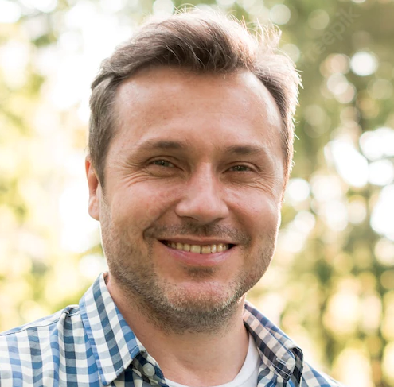
Persona: John Heathrow
Bio John is a carpenter who enjoys to cycle in town during his free time on the weekends. He has very little time to do this, as he is often preoccupied with taking care of his children and doing chores around the house.
When he is able to spend his precious time out and about, he is frequently disappointed: as roads are filled with cars and have few cycle paths. He wants to be able to quickly and easily find out where he can cycle without having to endure the stress of dodging cars and waiting at traffic lights, despite being in the middle of the city.
John makes a comfortable living in a stable job and cycles as a hobby so his budget is generous.
Goals
Cycle in an area with few cars, or an area that has cycle paths
To find out where he can cycle before he sets off
To make the best use of his limited time
Behaviours
Name: John Heathrow Age: 43 Gender: Male Occupation: Carpenter Nationality: British
Productivity
Exercise activity
Budget/Spending power
Technical ability
Pain Points
Dislikes cycling without music, but doesn’t feel confident to cycle with music when there are cars around
Gets impatient when he has to wait at multiple traffic lights
“It’s quite difficult to find a quiet cycle path in town these days…”

Slide 21
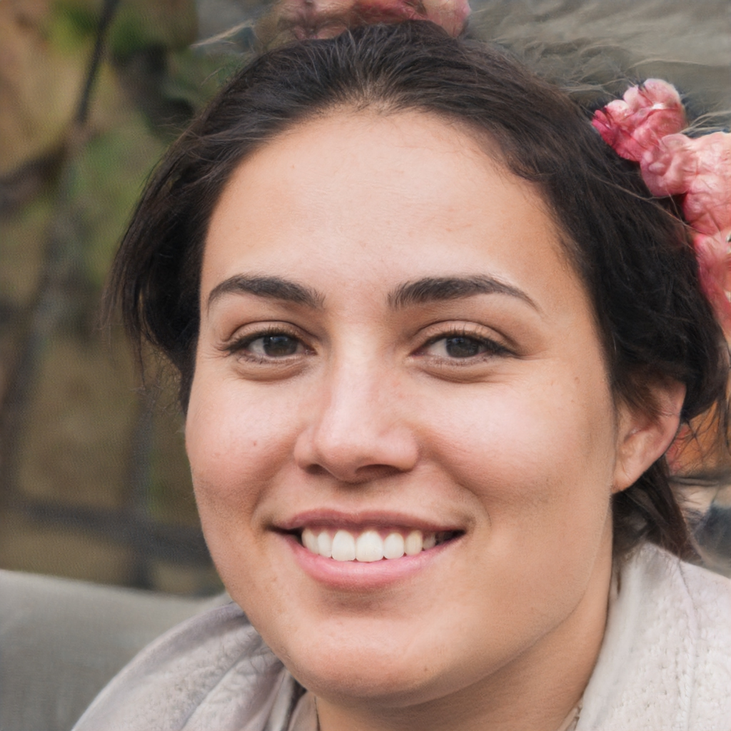
Persona: Emily Hansley
Bio
Emily is a food delivery driver who uses a bicycle to make deliveries. She gets paid per delivery she makes and receives public feedback on the delivery service she provides. As a result, she wants to take the quickest and most efficient route possible every time she has a delivery.
Emily is self-employed so needs to maximise the time she has to work to make sure she can pay her bills. Sometimes she has to cut a shift short or take an unwanted break since she can’t find facilities such as a toilet that she can use and therefore has to go home before resuming work.
She wants to maximise her safety because she’s somewhat vulnerable riding alone, often when it’s dark, so she wants to avoid dark/dangerous paths and tries to cycle in groups. She also wants better protection for her bike while waiting inside restaurants to pick up orders for delivery. Since the profit margins in her work are tight, she doesn’t mind making an investment into a product that will improve her efficiency, safety or experience significantly but can’t afford to keep replacing high-ticket items or paying expensive subscriptions.
Name: Emily Hansley Age: 27 Gender: Female Occupation: Food Delivery Driver Nationality: British
Goals
Take efficient routes to save time and energy
Easily find facilities she can use so she can keep working for longer
Avoid potential safety hazards
Keep her bike safe in various locations around her city
Behaviours
Productivity
Exercise activity
Budget/Spending power
Technical ability
“Sometimes it can be a bit intimidating cycling alone at night”
Pain Points
Having to waste time to find a toilet/somewhere to eat etc
Concerned about risk of cycling alone at night
Cost of replacing broken equipment

Slide 22

Persona: Mikael Karlsson
Bio Mikael received his PhD in Philosophy in 1997 from Exeter University and remained there until he became a lecturer. He loves his job and commutes to and from work every day when the weather isn’t awful. Luckily he has a relatively simple route that he can follow from his house to the university. However, he doesn’t trust the bike racks that he must leave his bike at, as his bike has been stolen before.
Due to this, throughout his day at uni he spends time to check his bike between lectures and meetings. If he doesn't have a bike then he struggles to get back home without having to rely on someone to help him because of his leg pain he experiences.
Since he is settled in life, the cost of a product is not a big issue for Mikael if the product provides a good experience or solves a problem well.
Name: Mikael Karlsson Age: 55 Gender: Male Occupation: University Lecturer Nationality: Swedish
Goals
Focus on his lectures and seminars
Have a way to track/see his bike during work
Reduce commute time
Not have his bike stolen
Behaviours
Productivity
Exercise activity
Budget/Spending power
Technical ability
Pain Points
Anxiety from fear of getting bike stolen
Physical pain from extended walking
“If only I can keep an eye on my bike from my office”

Slide 23
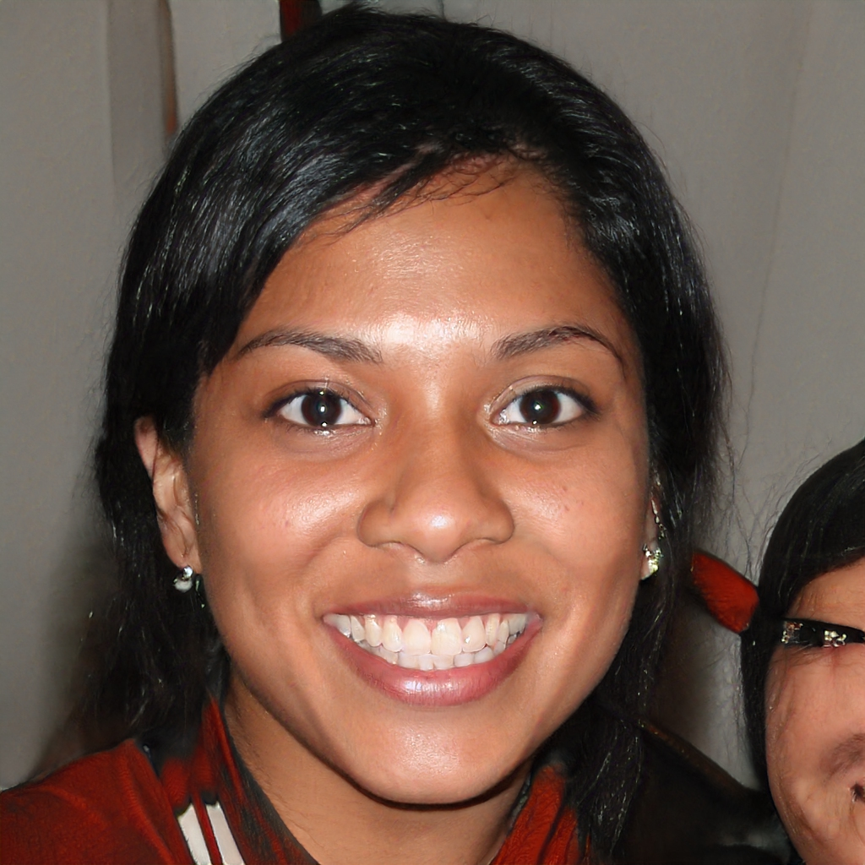
Persona: Jesika Langley
Bio Jesika is a full-time university student studying Law at the University of Birmingham. She lives in Northfield, about 4 miles from the university’s campus and commutes by bike every day. She never goes far from her bike while on campus since she often sits in the library for hours. Once she had her bike lock cut and her bike stolen while she was in a lecture and wants to prevent this happening again since she can’t afford another new bike if it does since she is living off a limited student budget. She also once got into a cycling accident due to a blocked, unlit cycle lane. She often has to cycle home alone in the dark due to the early sunset in winter so would love anything that improves her safety in this situation.
Name: Jesika Langley Age: 21 Gender: Female Occupation: Student Nationality: British Indian
Goals
Protect her bike
Avoid hazards while cycling
Improve safety when cycling alone
Behaviours
Productivity
Exercise activity
Budget/Spending power
Technical ability
Pain Points
Bike theft
Low perception of safety cycling at night
Monetary Cost
“I’m quite paranoid about my bike being nicked while I’m studying on campus.”

Slide 24

Persona: Alex Green
Bio Alex Green has just passed his A-levels and is going to university in September. He is an avid cyclist- due to living in a rural area, he rode both to school and his part-time job. He has never been an accident, nor had anything stolen; however, he will soon be moving to city he's never been to before. It is an unfamiliar, urban landscape, and Alex is becoming increasing anxious about cycling there. He does not know any routes and is not used to cycling through busy traffic. He also worried about the risk of theft. He would appreciate something that could show him safe routes through the city, as well as protection from crime. Since he doesn’t have a student loan yet and is spending a lot of money to prepare for university, his disposable income to spend on cycling is very limited.
Goals
Continue cycling at uni.
Avoid accidents.
Ensure his equipment isn’t stolen.
Get used to city life.
Behaviours
Name: Alex Green Age: 18 Gender: Male Occupation: Sixth-form Student, soon to be Uni Student Nationality: British
Productivity
Exercise activity
Budget/Spending power
Technical ability
Pain Points
Doesn’t like cycling in unknown areas.
Scared of a bike theft/accident.
Uncomfortable with traffic.
High prices
“I’m moving to an unfamiliar environment and am concerned with cycling there.”

Slide 25
Persona Explanation
John Heathrow - Our questionnaire indicated that 33% of responders cycled for fun and 73% did not always set a route when cycling. Additionally, 19% of people only cycle a few times a month. This persona demonstrates these habits, which is the demographic of the busy leisure cyclist, and is a natural fit for an app that provides navigational information for cycling routes and areas of high traffic. A situation in which someone has limited time to cycle and wants to get the most out of their excursion.
Emily Hansley - 50% of survey respondents were female and 79% were between 19 and 29 years old so these demographics are represented by this persona. Further, 38% of respondents who said they do cycle, said they cycle frequently (2 or more times per week) and 43% said they cycle as a form of transport. To capture these habits and the demographic of the so-called ‘professional’ cyclist (meaning they do it for their work, not necessarily competitively), this persona works as a cycling food delivery driver. This job also means that safety and efficiency are important to Emily. She also covers the use cases of both using a bike security system frequently and in various different locations.
Mikael Karlsson - From our questionnaire, over 14% of responses were people who were over the age of 50 so the purpose of this person was to help portray this demographic. Additionally, he uses a bike to commute to work so that he can maintain his health and it saves him time compared to just walking to work. He also has knee problems which means extended periods of walking could cause him pain so the use of a bike is more vital in his day to day life. This means that the safety and security of the bike is important to him and a cause for concern.
Jesika Langley - Jesika is another young (79% 19-29), female (50%) persona to capture the demographic of commuting cyclists (19% of cycling respondents). She has been in a cycling accident before (like 29% of cycling respondents) due to a blocked, unlit cycle lane. She has also had her bike stolen before (like 29% of cycling respondents), while working within her university’s campus.
Alex Green - 38% of the survey respondents who didn't cycling mentioned a fear of cycling. In addition, 95.2% said they cycled more in the past than they currently do now. This persona is meant to represent a person who faces fears that may prevent them from cycling comfortably, leading them to quit altogether. The majority of respondents were student-aged and so this persona fits that demographic as well.

Slide 26
Scenarios
John has a spare hour on Saturday at 10am after a busy week at work and with his kids over at friends’ houses. He decides to go for a leisurely cycle around town and having grabbed his phone, wallet, keys, bike and a lock (in case he wants to stop anywhere for awhile) he heads out. On his way into the city centre, he heads up a four-lane, 40mph-limited road with a bike lane on one side but finds that the bike lane is blocked by construction equipment meaning he has to cycle alongside fast-flowing traffic on a fairly busy day as shoppers head to the shops. John is a competent and fairly confident cyclist but the speed and proximity with which some drivers are passing him is both distressing and aggravating for him as certain drivers are showing little regard for his safety. Upon reaching the centre in a bit of a state, John decides he’s going to lock his bike up at a bike-park near a cafe he likes. He reaches the cafe to find that the bike-park he expected has been damaged beyond the point of use and he cycles off to find somewhere else to lock up his bike. After calming down with a coffee, he heads home having given up on a stress-relieving cycle around town.
Emily is a gig-economy food delivery driver who uses her bike to make deliveries. She heads out to work a shift in the middle of Manchester at 5pm on a dark Friday evening - a typically busy time of the week for her - and marks herself available on the apps she uses. She receives her first job quickly - a 3km trip from a McDonalds in the Arndale Centre 1km away - and starts heading over there straight away. She’s unfamiliar with the area she’s working tonight and uses Google Maps for directions which takes her along an unlit path running alongside the River Irwell. She passes a group who start catcalling her as she rides past leaving her somewhat shaken when she makes it to the restaurant. She finds a railing to lock her bike to and digs around her backpack until she finds her bike lock. She doesn’t like to keep it on her handlebars since the D-lock is heavy. Emily enters the restaurant and after a few minutes she picks up the order she’s waiting for, loading it into her bag. She then finds her keys and after a few awkward tries, manages to unlock her bike, carefully squeezing the lock into her backpack while trying not to squash the food she’s carrying and heads off to make the delivery. Upon arriving at the customer’s building, she rides around for two minutes until she finds somewhere to lock her bike and repeats the (un)locking procedure either side of carrying the delivery up to the customer’s apartment.

Slide 27
Scenarios cont.
It’s 8:35 and Mikael is ready to leave for work at Exeter University at which he’s employed to deliver his 9am lecture but time’s a little tight and he’s at risk of being late since the commute normally takes 20 minutes. He grabs his bike locks among other necessities and hastily heads out. He quickly cycles to the nearest bike lock to his lecture theatre. When he parks his bike, he has to spend a couple of minutes running his cable lock and D-lock around his bike and the Sheffield rack. He uses two locks since there has been a string of thefts in the area lately and he knows his new expensive (>£1000) bike is a prime target. His new bike came with many different gears which he is unsure how to use efficiently and effectively. During his trip, as he was late, he didn't have time to be constantly switching the gears. Once he arrived, in his haste he accidently attaches one lock incorrectly, causing him to waste even more time redoing the lock. Due to this mistake, Mikael ends up five minutes late and flustered to the start of his lecture.
Jesika is heading onto campus on a bitingly cold February day at the University of Birmingham where she is a full-time Law student to study in the Library and later head to a lecture. She carefully locks up her bike in a rack using a chain lock. This lock is uncomfortable for her to carry due to its weight and has given her a bit of a back-ache sat in her backpack but she’s very concerned about her bike being stolen since her old bike was stolen when the cable lock securing it was cut. She heads into the library and starts studying, taking a break every hour to check her bike is still as she left it. After a long day, she decides to head home and walks back to her bike. After unlocking it, she sets off into the dark. She knows the route well but there are a couple of dark roads south of Selly Oak she must cycle along to reach her house. Because of this, she isn’t able to see a patch of ice at the side of the road that she hadn’t spotted on her cycle in from the other side of the road. Between the ice and the weight of the lock on her back, she narrowly escapes a nasty fall and makes it home.

Slide 28
Scenarios cont.
Alex is about to set off from his student halls to his first on-campus lecture at the University of Leeds. He decides to ride his bike since he lives 2 miles from campus and he wants to save money rather than taking the bus. He hasn’t ridden to campus yet and has no experience riding a bike in large cities since he grew up in a rural area. He sets off and due to the maps app he uses for navigation not reflecting the one way nature of some streets, he’s forced to take wrong turnings adding 10 minutes to his journey. He arrives on campus and rides around until he finds somewhere he can park his bike with a feature small enough that his cable lock will reach around. On his journey back, he’s careful of the one-way roads and ends up on the A61 at rush hour surrounded by very heavy traffic due to a collision further on. He precariously and nervously navigates the dense traffic, slowing his progress considerably. He arrives home exhausted and running late for the tennis taster session he had planned to go to.

Slide 29
Scenario Analysis
By analysing our scenarios , we discovered certain aspects of our personas lives that could be improved by certain measures such as:
Persona | Issues | Countermeasures
John | Encountered blocked lane due to construction | Discovered before he departed
 | Searching for a bike rack | Easily accessible bike rack locations
Emily | Encountered people distressing her | Areas know to have high crime rates marked to be avoided
 | Tedious locking/unlocking | A keyless lock or better lock system
Mikael | Hassle of 2 locks for extra security | An improved lock with better countermeasures/deterrences
 | Learning new bike gears | Guide to bikes or a gadget
Jesika | Hassle to carry heavy lock | Portable lock
 | Slippery roads | Better traction on tyres or better awareness of nearby hazards
Alex | Gets lost in unfamiliar area | Planned routes/ongoing route changes
 | Nervous navigating heavy traffic | Avoid high-traffic areas

Slide 30
Top Ideas
After reviewing our personas and research we concluded upon 3 main ideas that are aimed in resolving the issues that our personas face as described in their scenarios. Through our research, we noticed a big market in bike locks meaning there was a variety of different locks and they may not be up to par due to the size of this market. So we wanted to eliminate the need of normal locks by using a more unique and secure lock. Additionally the majority of our personas commuted a lot meaning that a need of assistance could benefit them along with an app to help them along their route. A couple of our personas also frequently use a bike lock so a better lock would benefit them. Thus by narrowing down our ideas to a select few, we can focus on helping our personas which will help our target audience.
Therefore the 3 main ideas we ended up upon are:
A smart bike lock with fob activation and versatile use. This focuses on security and the safety of the bike so that the biker can continue their day with less worry of their bike being stolen. With additional features such as updates and alarm if the lock is broken, it ensures that the bike is safer than when using a normal lock. This would help Emily waste less time on her deliveries and Mikael a greater sense of security.
A gear advisory tool to assist the biker with gear switching. Focuses on helping bikers change gears to provide a smoother journey and reduces error for a wrong gear selection. Helps Mikael in understanding and learning the new gears in his upgraded bike.
App that crowdsources data and information such as hazards and bike routes to assist other bikers. Encourages non bikers and bikers as it provides a platform to share useful information that makes a bike journey easier. Also with route recommendation and sharing, provides new bikers different paths to use without the hassle of finding one themselves. Alex can benefit as he is new to the area. Knowing of the hazards early on, John may plan his route accordingly.

Slide 31
Top Ideas cont.
To further narrow our ideas down, we decided to use the star voting method to decide upon this. The star voting method involves each person giving each idea a score from 0 to 5 to indicate the overall levels of support for each idea. Duplicate scores are allowed and allocated scores do not need to be sequential.
As can be seen in the table below, the gear advisory tool has been eliminated (due to members’ concerns about a real need for the product). The gear advisory tool is more suited for an inexperienced mountain biker so due to the fact that our questionnaire consists of almost all types commuters rather than this small demographic of bikers, this idea ended up with the least amount of points. Therefore, the bike lock and crowd-sourced information app have been selected for lo-fi prototyping in the next stage of the user-centred design lifecycle.
 | Adam | Zi | Harrison | Matvey | Zakk | Total
Smart lock | 5 | 5 | 2 | 4 | 5 | 21
Gear advisory tool | 2 | 4 | 4 | 3 | 3 | 16
Cycling app | 4 | 3 | 3 | 5 | 4 | 19

Slide 32
Lo-Fi Concept 1 - Navigation App
We began the lo-fi prototyping of our first idea and later test it with our personas.

Slide 33
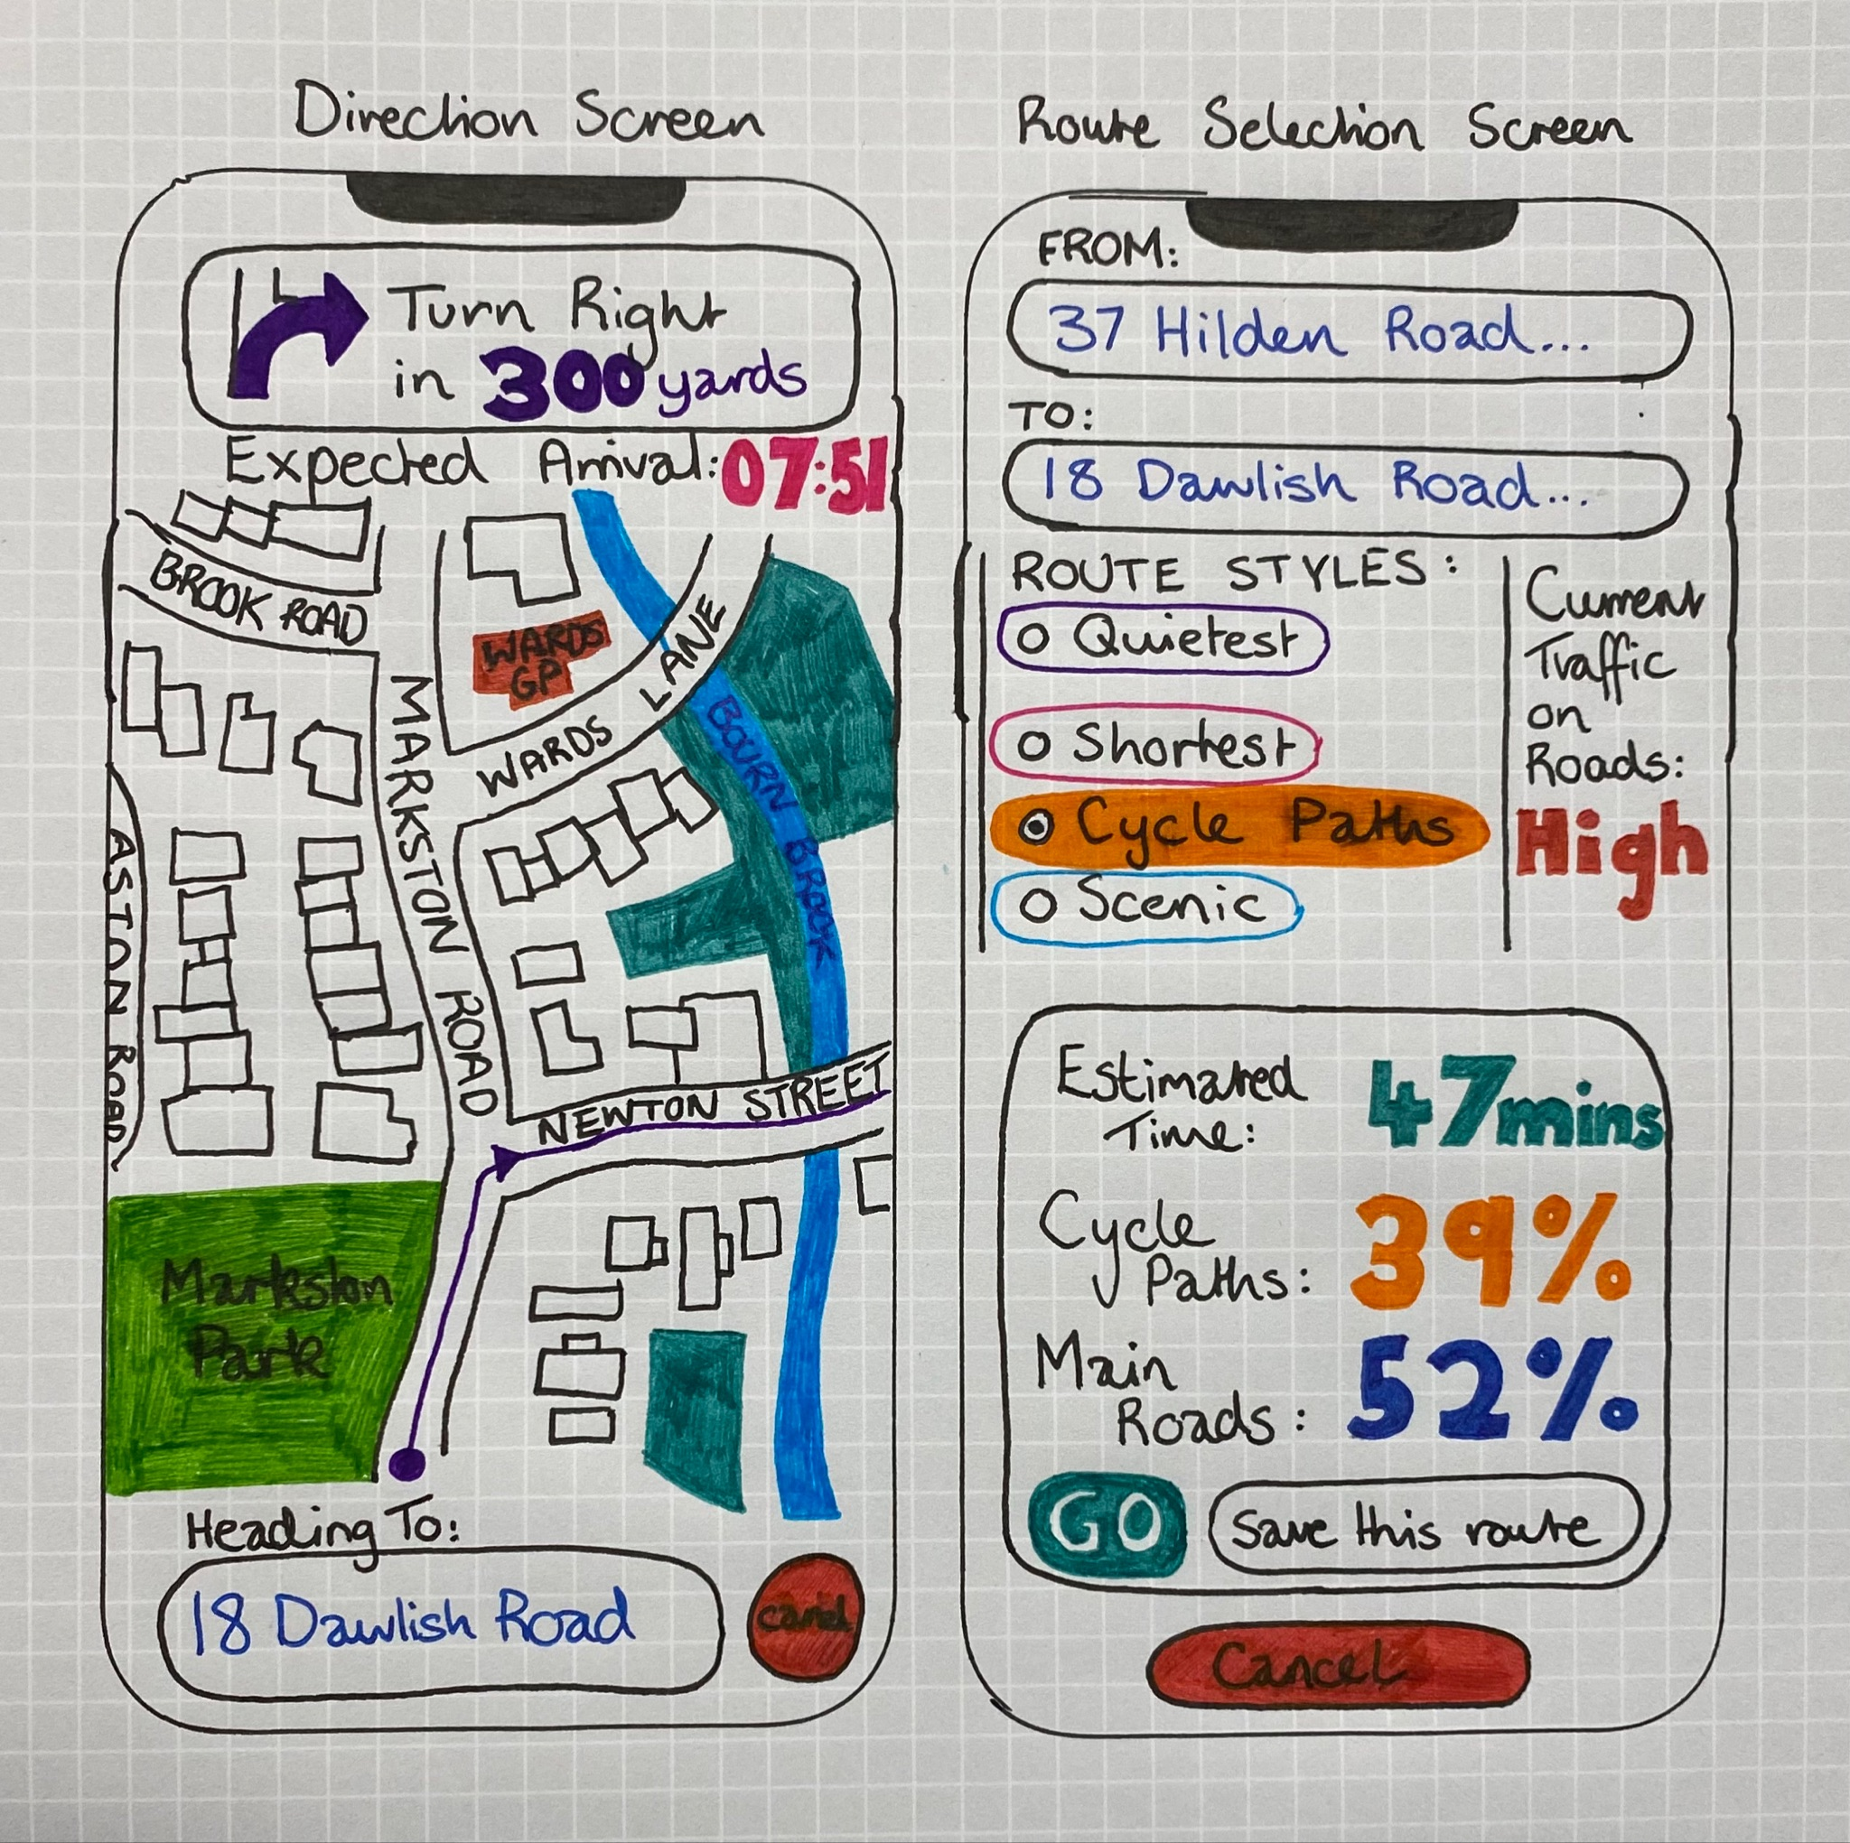
Early Design Sketches- Cycling Navigation App
Route navigation screen
Route selection screen
This screen allows the user to focus on the route with the current approaching instruction at the top of the screen. It continually displays the distance until the instruction is required, to allow the user to anticipate and easily follow the route. Below the instruction bar is the expected arrival time displayed in a 24hr format. At the bottom of the screen is the destination alongside a cancel button. All other functions are hidden in order to avoid distracting the rider while they are navigating. The main element of the screen is the Aerial view map, which contains a continuous line with arrowheads to visually guide the user along the journey. As the user rotates onto new roads, the map will automatically adjust, so that the map always aligns with the cyclist’s direction.
When selecting a route, the screen has a simple structured design. At the top, it allows you to select a starting point and a final destination with both allowing you to use your current location. Below you can select a route style such as: shortest, quietest (avoids as many main roads as possible), cycle paths (focuses primarily on navigating you down cycle paths) or scenic (focuses on navigating you past rivers and through nature, away from traffic). Next to the route styles is the current traffic indicator which will either display Low, Medium or High depending on the current level of traffic across the whole route. At the bottom it displays an estimated route time in minutes, the percentage of the route that aligns with your route style and also a percentage of the route which follows main roads. You then have the GO option to begin the route, Cancel to abandon the route plan or even an option to save the route for future use.

Slide 34
Refinement - Live Information App
We held a meeting to expand and formally define the initial ideas we’d had for the app. We pivoted away from the idea shown in the sketches at this point as we showed them to some potential users who took part in either the questionnaire or an interview and those we spoke to felt that the idea wasn’t useful enough for cyclists since it covered a largely solved problem. As a result, we reconsidered the feature set of the app and we decided that:
The app should be centred around a map component with incidents/hazards plotted as pins over the top.
The app would be an add-on for an established map app (such as Google Maps).
The user’s location will also be plotted on the map.
The app will allow for filtering of event types so that only the information most relevant to the user is shown to facilitate easy, quick use of the system where the user may be actively travelling on their bike.
The app would use a client-server structure for receiving reports and updating the map for the users, and a database for storing user information, routes, hazards and other data.
This feature set is inspired by Waze. The app will allow for reporting of events quickly in as few taps as possible to allow users to report incidents they’ve experienced or observed as they happen. If the application detects that the user is moving, the location of the incident will be taken as the user’s current location when they make the report. This is so that users are neither distracted by the app while they are travelling nor discouraged from reporting incidents. If the user is stationary, the app will allow the user to make finer changes to the report such as the exact location and additionally to past reports.
The final categories for reporting are hazards (e.g.road closures, broken glass, ice), road/path congestion, recent or repeated historical crime/anti-social behaviour reports and weather warnings. The app will also allow for route recording, sharing and scoring. This is to allow users to easily repeat routes they’ve taken in the past that they liked for any reason or to explore routes suggested by other users. This is inspired by a similar system for runners provided in the MapMyRun app.
We decided to create basic mockups to prototype the app and demonstrate to the users our new feature set. The focus for the mockups will be on the layout and navigation structure of the app to make the user experience as effortless as possible.

Slide 35
Norman's Design Principles
While refining our idea for the app, we considered Norman’s 6 principles to influence it’s ergonomic and logical design and avoid making bad design decisions. The key points discussed and decision made were:
Visibility - The navigation buttons will be omnipresent at the bottom of the screen so users can always immediately navigate to another section of the app. On the map there will be icons - each corresponding to a hazard, facility or event. This is to allow users to quickly and easily acknowledge the events around them.
Feedback - When a button is pressed the app will take them to the corresponding area and in the loading time before, the button will be highlighted to demonstrate that it has been selected. A loading spinner could also be used to show that an action has been registered when a longer loading time is experienced.
Affordance - To ensure that users of the app know the function of each navigation and filter toggle button, we will add symbols to them that clearly display what their use is. For example, a snowflake for hazardous weather (iced roads), a blockade for a blockage, etc. The plan is to have the fewest number of navigation buttons that still provide easy navigation to all the main pages of the app to minimise confusion or misclicks.
Mapping - Map filter buttons will change background and font colours depending on whether each individual layer is active or not - in this way the controls will look like a stack of filters overlaid. We will implement a simple scroll bar on the bike routes so users know they are able to scroll down.
Constraints - Further options are hidden behind other sections so that the users don't get overwhelmed with the various different options since we are limited by a requirement for responsive design down to the size of an iPhone 5 (the current industry standard smallest supported screen size). Another constraint is the lack of accuracy of interactions when using a phone one-handed or on a moving vehicle such as when riding a bike. Therefore, the event reporting UI which will be either a modal overlay in the most accessible part of the screen when the phone is hand held or a completely separate and fullscreen page when the phone is mounted to the bike.
Consistency - We keep all the symbols the same where relevant, so a symbol for a blockage in the reporting system will be the same symbol on the map showing that there’s a blockage. Other UI button symbols for the various hazards will remain the same throughout the app. This will be shown in the app structure diagram, which will demonstrate the screens and steps through the app. This will be completed soon.
Therefore these design principles have made changes to our app so that it may be more intuitive to use and less overwhelming with the display of information on the current screen.

Slide 36
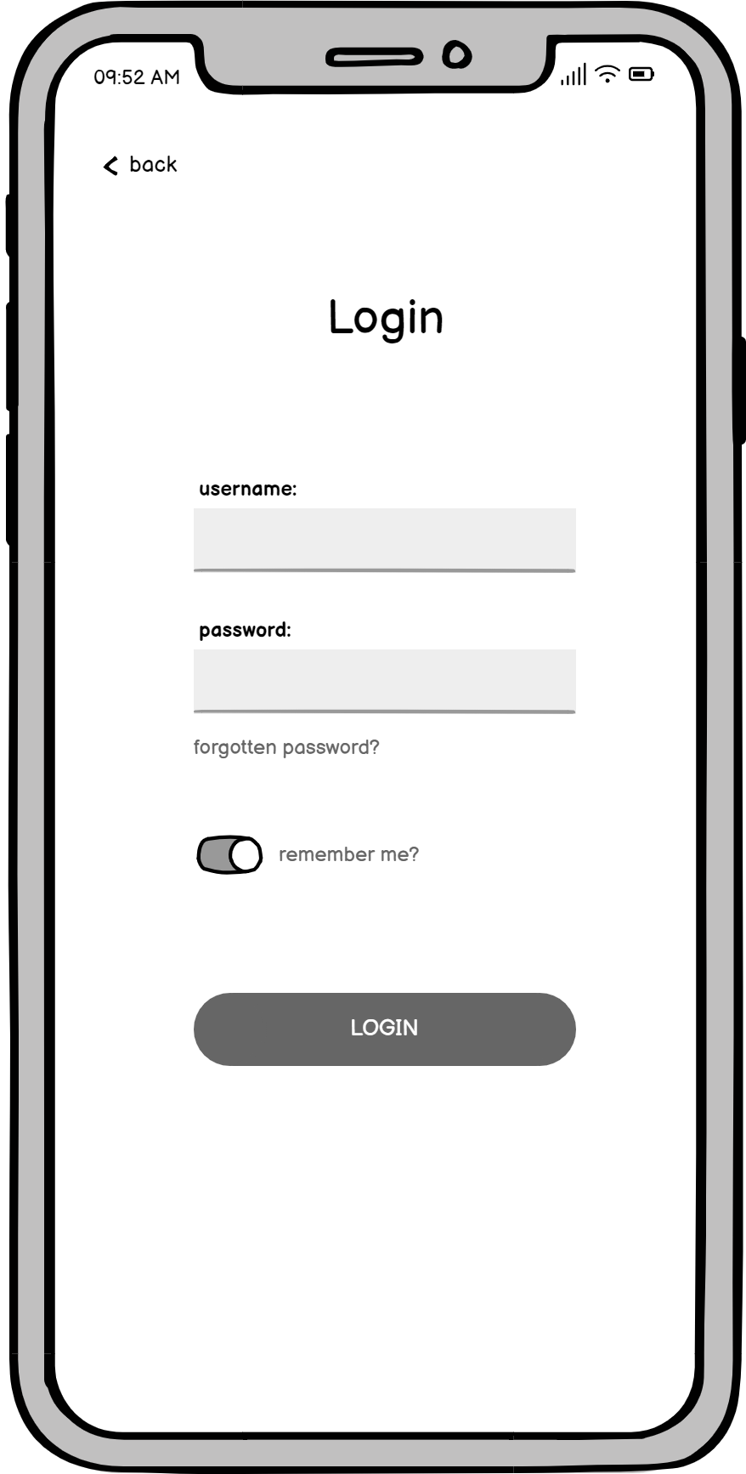
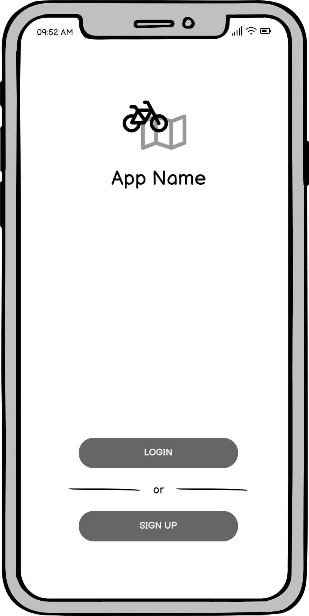
The App - Overview & Auth Form
This login form was included to provide a natural and recognisable beginning to the user experience when demonstrating the prototype. Furthermore, it shows that very limited information is collected by the app and demonstrates the simple authentication process.
We decided to use Balsamiq to create blueprints with slightly more detail and embellishment than a wireframe but less than a mockup. Emphasis was placed on feature demonstration and layout rather than appearance, theme and experience. We also picked what would be the most relevant and critical screens for a minimum viable product and omitted some less vital screens such as settings, for example.
For this reason, the wireframes (as they will be referred to hereon) are largely grayscale with some exceptions where limited by Balsamiq.
While a desktop/web app would be possible, the wireframes take the form of a mobile app since this is the form factor that users will utilise for the vast majority of the time they spend using the app. Further, an iPhone X was chosen as the frame to provide context and to take advantage of Apple’s expertise and design ability to give a more positive context when gathering feedback. The final and most important reason is that the iPhone X has a large screen giving us more space to work with to create a larger and less cramped wireframes to show to potential users.

Slide 37
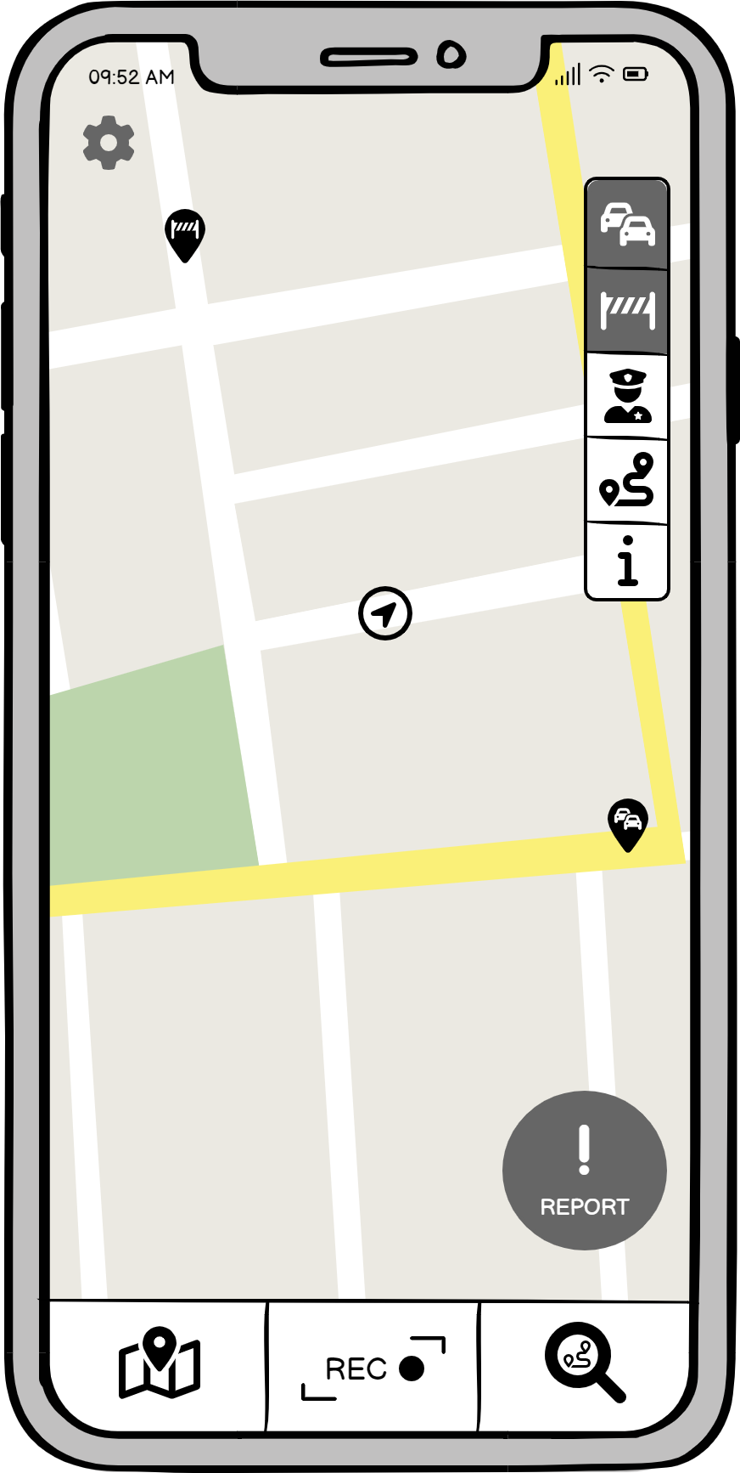
App - Central Map Screen
The map screen is integral to the app and is the view around which the rest of the app centres. A lot of thought went into the layout to ensure that it is very quick, simple and ergonomic to use when the user is out on their bike.
The obvious feature is the map itself which supports industry standard gestures to zoom and pan. The user’s location is indicated centrally and event alerts are shown using pins with icons to denote their nature. All of the features a user may wish to utilise when out on their bike have been placed along the bottom or the right hand side as these are the places easiest to access by a right handed user while only using one hand. The handedness of the app can be changed in the settings, mirroring the layout of these elements about the vertical line of symmetry.
The filters on the right hand side are used to toggle the visibility of different categories of pins on the map. The categories shows congestion heatmap, hazard, crime & anti-social behaviour, user recorded routes and information filters. The heatmap is similar to congestion on google maps however as cycling doesn't need a set route, the heatmap is more suited in displaying areas with a large number of bikers, thus a higher amount of congestion for them. Along with this heatmap, we also have another heatmap to demonstrate areas of high concern due to a larger reporting of bike related crimes. This ensures that the bikers will try to avoid these areas, so are more safe when travelling.
The buttons along the bottom are primarily for navigation. The first one is for this map screen, the second is to begin recording a route to share with the app’s community and the final one is to explore other user’s recorded routes.
The report button in the bottom right is to report an event or hazard at your current location. There are two designs for event reporting, demonstrated in the following slides, toggleable in the user settings. This is to support mounting the phone on the bike or using the app with the phone in hand.

Slide 38
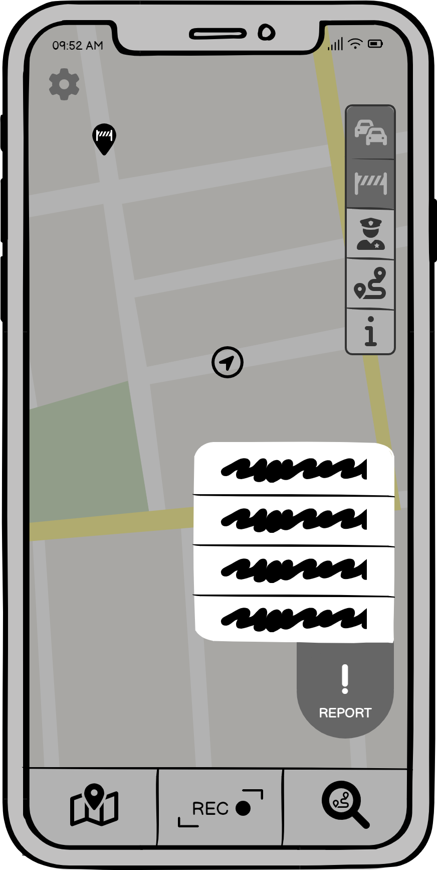
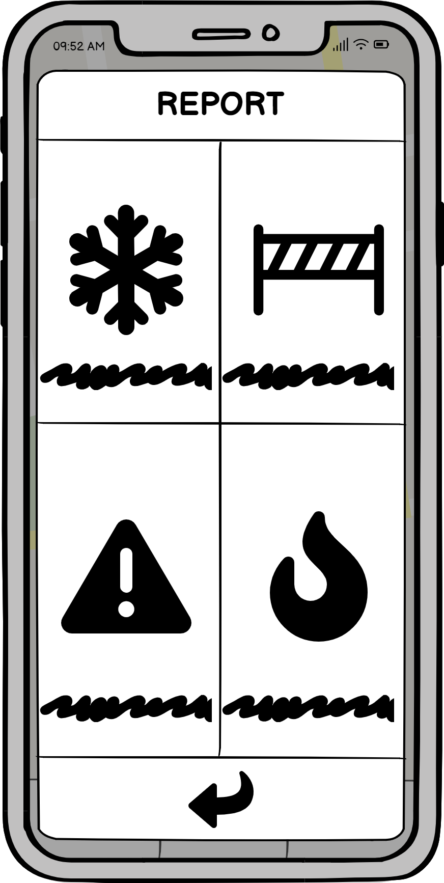
App - Reporting Screens
This method of reporting is designed for users using the app with their phone in hand. In this situation, it will be difficult for many users to:
Make multiple taps on the phone while also looking where they’re going.
Reach the top left corner of the screen.
To solve these issues, the design requires the user to hold the report button for one second, until they feel a vibration, and then slide their finger up to the desired event type. This means they will hopefully require only a quick glance (or maybe none at all) to find the button and then another quick look to select the type of event without stretching across the screen.
Bike-mounted reporting:
An alternate style of reporting. In this method, the UI takes up the majority of the screen, allowing a user to clearly see and tap on the correct icon. The icon choices were determined by the simplest image that corresponds to its action as we wanted based on the 6 Norman principles. After pressing the report button this window would appear on screen, allowing the user to select the appropriate event. It can be dismissed with a button at the bottom. As the phone in this instance is not held in the user’s hand (instead mounted to the bike handle) it is important for the user to be able to clearly identify each symbol at a glance.

Slide 39
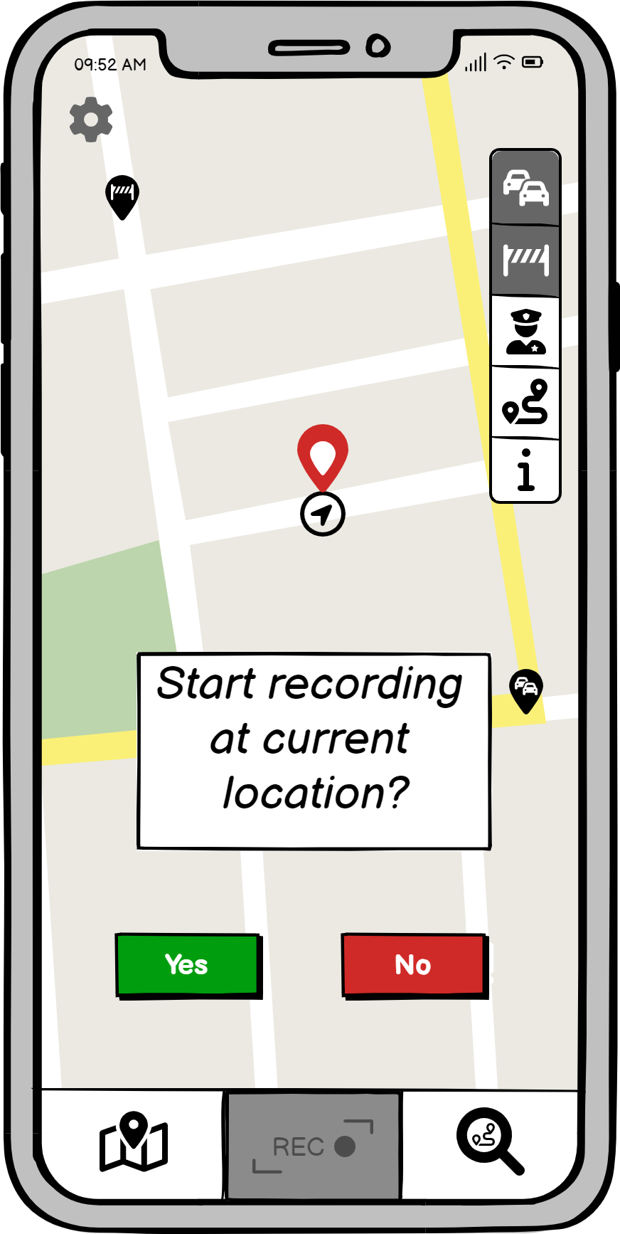
App - Route Recording
When selecting the record button on the bottom, you’re taken to a confirmation screen which showcases where the starting location of the route will be. Upon confirmation the app will record where you cycle.
Once you finish the route, you press the record button again to stop the recording. You will then see your entire recorded trip on the map, and will be given the option whether to save it, publish it, or delete it.
The button on the bottom right of the screen will take you to a page where you can explore other user’s recorded routes, prioritising routes that have a starting point closest to you. The routes will contain basic information such as the end spot which can be modified to the users situation. It will also give a warning if there is a change due to a danger or blockage affecting the route.
The routes will have a rating system so other users may rate the routes they’ve tried to give others a better understanding of how popular/useful the route is.

Slide 40
App Structure Diagram
A structure diagram to show the structure of the pages included in the MVP wireframe prototype for the app.
Map filters change map overlay but don’t affect site navigation
back
Alternative report methods dependent on reporting type in settings
back

Slide 41
User Feedback
We held informal discussions with our peers to gain an insight into how our end users would respond to our Navigation app design. We displayed our Lo-Fi designs and asked them to discuss their thoughts regarding primarily the layout and functionality of our current product, as the design has yet to be implemented. As the login screen was synonymous with the majority of current apps on the market, users felt it was effectively simple and little to no improvement was suggested.
The nature of the app itself has developed into a route and live hazard recording app, which overall the users responded positively. A few users however did bring to our attention that there were already a few apps which possessed similar features. This has been an important step in our process as we do not wish to replicate an already useful tool. When asked if a more social focused app would be of greater use, our peers supported this idea and felt there was a gap in the market for people to meet other fellow cyclists and track their routes.
On the back of these discussions with potential users, we started brainstorming ways to further differentiate our app from the currently available products and to provide novel, useful features. Through this process and further research, we determined that there were new features that we could potentially add to our own app that the others lacked. The strongest idea was some sort of communication feature, which could take various forms. One could be a sort of cyclist social media, in which there would be accounts that you could follow to form a timeline. This feature could also be restricted to be focused on the local area rather than world-wide, allowing users to connect and socialise with their fellow cyclists nearby. Another idea was the ability to see and communicate with other cyclists on the map, being able to see their positions and meet up with them. This might suffer from privacy issues, however, and would have to be an opt-in feature.
Our current key novel features would be our heatmap concept. A heatmap is overlaid on the map, highlighting, for example, areas where a high amount of bike robberies have occurred, alerting users to places where it might not be safe to leave their bike. The scoring feature of the routes also provides a minor social element to our app.

Slide 42
Scenario Reflection
Before the reflections, we decided to come up with a name for the app. The aim of the name was to be intuitive for what it does and simple enough that it doesn't deter people away from the app. After some discussions and lots of ideas, we decided upon SafeCycle which it will be known as here on out. We now go through scenarios with our personas using SafeCycle.
John has a spare hour on Saturday at 10am after a busy week at work and with his kids over at friends’ houses. He decides to go for a leisurely cycle around town and grabs his phone, wallet, keys, bike and a lock (in case he wants to stop anywhere for awhile). He attaches his phone to his bike and opens SafeCycle. On his way into the city centre, he is about to head up his usual route but notices SafeCycle is alerting him to construction work blocking the bike lane. He quickly glances at the map to figure out a new route, and proceeds on his cycle. Upon reaching the centre, John decides he’s going to lock his bike up at a bike-park near a cafe he likes. However, SafeCycle notifies him that the bike-park has been damaged and is not a safe place to lock his bike. Using SafeCycle, he is easily able to find a nearby area that allows for safe locking, and cycles there. He then walks back to the café and relaxes with a cup of coffee.
Emily is a gig-economy food delivery driver who uses her bike to make deliveries. She heads out to work a shift in the middle of Manchester at 5pm on a dark Friday evening - a typically busy time of the week for her - and marks herself available on the delivery apps she uses. She receives her first job quickly - a 3km trip from a McDonalds in the Arndale Centre 1km away - and starts heading over there straight away. She’s unfamiliar with the area she’s working tonight, so she uses SafeCycle, which alerts her to an area along the canal with a history of anti-social behaviour, allowing her to avoid it. Emily enters the restaurant and after a few minutes she picks up the order she’s waiting for, loading it into her bag. Before arriving at the customer’s building, she uses SafeCycle to find a place to lock up and once there has no issue locking before carrying the delivery up to the customer’s apartment.

Slide 43
Scenario Reflection cont.
Alex is about to set off from his student halls to his first on-campus lecture at the University of Leeds. He decides to ride his bike since he lives 2 miles from campus and he wants to save money rather than taking the bus. He hasn’t ridden to campus yet and has no experience riding a bike in large cities since he grew up in a rural area. However, he has downloaded SafeCycle to help him navigate this new city. Yesterday he followed a popular bike route on the app to gain confidence in city cycling. Today, he uses SafeCycle to reach the Uni, which tells him of one-way streets and shortcuts to avoid traffic. He arrives on campus and can navigate directly to a bike rack thanks to SafeCycle. On his journey back, SafeCycle further alerts him of traffic. He arrives home with plenty of time to prepare for the tennis taster session he plans to go to.
So based on these scenarios and the use of the the app, it has reassured us of the practicality and usefulness that it will have on our target audience. We see that the idea is feasible and can accurately help users in various different ways as we’d hoped, such as: Alex getting to know new routes better in a new city, John being informed on disruptions on his usual cycling route, and Emily staying alert of dangerous areas which ensures her safety when she works.
A future improvement of the app would be a cycle group finder as this would help Alex familiarise himself with the routes at his new university as well as to make new friends. So combining this improvement with the mention of a social timeline from the user feedback, the next stage for this app would include a social media element like Facebook but broken down into smaller, more intuitive areas of the app.

Slide 44
Lo-Fi Concept 2 - Bike Lock
Development of the lo-fi bike lock and getting feedback from focus groups whom are out target audience.

Slide 45
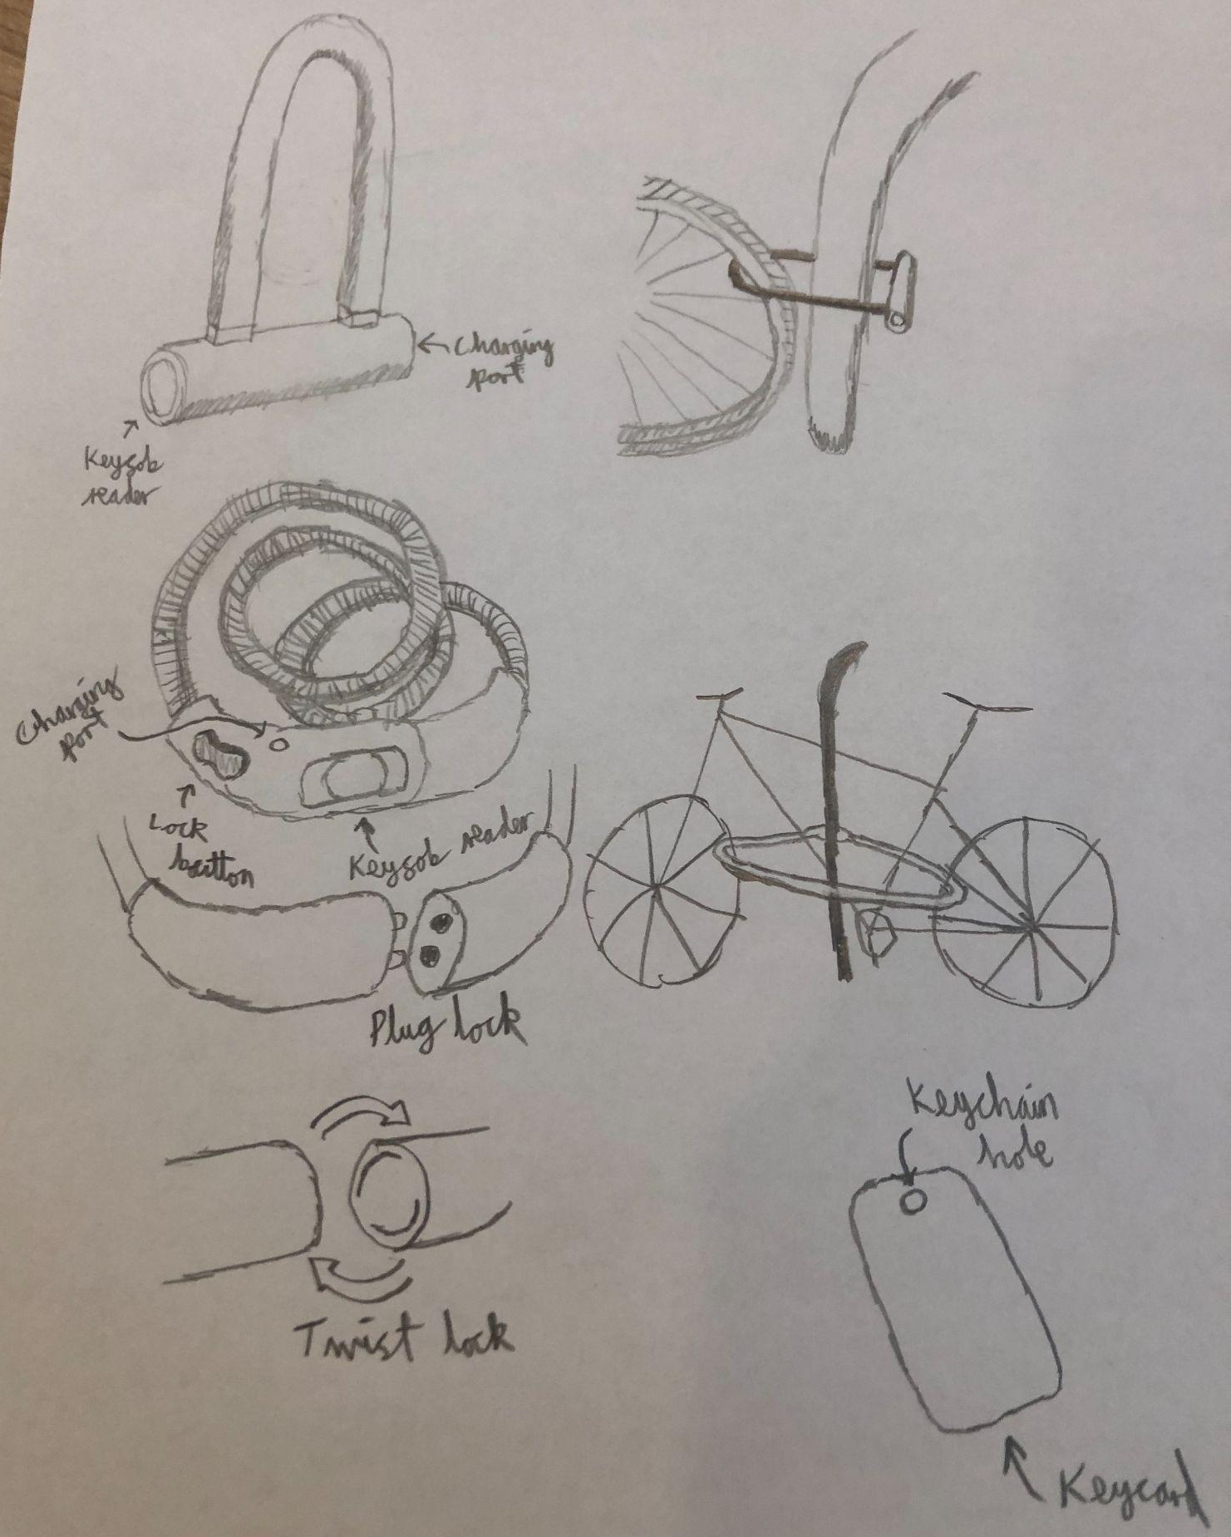
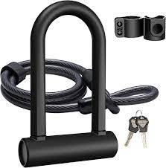
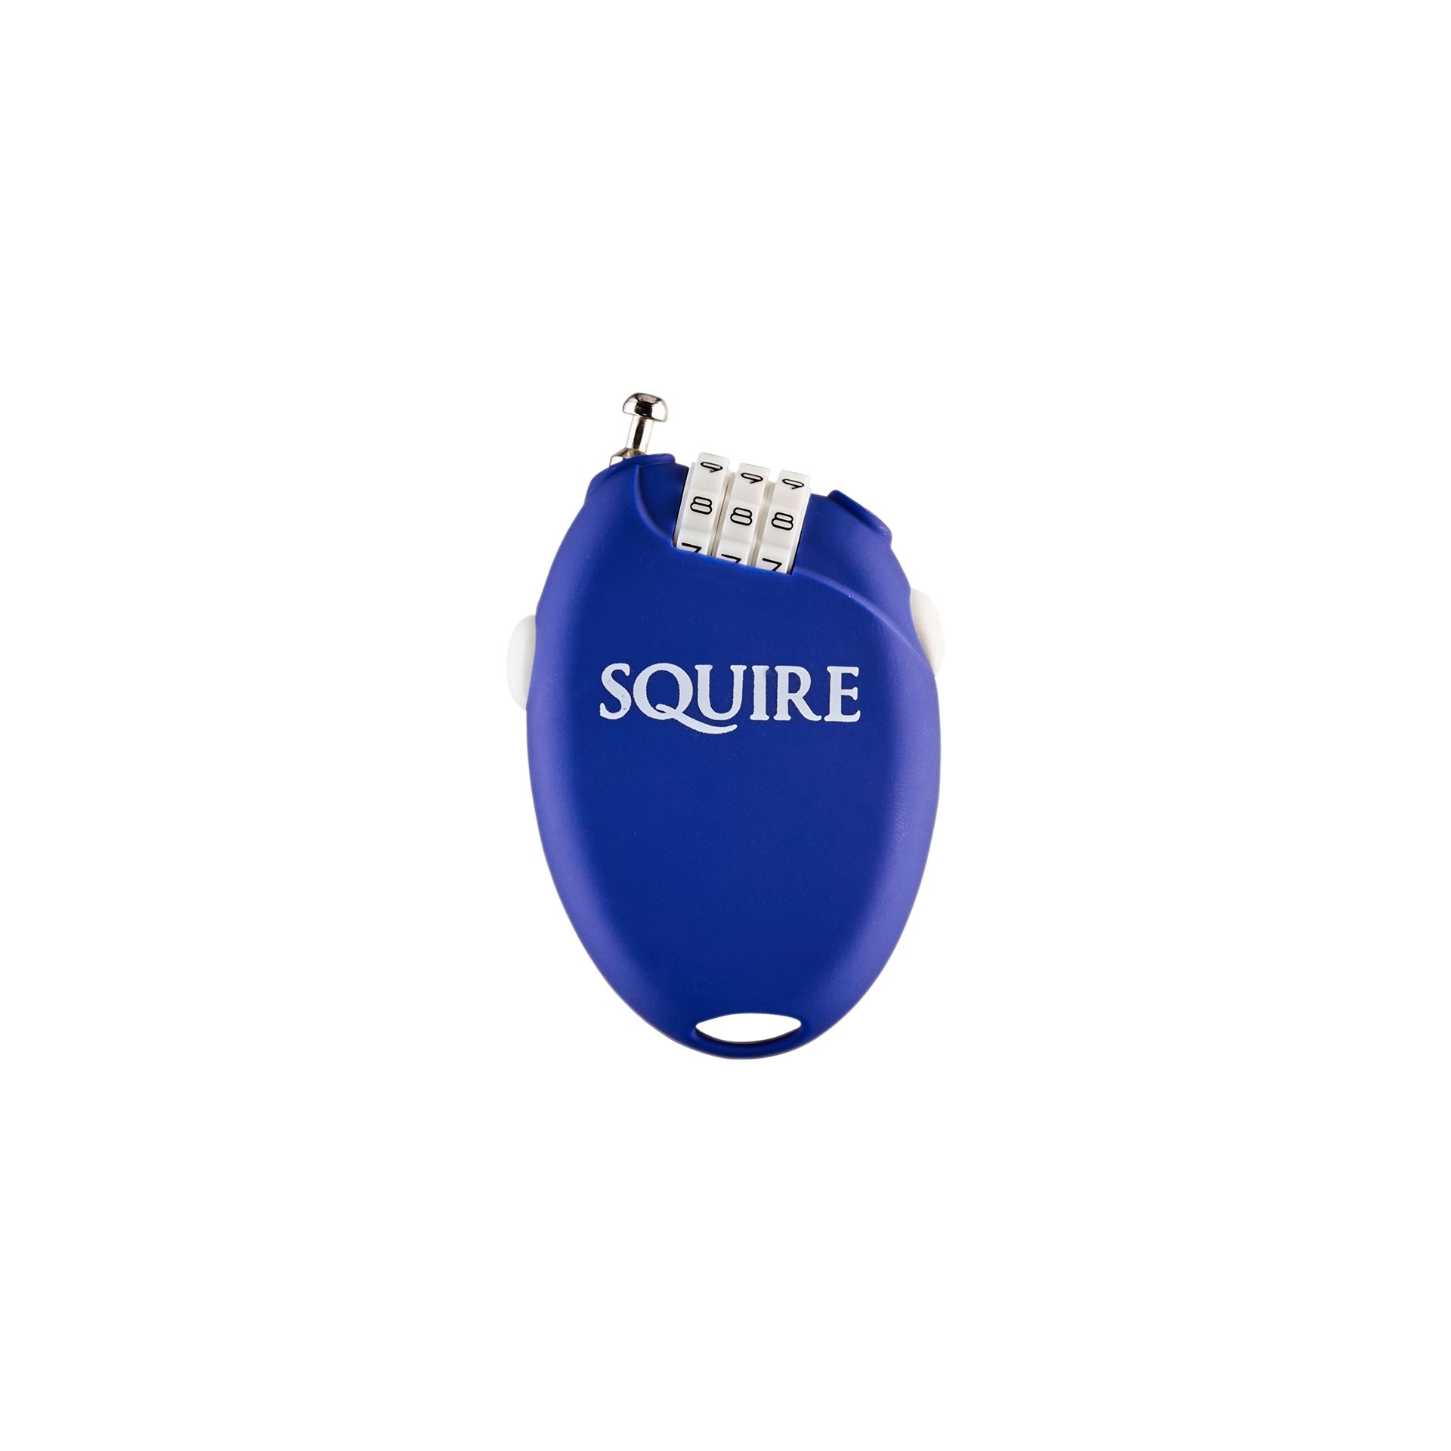
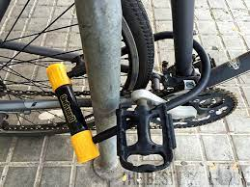
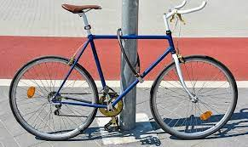
Early Design Sketches- Bike Lock Iteration 1
By exploring the different types of bike locks that already exists, we considered ways to upgrade them so that they provide more safety to the bike.
Our initial sketches and ideas was to create the bike lock so that it would need the use of a fob, a card or a small object that would be used to lock and unlock the lock. We want the lock to be able to sense when its been cut which can be done with a live circuit within. This enables the lock to detect theft so that it may send an alert to notify its owner which may be in the fob. However this means that the lock will need a charging port to maintain this security.
We also experimented with different lock ideas shown in the sketches.

Slide 46
SCAMPER Technique
To generate more ideas that were more novel, we used the SCAMPER technique to come up with various new ideas that we will sketch and discuss. We summarise the each of the stages as follows:
Substitute - With a normal lock their locking mechanism is simple. So we want to develop one that has a better lock system and to replace the need to carry one about. Also instead of an app to track and receive updates, perhaps something more physical and practical. This led us to determine ways to replace the usual rubber locks or D/U-locks etc.
Combine - A way to store or carry the lock such as on the bike. This enabled us to come up with locks that factored portability as well as practicality.
Adapt - Features that can be combined within the lock such as built in GPS tracker, an alarm for theft prevention and a fob sensor.
Modify - Size of the lock and length of cable, maybe we can change how the cable is designed rather than the usual types of locks. So instead of the cables we used in our first iteration, we want something more compact.
Put to other use - A lock that is versatile and has other components so that it may have multiple uses rather than being just a simple lock. Thus we need to incorporate room in our lock design to account for the additional features that would benefit the biker.
Eliminate - Locks can be a hassle to bring and people may even forget to bring one so we want to mitigate this by designing one that might attach to the bike or easily portable.
Reverse - Instead of the process of locking the bike after its been parked, a way to have the lock ready beforehand so that it’ll be easier to lock when the biker is at their destination. This further reinforces the idea of a secure portable lock which means our current ideas doesn't account for this and so we will amend and upgrade them.
In conclusion, the SCAMPER design technique enabled us to explore more possibilities and helped in coming up with unique ideas. It encouraged innovation within the group so that we had improved ideas to work upon.

Slide 47
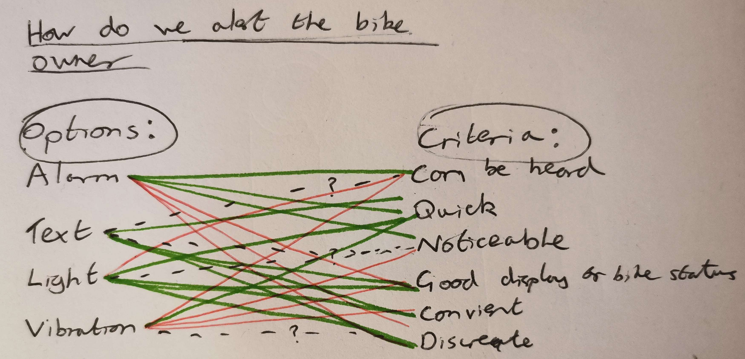
Early Design Notes- Bike Lock
We went through a variety of ideas based on our SCAMPER for the bike lock which gave us a few consistent components throughout:
It should be unlocked with a key fob or key card.
It should be attached directly to the bike in some way.
It should alert the owner when broken/cut.
It should be easy to use and simple to set up.
We looked at existing bike locks and adapted them to our ideas, such as replacing the existing lock system with a key fob reader or changing its lock style. However we wanted more to the lock so that it may be the best lock around and be open for the use to everyone. Thus we considered the portability of the lock and by research and browsing we found that bike locks tend to be separate from the bike meaning that they must be carried within another container such as a backpack. So we explored the idea to have a lock that is easily portable as well providing the maximum security.
Additionally we discussed the ways we wanted the lock to alert the owner by doing a QOC with the basic options that would work.
By using the QOC technique we realised that even though an alarm on the user may be good, it may cause disruptions for them and people around. So the best way to alert the user was visually so we decided to have a light on the fob to demonstrate this.
We will also consider combining various ways so that it may provide an optimal way that alerts the user in time.

Slide 48
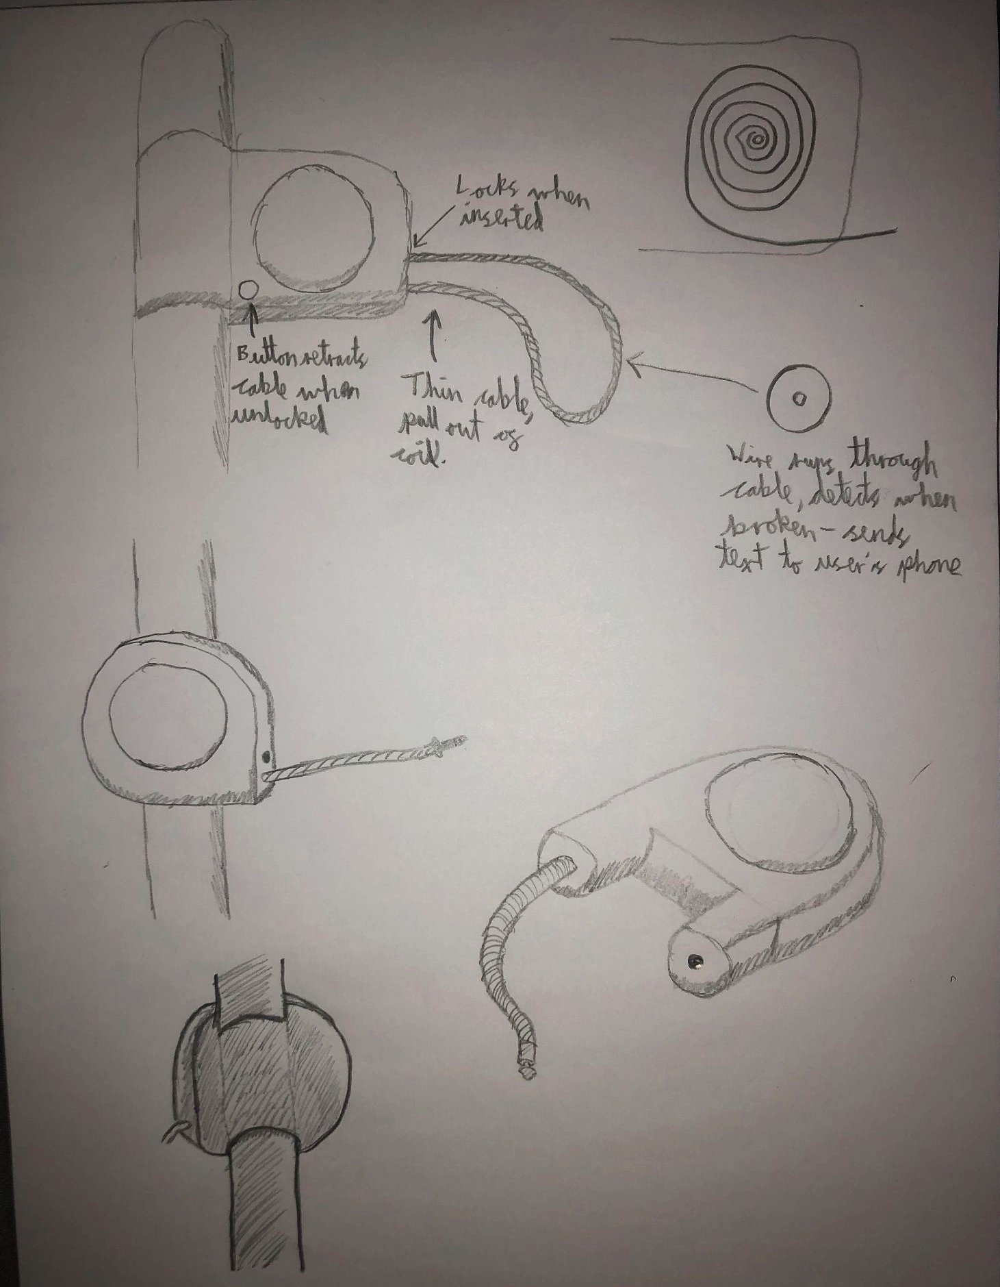
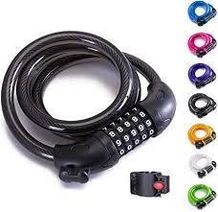
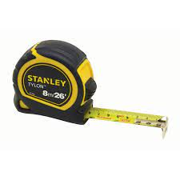
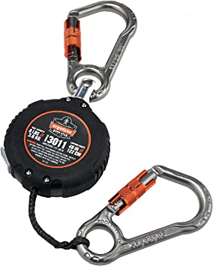
Early Design Sketches- Bike Lock Iteration 2
After the QOC and using the concepts that we generated from our SCAMPER, we created new sketches to visualise these designs.
We’ve decided to use a metal cable like lock so that it is retractable inside the lock which accounts for the easy store that was required based on our SCAMPER. Additionally the lock will be secured onto the bike securely for ease of transport. This means less hassle for the owner of the bike as they no longer need to bring a separate lock or two every time they travel.
Fob detection on the side of the lock to securely fully lock the cable in once it has been coiled around the necessary areas of the bike such as the wheel and frame.
The fob will be separate such that it may be placed upon keys rather than a separate device that needs to be carried. The fob will be a receiver on the safely of the bike and will display this information to the owner by lights corresponding to various statuses.
Therefore by using SCAMPER, we were able to improve our idea dramatically meaning an ease of use for our personas.

Slide 49
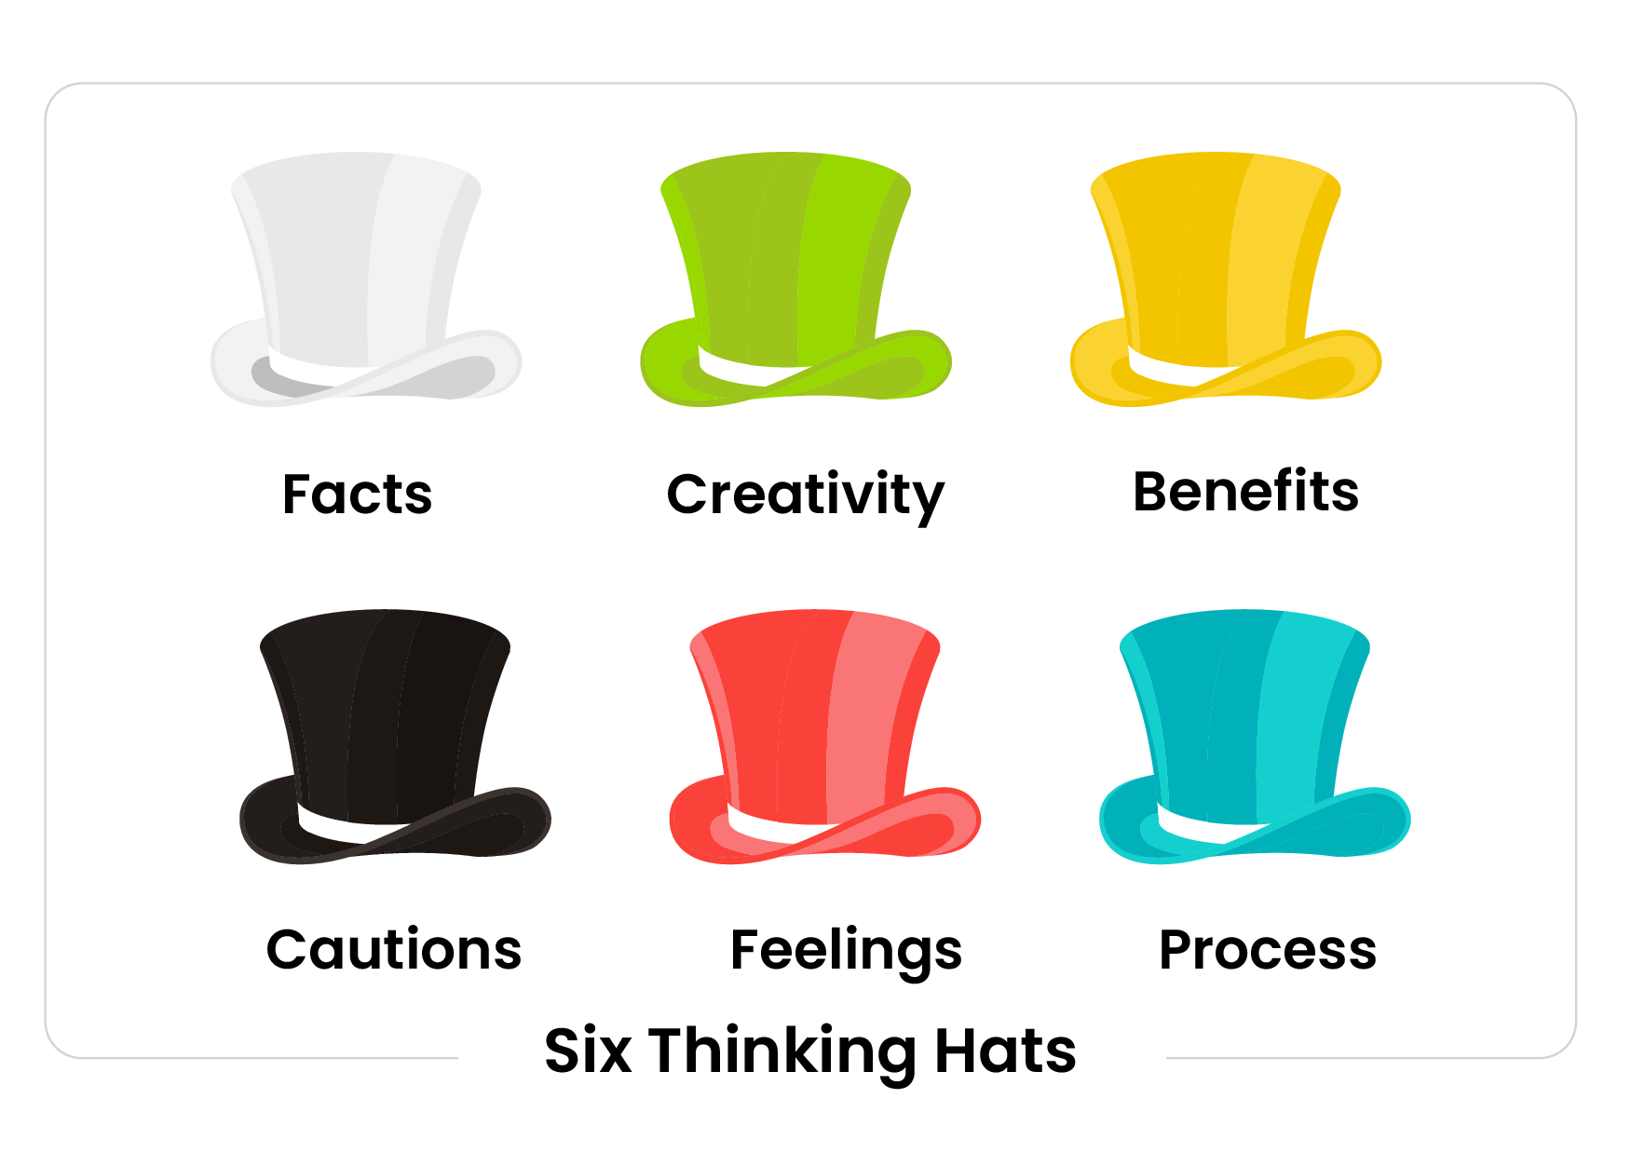
The Six Thinking Hats
To get different perspectives for our ideas, we used the 6 hat technique where we assigned 1 or 2 hats to each of us then went through some of our ideas to investigate any possible issues. An example of this is for the idea of a portable lock attached to a bike with fob features.
“Features such as the light display and text message are useful and the idea is practical as the lock would theoretically work”
“With a thinner cable, won’t it be easily cut? What is the range of the fob?”
“Instead of a fob, could have a separate small device that connects to the bike directly and can program the different features instead.”
“I like the idea of this lock, would be useful for me. Also like that I can carry the fob on my keys.”
“Great to have the lock to be more portable! Makes it easy to use.”
“Got to build a prototype and test out what features can be included as well as the installation on the bike.”
Through the use of the 6 thinking hats, we were able to identify any potential problems such as the fear of the wire being cut. To resolve this, we want to ensure that the cable is made from a suitably strong metal along with having the wire retractable. Additionally the alarm will trigger if the wire gets cut which acts as another deterrent. The idea of a unique device/item that we got from the 6 thinking hats may be good for the further development of the product in the future however is not necessary as a fob can be easily put onto keys and still accomplishes the same features. We were able to discuss the different views and incorporate the changes for our design and physical prototype so that we can further experiment and develop upon our idea.

Slide 50
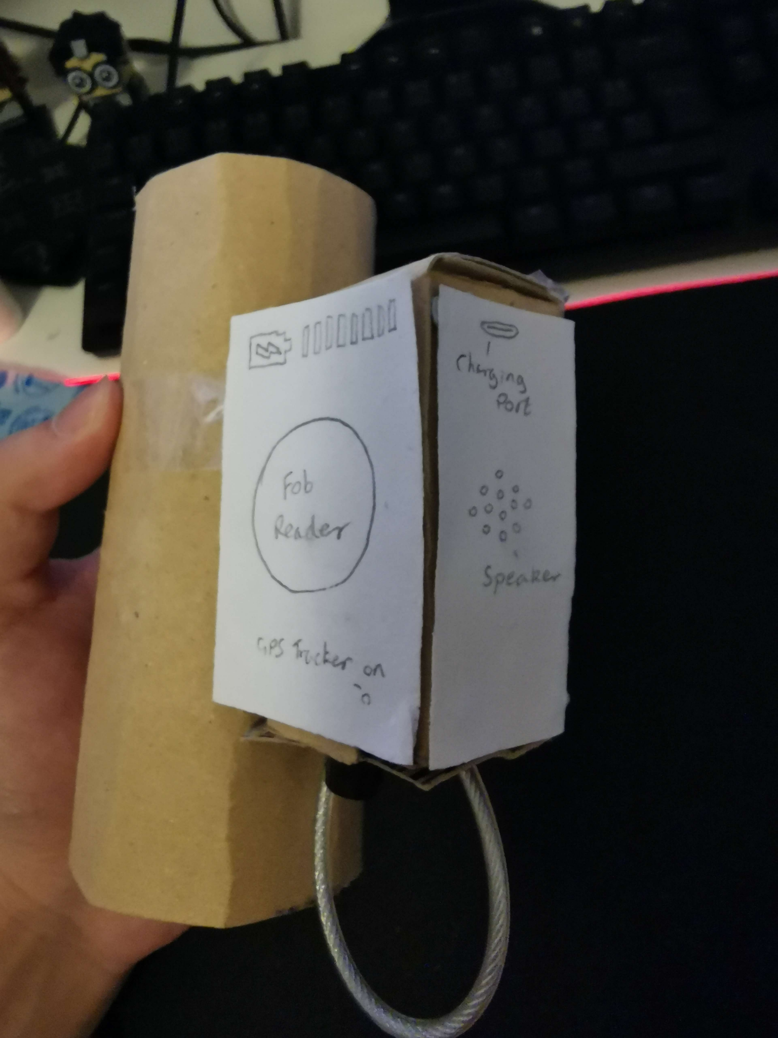
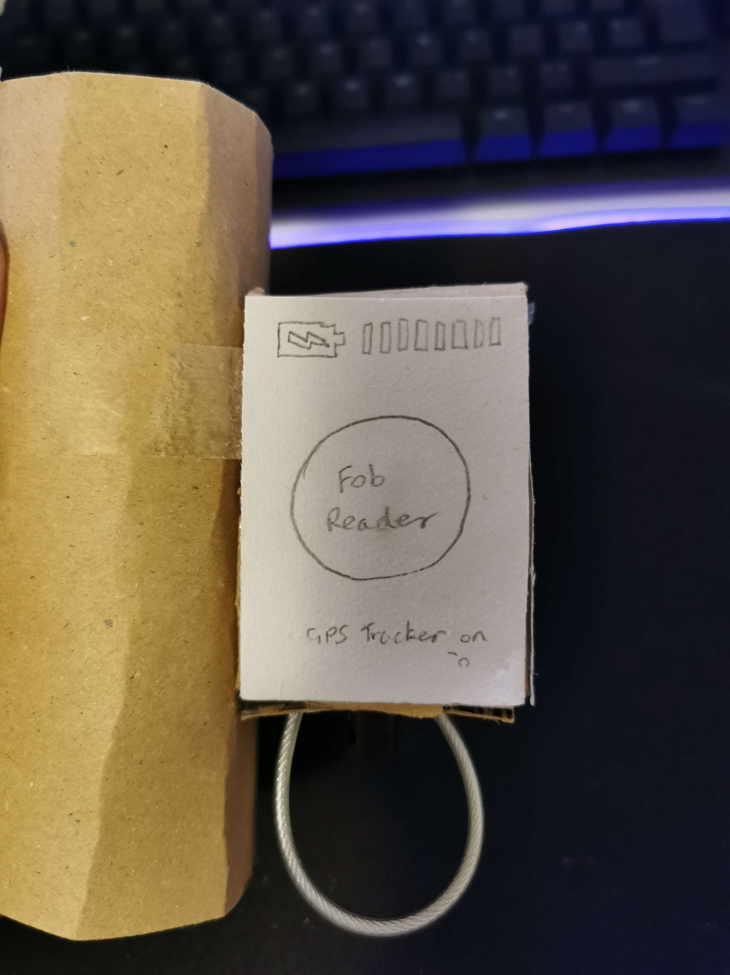
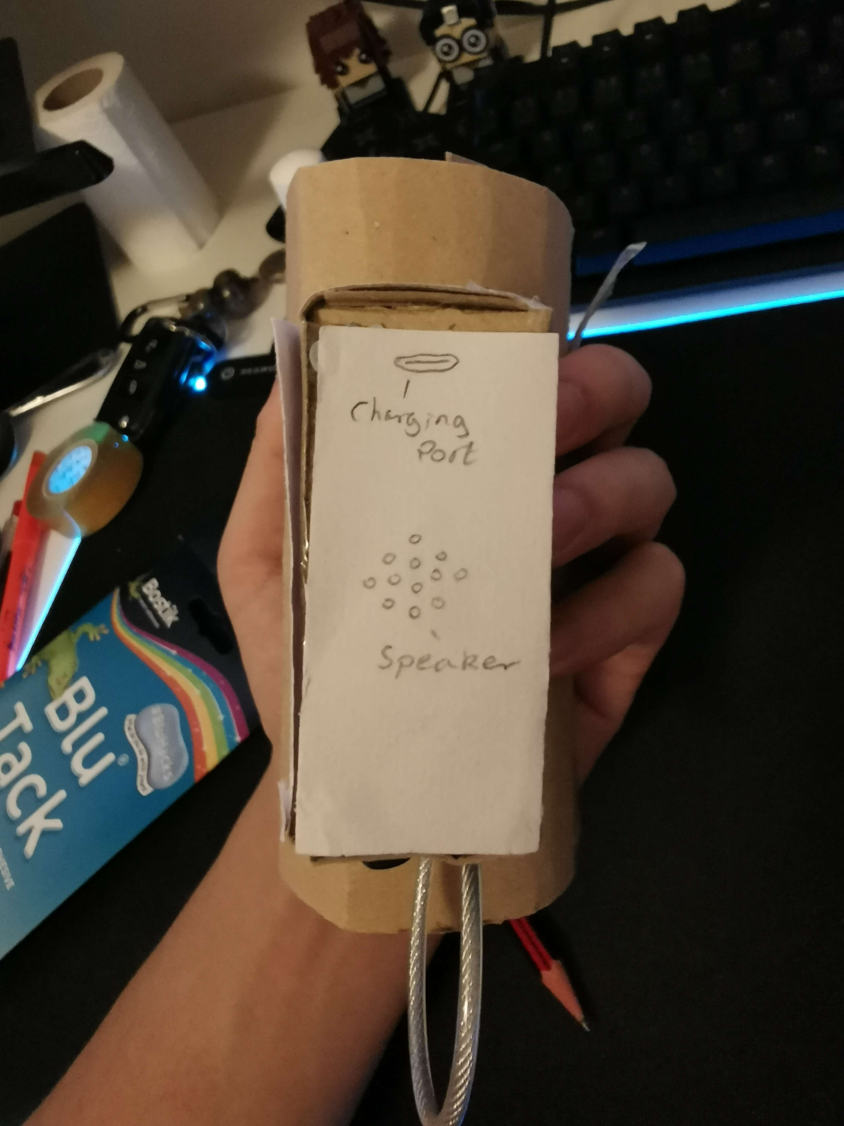
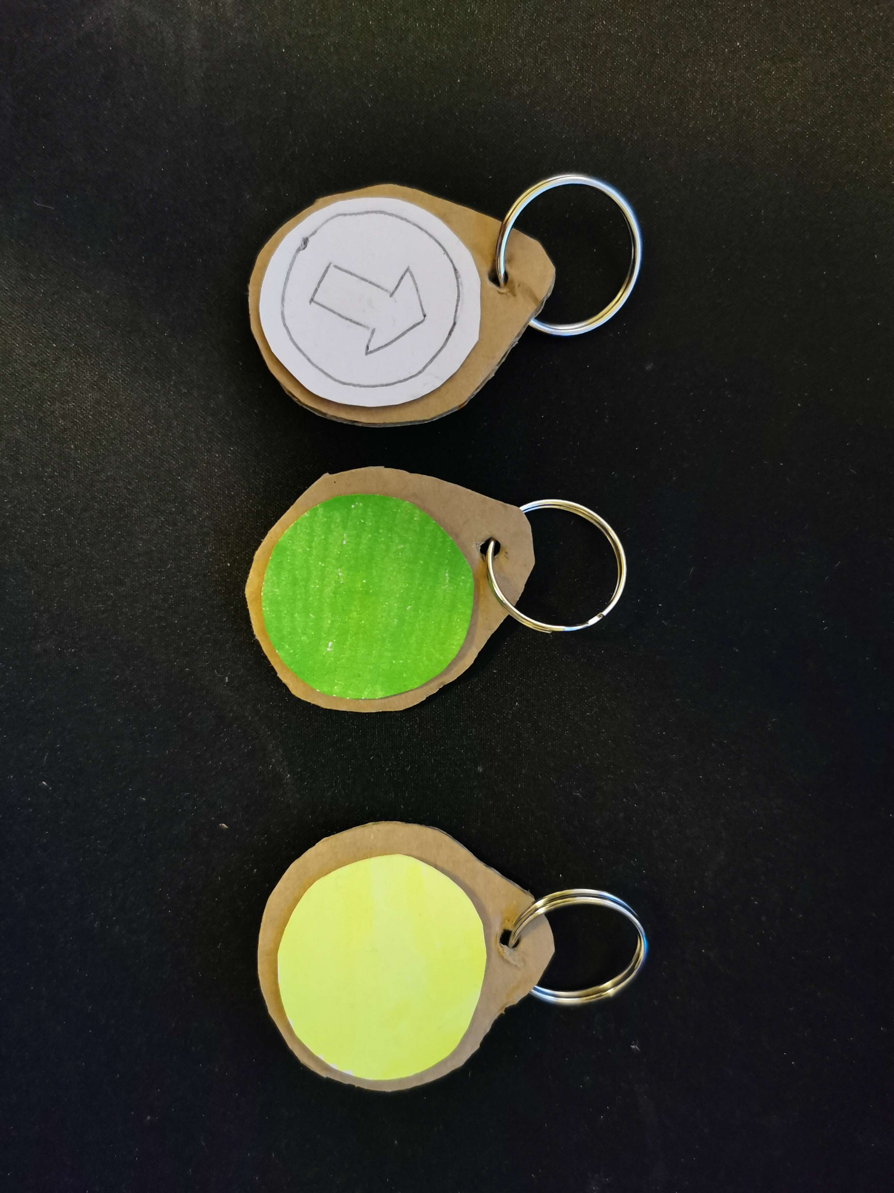
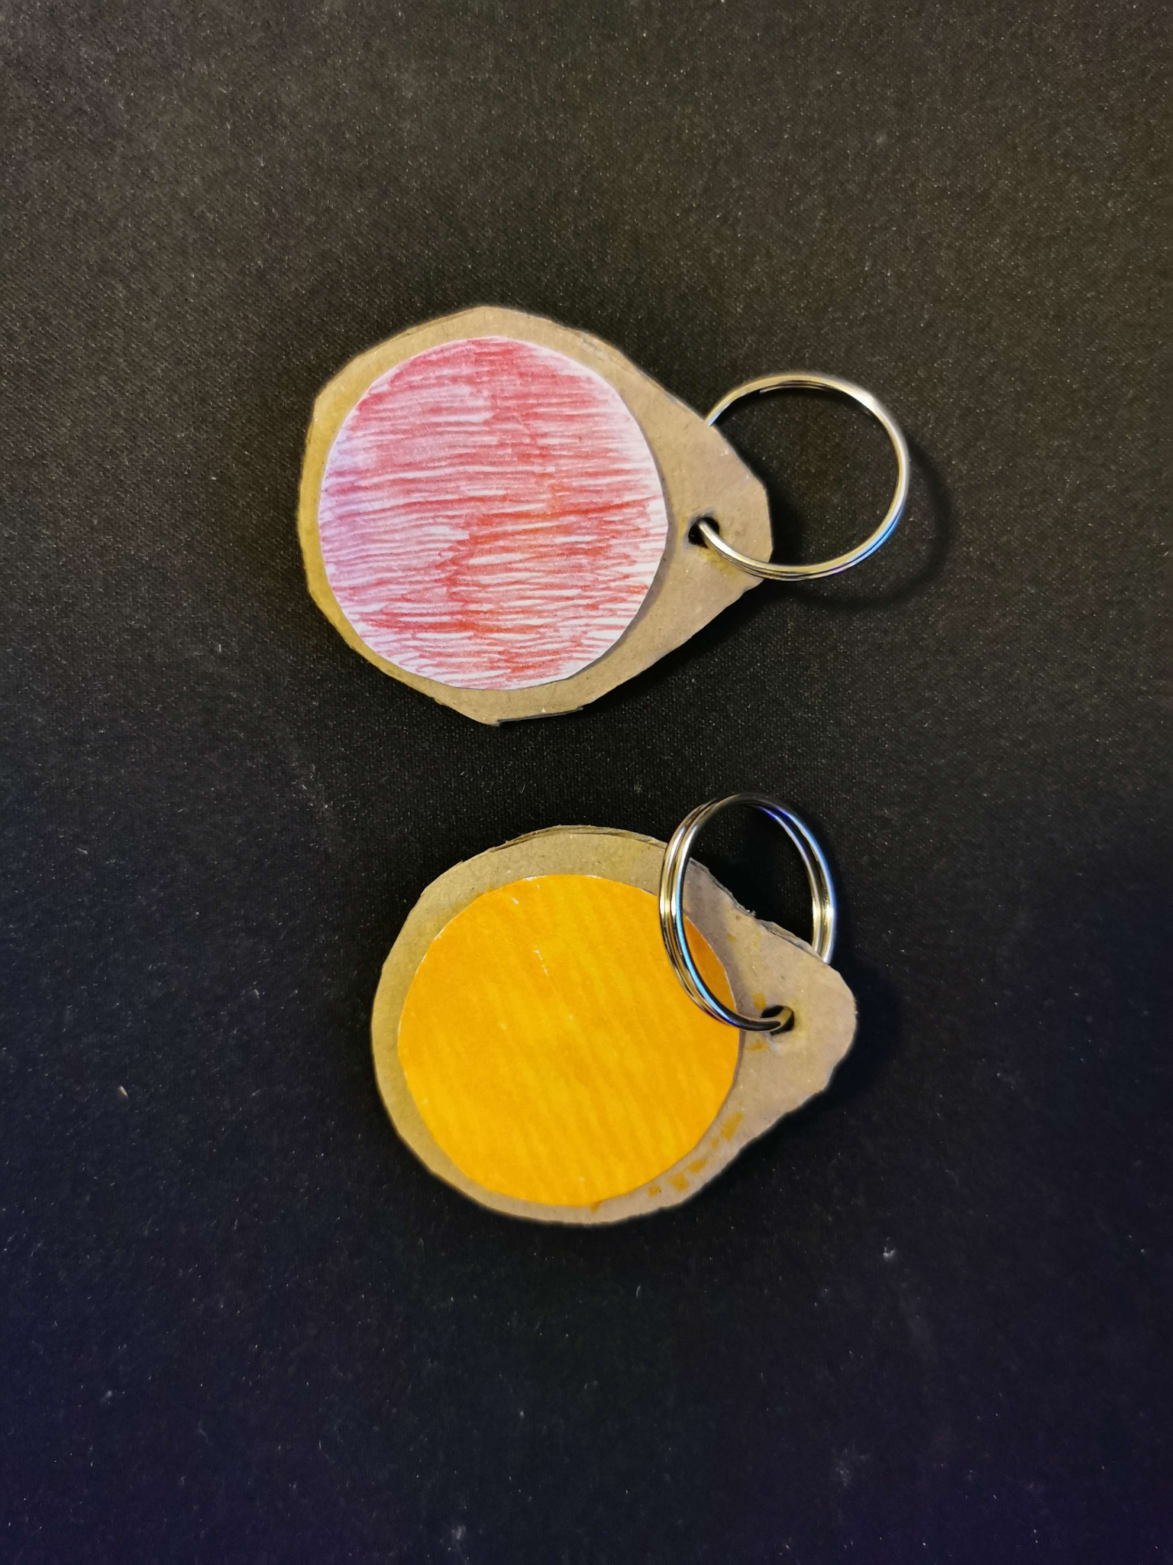
Bike Lock Lo-Fi Physical Prototype
Based on our sketches and design techniques, we built a lo-fi prototype to experiment with and to physically view our idea. This method will give us more insight on the practicality of the design. Along with exploring the size and physical attributes of the lock.
We designed the physical prototype based on the key concepts of our lock gathered through our sketches and improvements from SCAMPER and 6 thinking hats which are:
Wire reel thats retractable for security and portability.
GPS tracker within the lock.
Installation method for the lock to be mounted onto the bike.
Fob detection area on the lock.
Speaker area for the alarm.
Battery level and charging port for this.
Fob to display the bikes status and acts as a key to the bike lock.
We also created the fobs and displayed the different colours for various meanings such as:
Green - Safe
Yellow - Out of range, technical issue
Orange - For low battery
Red - Damage/Theft
Another feature we thought was to have a small LED display on the back that points to the bike as a compass for a quick access to location. However this wasn’t practical so a better idea was to have more accurate location on a map.

Slide 51
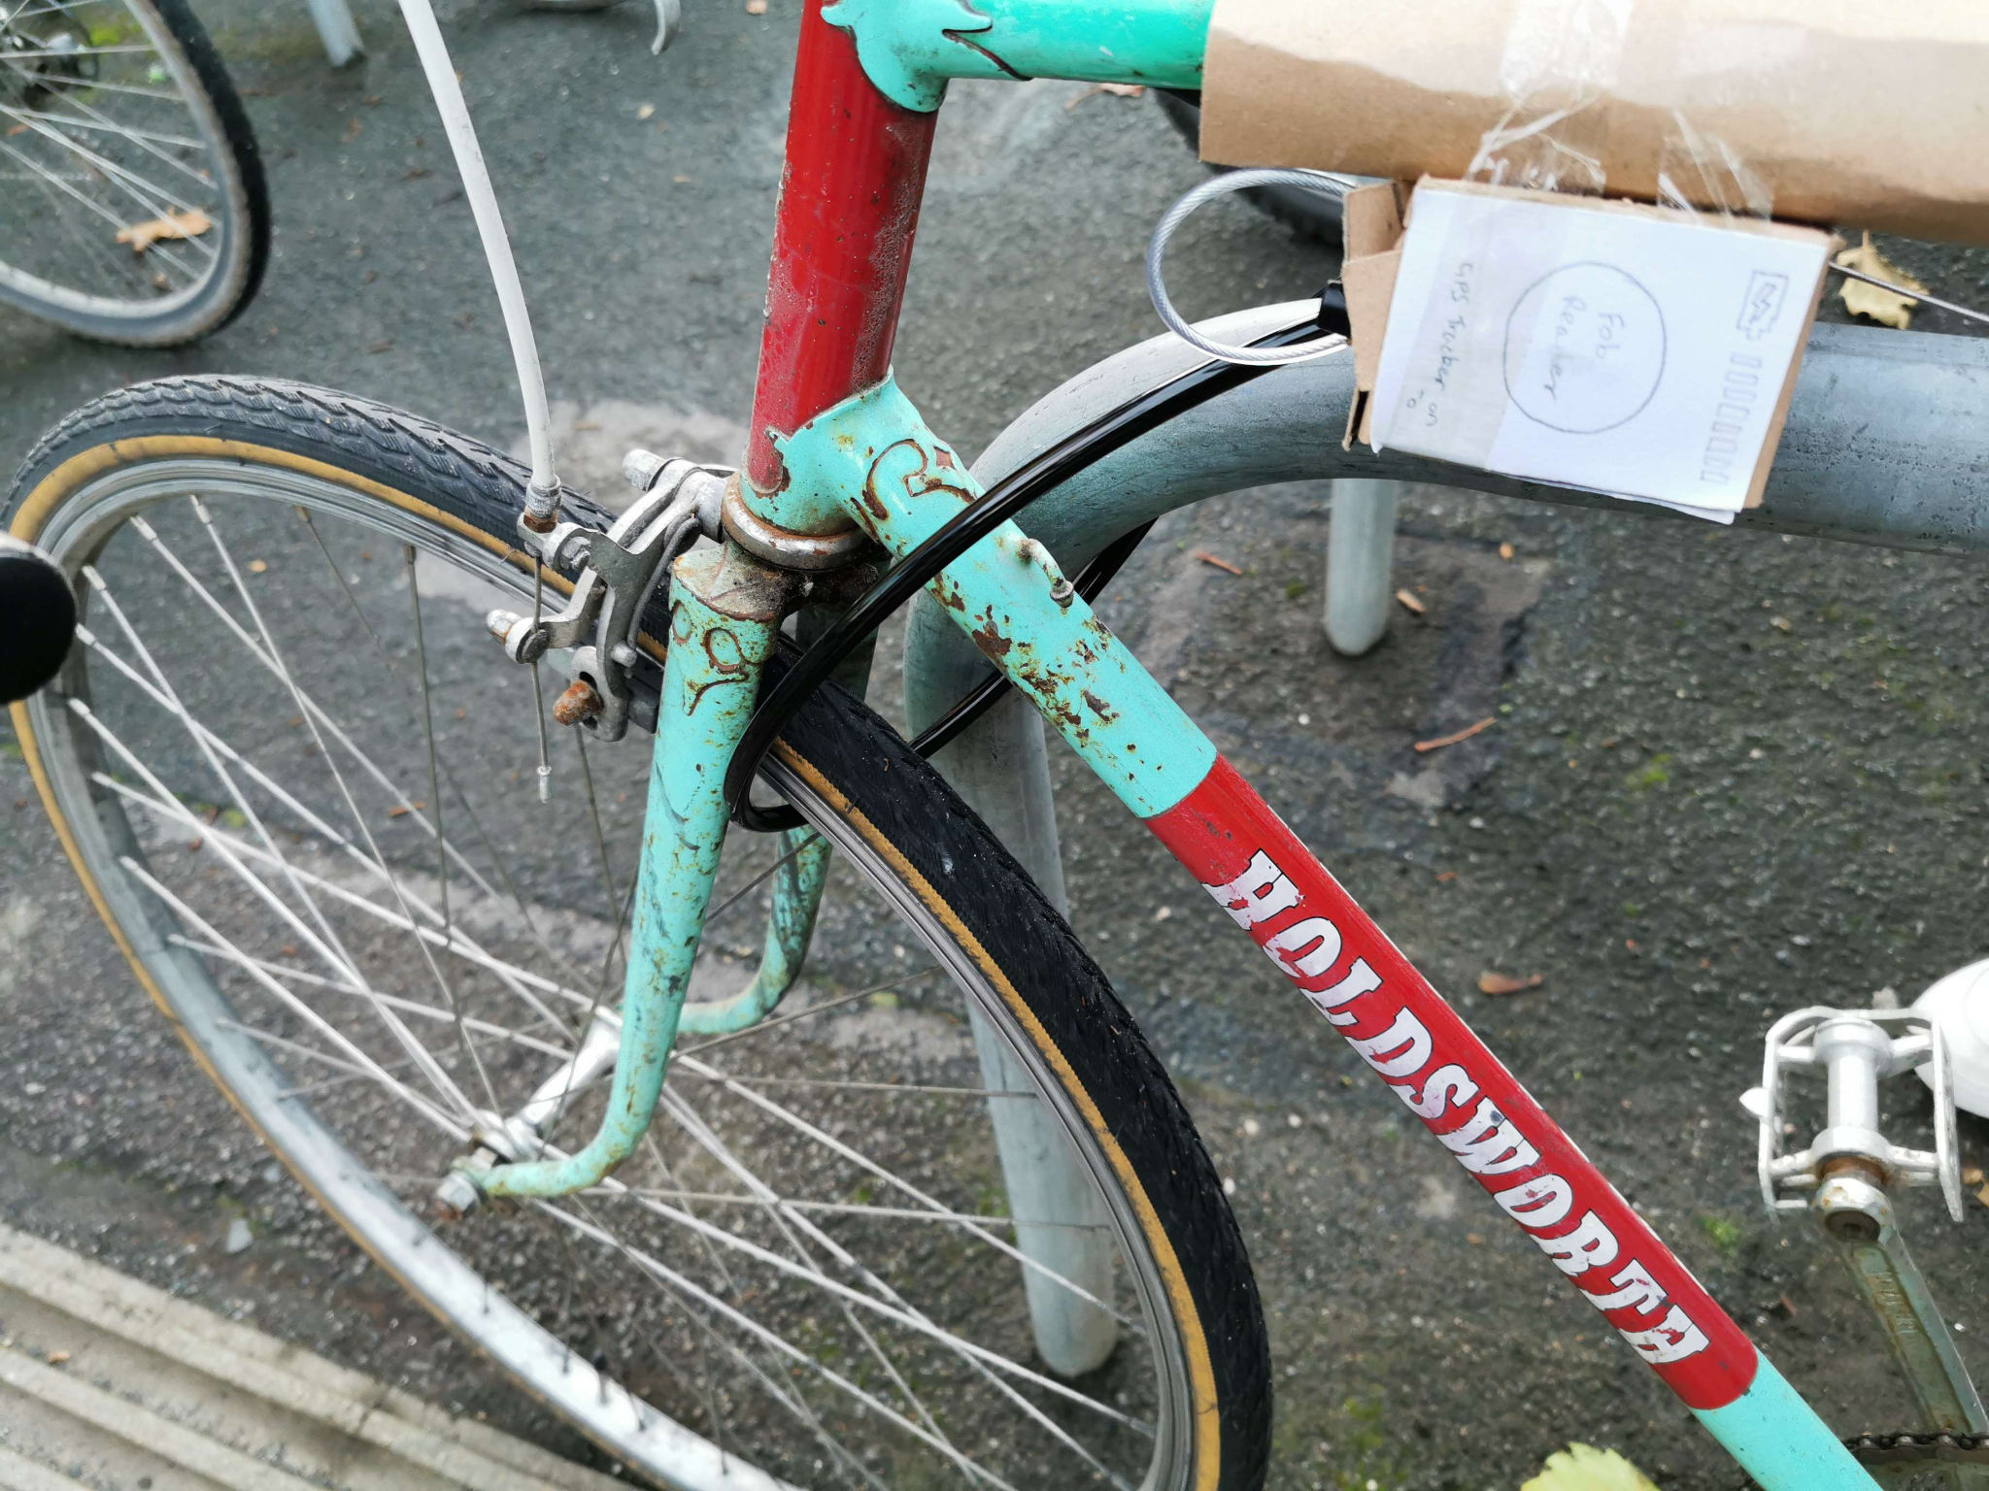
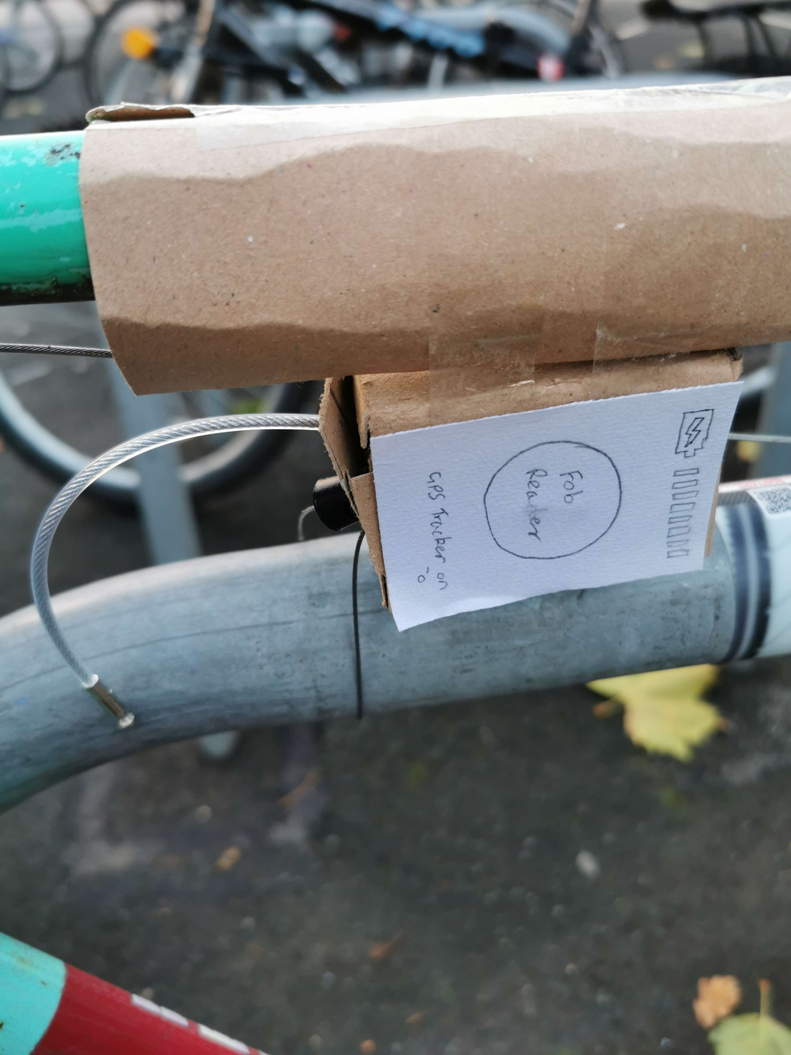
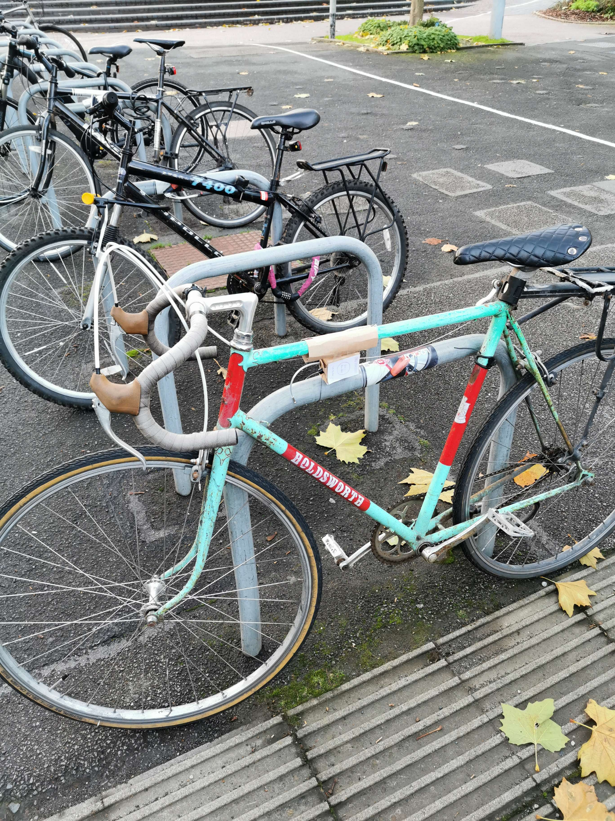
Lo-Fi Prototype
We gathered a focus group to demonstrate our prototype so that it can be experimented with and to gather any feedback. This also enabled us to visualise the lock on a physical bike and to check whether the proportions would be correct.
It gave us the opportunity to get opinions from potential users of our bike lock. Among what was discussed we received positive feedback such as:
Having a secure lock on the bike would better their ease of life.
Good plan to have it so they lock can attach to a part of any bike frame rather than only at a specified area.
Fob was easy to keep hold of and good source of information without the use of an app.
On the right, the bottom 2 shows that the retractable wire reel comes out of the lock and can be wrapped around the bike rack. Although we couldn't find a long enough reel, we substituted for a longer cable for purpose of demonstration as shown in the top image. Of course, the final version will have a wire that's long and tough.

Slide 52
Wizard Of Oz
Alongside showing our focus group our prototype, we created a Wizard Of Oz prototype for the lock. This was accomplished by having them be involved and by demonstrating the various features of the fob and lock. We explained how the lock would fit onto the bike, showed them on a physical bike and them the locking process with the fob. Afterwards we entered a building and displayed how the fob would change colours by switching out the colours on the fob to the relative ones. Additionally we emulated the text msg and the methods in tracking down the bike by its GPS through a website.
By doing a Wizard Of Oz, it was very useful as we were able to get instant feedback along the various stages from our focus group that may become users of the lock. It also reassured us on the ideas we had and grounded us on the possibilities of these such ideas with technology of the modern world as that was out goal from the beginning. This testing method was effective as it helped us demonstrate the almost finalised idea before considering the user feedback from this. Therefore once we go through their feedback and implement any changes, we can can develop a Hi-Fi version.
We recorded and made a short video of all the stages that was discussed with our focus group that acts like a digital storyboard of the scenario. The video can be viewed on the next slide or from the link here:
https://drive.google.com/file/d/17VatCwSe57ICZtRPSrgcGpGt2-0nj4cK/view?usp=share_link

Slide 53

Prototype Demonstration

Slide 54
User Feedback and Improvements
There were mostly positives from our focus group in response to the Wizard of Oz prototype demonstrations, however there were a couple issues that were brought up, such as:
Lights on fob being constantly on can be distracting and causes unwanted attention.
The hassle of the wire having resistance when unreeling.
Lock mechanism unclear how it is securely attached to the bike.
After having a discussion amongst ourselves and the focus group, we identified some improvements that would mitigate these issues.
The first issue was the light so for the light, we decided to instead have a button as one side of the fob that would light green when pressed to show the bike is safe. It may light orange/yellow if there is another issue specified before. But the fob will always vibrate and flash red when there has been damage or the bike is being stolen.
The second issue was the resistance when trying to lock the bike. To resolve this, we’ve found a simple mechanism for an automatic retractable reel online, similar to a vacuum cleaner cable. A retractable live connection cord reel is the idea for our wire as it provides a live circuit for theft detection and the ability to retract the cord back in once the lock is unlocked by the fob. The mechanism behind this is relatively simple by having a spring mechanism to provide the retraction force. So when the wire is pulled out then the tension in the spring builds but the tension would only be released by a button near the wire. This would then tighten the wire so its taut or reel it back in if the wire isn’t attached back.

Slide 55
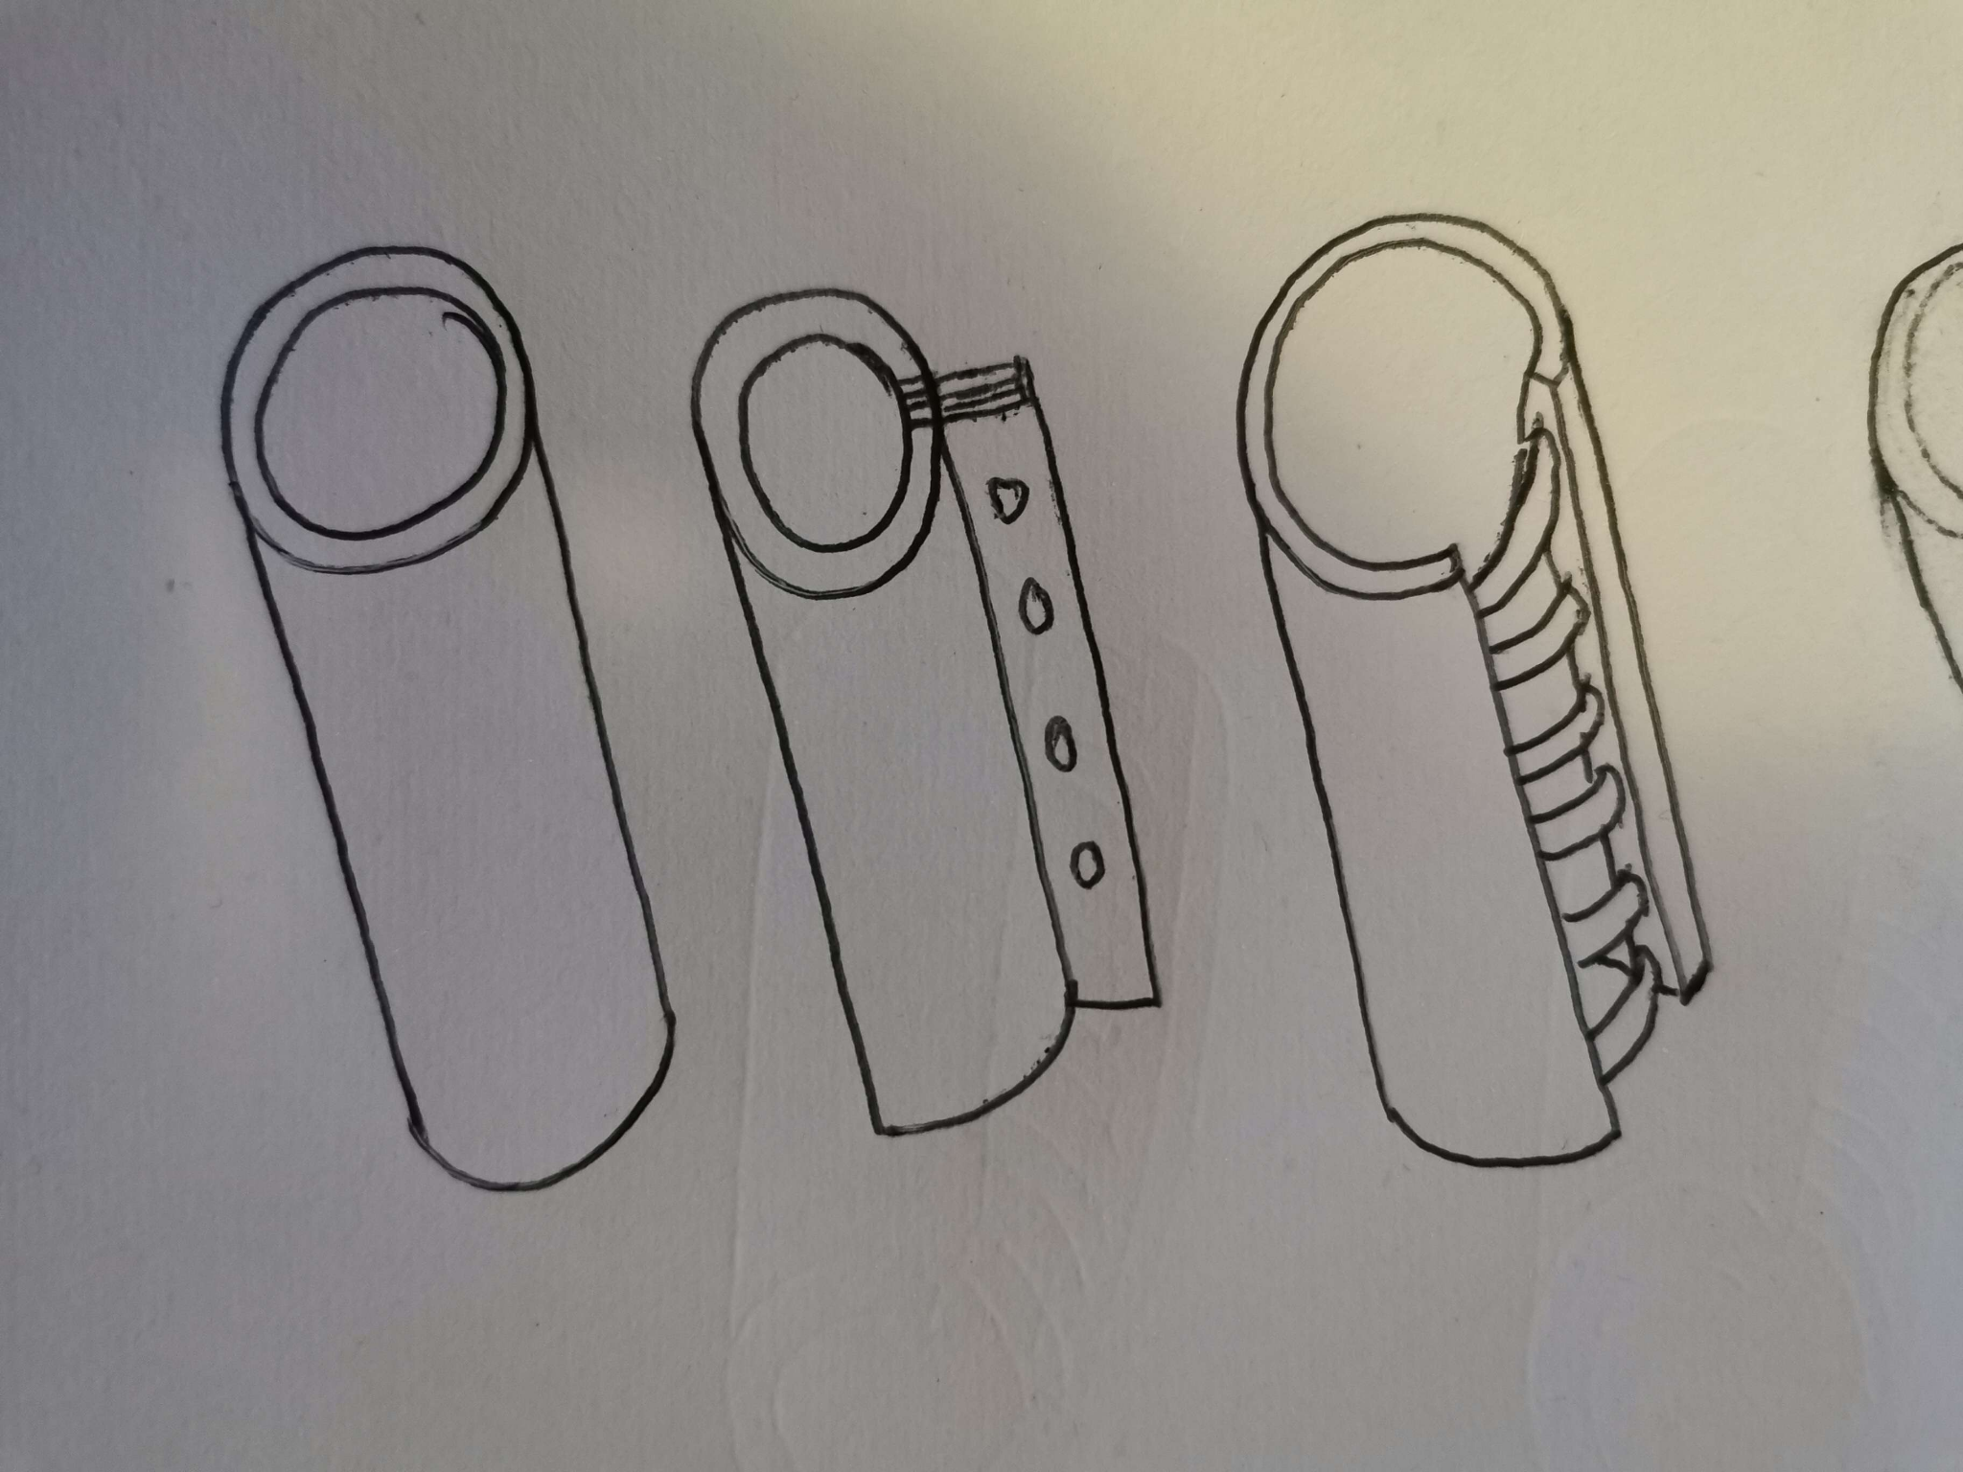
User Feedback and Improvements cont.
The third issue was the installation method which for the lock, we came up with three concepts through research and then a group brainstorming session:
Having the cylindrical part of the lock to have metal rods that is within the cylinder. These would extend and enter the other side when the fob is on the detector for 10 seconds. Similarly for uninstalling the lock with the fob meaning that the lock can be reused on other bikes.
Another idea was to have a rivet like cylinder where it can be placed around the target area of the bike frame or to have unique screws that are used to tighten and secure the lock in place. Unique screw are a must otherwise the lock could just be detached by criminals easily if they had tools.
The final simpler idea was to just have a metal cylinder and it would be installed by removing the handlebars of the bike. Once removed, slide the lock into place and then reattach the handlebars.
All these will have a rubber inside to both mitigate any scratches to the bike and provide a tighter fit. The material will be tough and semi flexible so that it cannot be easily broken and provides a tighter fit onto bikes of various sizes.
To decide on which idea we wanted, we used a QOC in our discussions.

Slide 56
User Feedback and Improvements cont.
Rather than writing out the QOC and drawing lines which can be messy, we summarise the QOC using a simple table with the criteria as the rows and the different options as the columns.
From this we saw that the rod mechanism was the best option for us even though it may be slightly more complex compared to the others.
 | Extending Rods | Rivet | Unique Screws/Bolts | Simple Cylinder
Ease of installation
Ease of uninstalling
Simple mechanism
Easily attached to any part of the bike
Securely tightened
Minimal parts
Difficult to remove using portable tools

Slide 57

Brand Concept
Before moving on to the Hi-Fi prototype, we wanted to brainstorm some name ideas for the lock. We noted down any ideas we’ve had that suggest the idea of our product and concluded that Intellilock was best suited. We designed a simple logo to go along with the name that can go onto the lock/fob as well as any other areas like posters.

Slide 58
Scenario Reflection
To determine the current state of Intellilock, we go through a few of our scenarios from our personas but implement the use of Intellilock in their daily life.
It’s 8:35 and Mikael is ready to leave for work at Exeter University at which he’s employed to deliver his 9am lecture but time’s a little tight and he’s at risk of being late since the commute normally takes 20 minutes. He grabs his things and hastily heads out. Luckily, his Intellilock is already attached to his bike, saving him any hassle. He cycles quickly to the nearest bike park to his lecture theatre. Using the Intellilock takes no time at all to lock up, and he quickly binds his bike to the rack. He used to use two locks; however, he is confident that the Intellilock alone gives him enough security to feel safe, as it would alert him and people in close proximity if the lock was broken. Thanks to being able to lock his bike quickly, Mikael manages to reach his lecture five minutes before it starts.
Jesika is heading onto campus on a bitingly cold February day at the University of Birmingham where she is a full-time Law student to study in the Library and later head to a lecture. She carefully locks up her bike in a rack using Intellilock. Thankfully, Intellilock is attached directly to her bike, leaving her plenty of space in her backpack. In addition, it gives her peace of mind that her bike is secure whilst she studies. She heads into the library and starts studying. After a long day, she decides to head home and walks back to her bike. After quickly unlocking it with a key fob, she sets off into the dark. She knows the route well but there are a couple of dark roads south of Selly Oak she must cycle along to reach her house. Luckily, she is also using SafeCycle, which alerts her to icy roads ahead of time. By cycling carefully she avoids any accidents and makes it home.

Slide 59
Scenario Reflection cont.
Emily recently got Intellilock based on a recommendation she heard from a friend. She installs the lock onto her work bike and heads into Manchester before marking herself as available for deliveries on her work apps. A job pops up to collect an order from Dominos 2km away which she accepts and heads off towards the shop. Once she’s at Dominos, she goes to lock her bike by pulling on the cord and wrapping it around the wheel and bike frame. This saves her time as a large D-lock doesn't need to be carried and installed every time she stops somewhere. Whilst she waits, she likes to fidget with the fob and is able to check her bike whenever she presses the fob. So she can wait happily and patiently for the customers order before delivering it. The number for the order gets called and she hastily grabs the pizza and goes to her bike. As the fob unlocks Intellilock, the cord springs back into the lock and she navigates through Manchester to delivery the pizza to a happy customer which in return she receives a nice tip.
These scenarios illustrate that the lock is: useful in real-life situations, feasible, and able to help the remaining users in their problems from an simple sense of security for Mikael and Jesika to excessive use due to work as shown with Emily. This encourages us with the knowledge of the lock fulfilling its design goals. So we take this further into hi-fi for further visualisation as our personas are happy with the current capabilities of the lo-fi and have demonstrated its viability.

Slide 60
Hi-Fi Prototype
We’ve chosen to take Intellilock into hi-fi prototyping so continued developing and testing to further advance our idea.

Slide 61
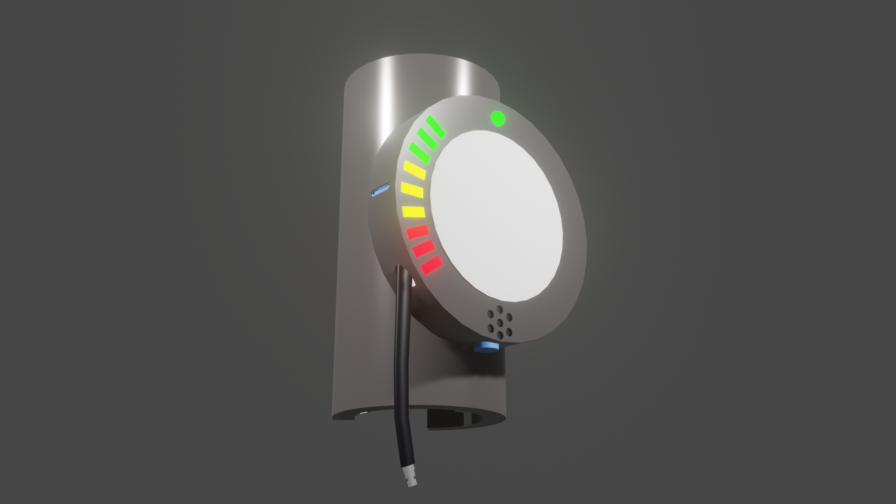
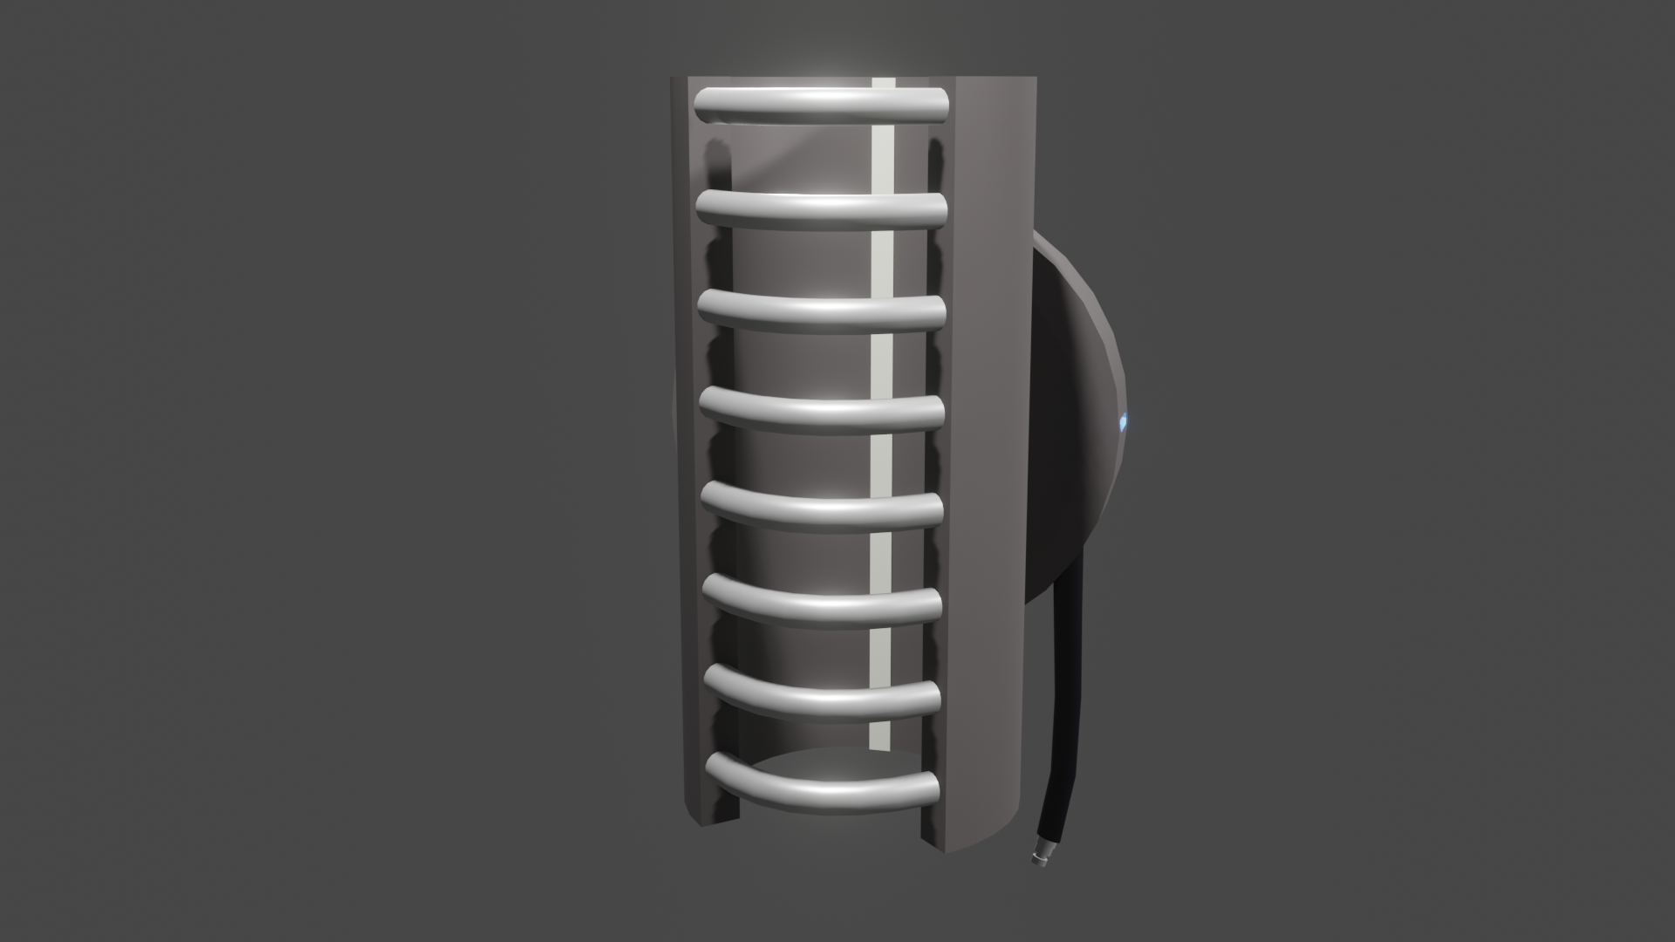
Model
Upon deciding that we would go with the bike lock as our hi-fi prototype: we wanted to further test its feasibility by making a 3D model of it. This also served to help visualise the design in a way that meant everyone was on the same page.
Shown here is the first iteration of the hi-fi design. In the image of the front you can see:
The RFID fob reader (circular white plastic receiver - has a metal backplate to protect other electronics)
Battery charging port + charge level (small blue port on the left + bright LEDs ranging from red to green)
Status indicator (circular LED above fob reader)
Cable coming out of the lock (below the charging port)
Speaker for bike alarm (below the fob reader)
Button for retracting the lock cable (blue button below the speaker)
The image of the back demonstrates the mechanism that would hold Intellilock to the bike, which is comprised of white rubber strips that would protect and grip the bike frame and metal bars which would retract to tighten the lock around the bike.
Front of lock
Back of lock

Slide 62
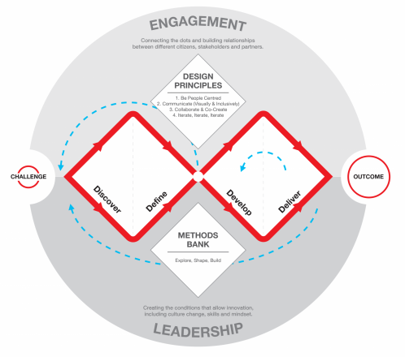
Double-Diamond Model
When developing our ideas, we use the Double-Diamond model to help us with the design process, we summarise each stage throughout this project as:
Discover - we initially discussed a broad variety of issues that cyclists may potentially face. After releasing a survey, we were able to narrow said issues down.
Define - through the survey, we discovered that a large proportion of cyclists have had their bikes stolen, and most participants only had a simple cable lock, or no security at all. Most participants also only spent <£100 on cycling in the past year. There we also a lot of people who used to cycle, that no longer do. From these results, we considered a couple of spaces for solutions, which included some sort of security, and an app that would help motivate people to cycle again.
Develop - we went through numerous different ideas when considering our design space. For the lock, we decided that we wanted it to be bound to bike in some way, as well as having a key fob lock. We looked at the existing bike locks, taking note of the way they worked. For the app, our ideas ultimately converged onto a map app that allows users to create/share routes, as well as mark potential hazards.
Deliver - our 2 lo-fi ideas are a bike lock and a community-sourced map app. However, whilst in the process of deciding which one to develop into a hi-fi prototype, we discovered a few existing apps that were very similar to our map app. As a result, we went with the bike lock as our final idea. We went through a few iterations until we settled on a final design for the lock, featuring a method to attach it to the bike, a key fob lock, a gps and a text-based alert system.
Benefits of the model - The Double Diamond model was useful as it split the design process into distinct phases. By placing the research phase first, it helped reduce a broad problem such as 'cycling' into more precise areas, allowing us to pick one those that were both important and appealing to our group. It further helped us develop a wide range of ideas, then bring them together to form our final concepts.

Slide 63
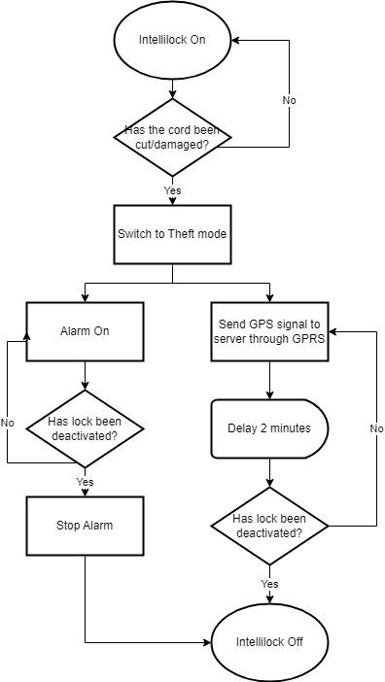
Circuit Flowchart
Intellilock contains a key fob reader and locking mechanism, a GSM (mobile messaging) module, a GPS receiver, an alarm and a tripwire circuit that passes through the locking cord, all which require power. The alarm is triggered when the circuit passing through the cord is broken, so if someone tried to cut the lock it would trigger. Therefore while the lock is in use, a small current must constantly pass through the circuit.
The other systems will only be powered when in use; for example, the GPRS emitter needs to only be powered when the GPS signal needs to be sent (which is the same event as the alarm- the lock has been cut). The alarm for when it needs to be active due to the theft mode on the Intellilock.
The flowchart on the right demonstrates how Intellilock processes information depending on its state.
The key fob itself only needs a small amount of power to display the light, which is also provided by button batteries. The lock itself powers the key fob when it is being read, as the key fob uses electromagnetic fields emitted by the lock to send a signal to it as described on the next slide.

Slide 64
Security Fob
The purpose of using a fob is for the locking/unlocking of Intellilock. Instead of using a key like most locks, the fob will have other functionalities as well as being easily portable like with a key. It’s portable as its small and can be put on a set of keys like a keyring. The features of the fob are as follows:
Installation of Intellilock explained in the next slide
Lock/unlock Intellilock
Simple alert system for the biker, accomplished by lights and vibration
The fob will work by using Radio Frequency Identification (RFID) as well as an intelligent barcode system that acts as the unique identifier for Intellilock. This uses electromagnetic fields so that it can track and identify the stored data of the identifier. Radio waves are used for the interaction between the fob and the fob reader that’s on the lock. They are preprogrammed so that each set is unique to one another and each chip in a fob will have an assigned frequency that can communicate with the reader. Therefore once the frequency lines up with one another then the reader will activate. Based on the length of this activation, it has two functionalities. A short activation is the bike lock/unlock mechanism but a longer activation (10 seconds) is the installation of the bike lock detailed on the next slide.
Along with Intellilock, one side of the fob is a LED button that when pressed will display green if the safety is certain, yellow if it’s out of range or technical issue, orange if the battery needs replacing. If the lock is broken into then the fob will flash red regardless of whether the button is pressed as well as the fob vibrating incase the user doesn't have a line of sight on their phone or fob. With two ways to notify the biker as well as a text message, the biker will be able to react quickly and efficiently wherever they may be.

Slide 65
Lock Fitting and Setup
Intellilock’s fitting mechanism is designed so that the lock can be attached at various different points depending on the design of the frame of the users bike. The system works as follows:
Hold fob on lock for 10 seconds to unlock & retract clamping bars
Position lock around bike frame
Hold fob on lock until lock emits a ‘beep’ indicating the clamp bars are locked in place
The clamp bar locking process is as follows:
Upon user holding fob against lock for 10 seconds, the clamp bars start to extend - the extending force is weak, for safety
When the clamp bars reach the other end of the locking mechanism, they enter and hook inside Intellilock’s frame
The clamp bars then start to be retracted until a certain clamping force is achieved at which point the other end of the clamp bars lock into place inside Intellilock’s frame
The force driving the extension of the clamp bars is weak and interruptible in the event of detection of an obstructive body (such as human fingers). If the fob is removed from the lock at any point before the audible cue indicating completion of the locking process, the locking procedure is immediately aborted and all tension/driving forces in the system are released.
In order for alert messages to be sent to the user upon interference with the lock, some contact information is required. This is gathered and Intellilock is registered as in-use with this person using a simple website. The basic wireframes for the MVP of this website are on the next slide.
The basic process is to input a contact number, Intellilock’s unique serial number and a password via the setup page in order to link the specific unit and the signals emerging from it to the contact number in the central server. Intellilock then downloads the number from the server and stores it locally in an encrypted flash memory store to utilise in a notable event.

Slide 66
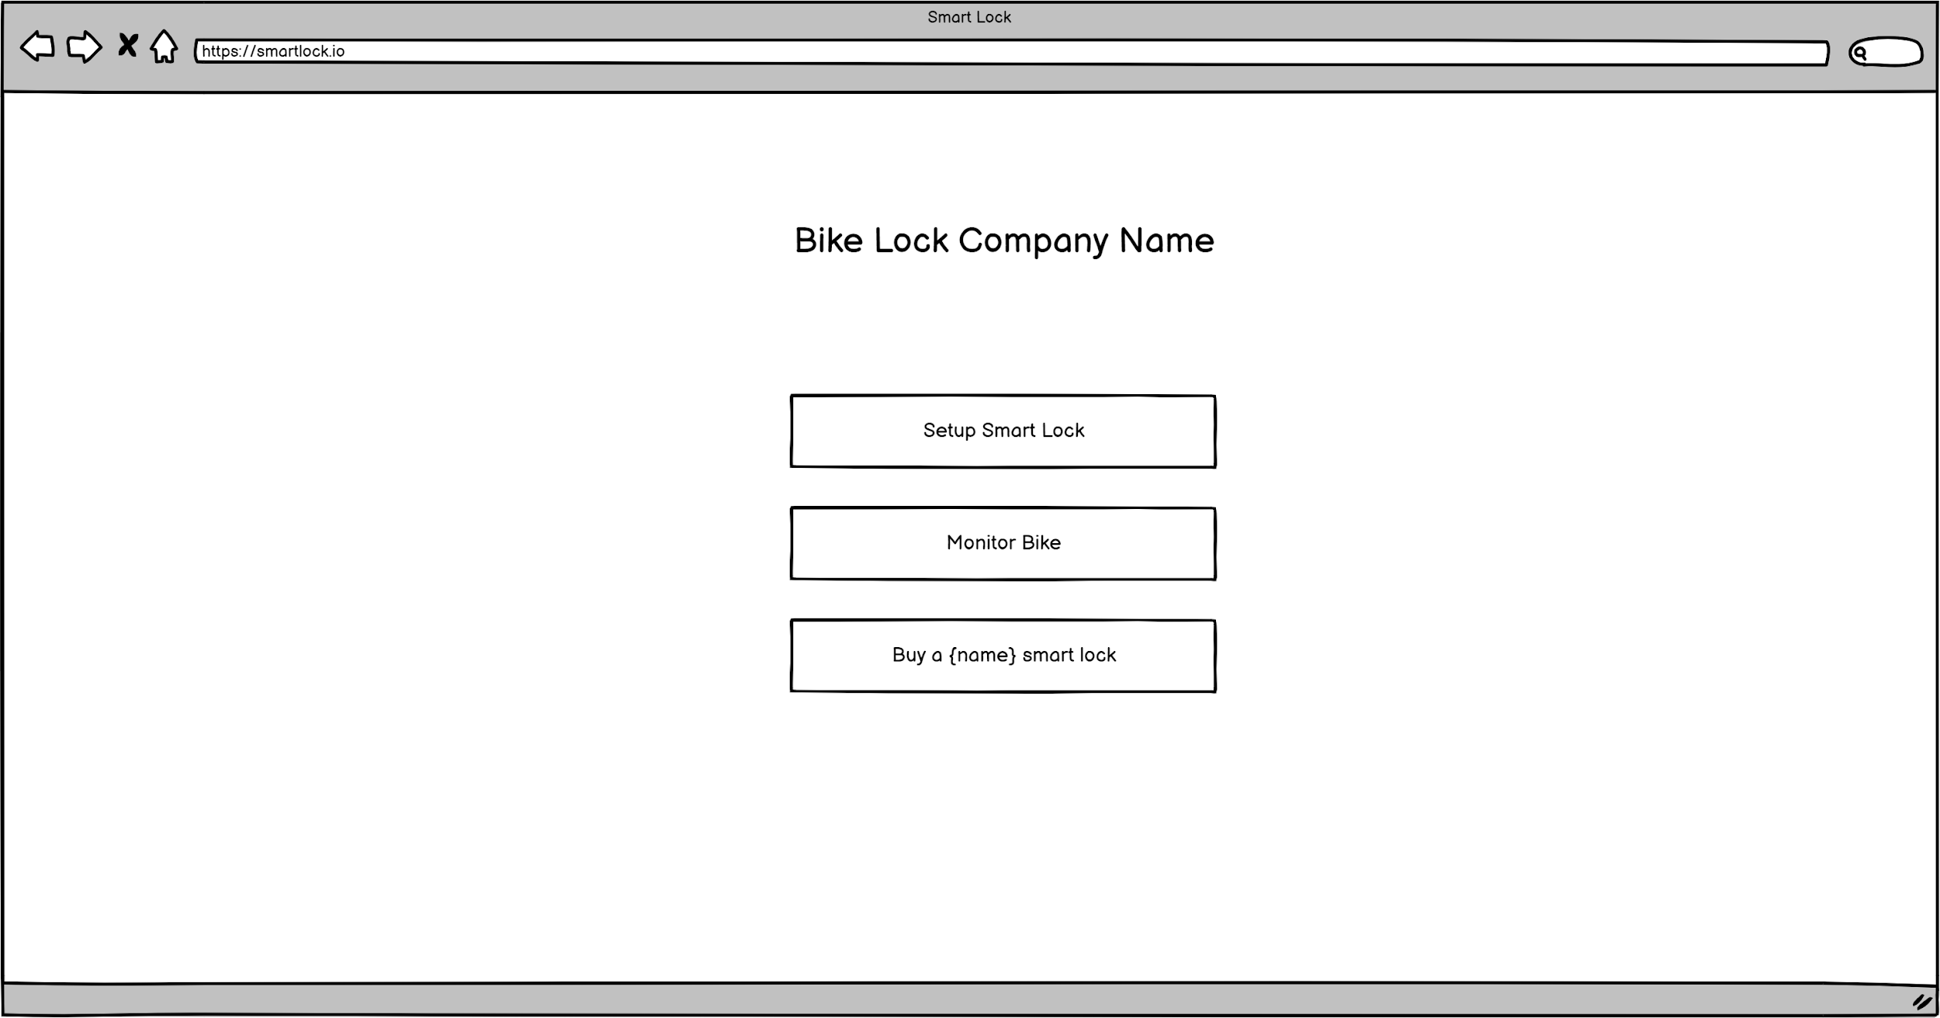
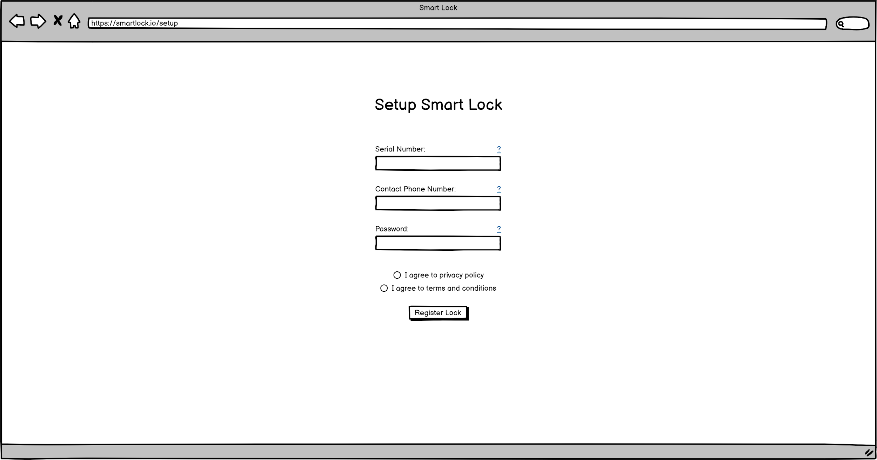
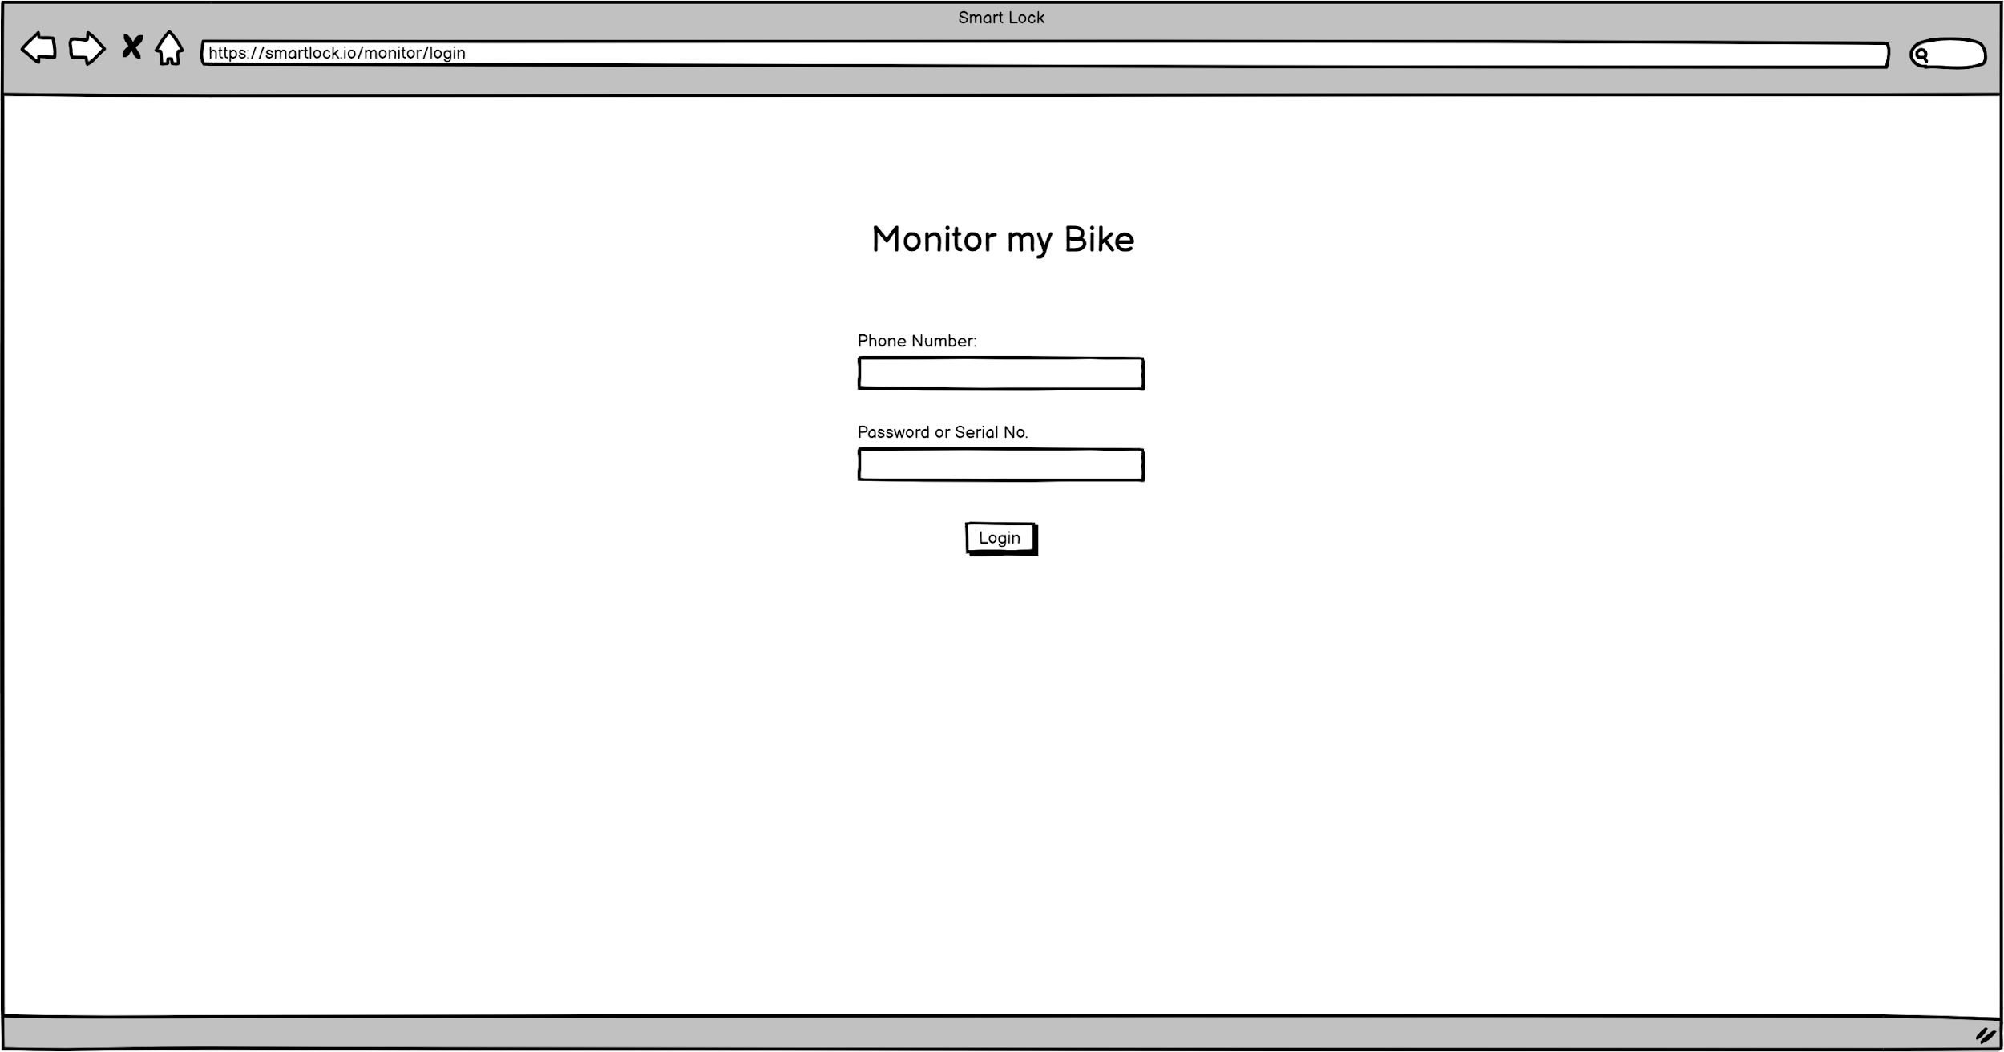
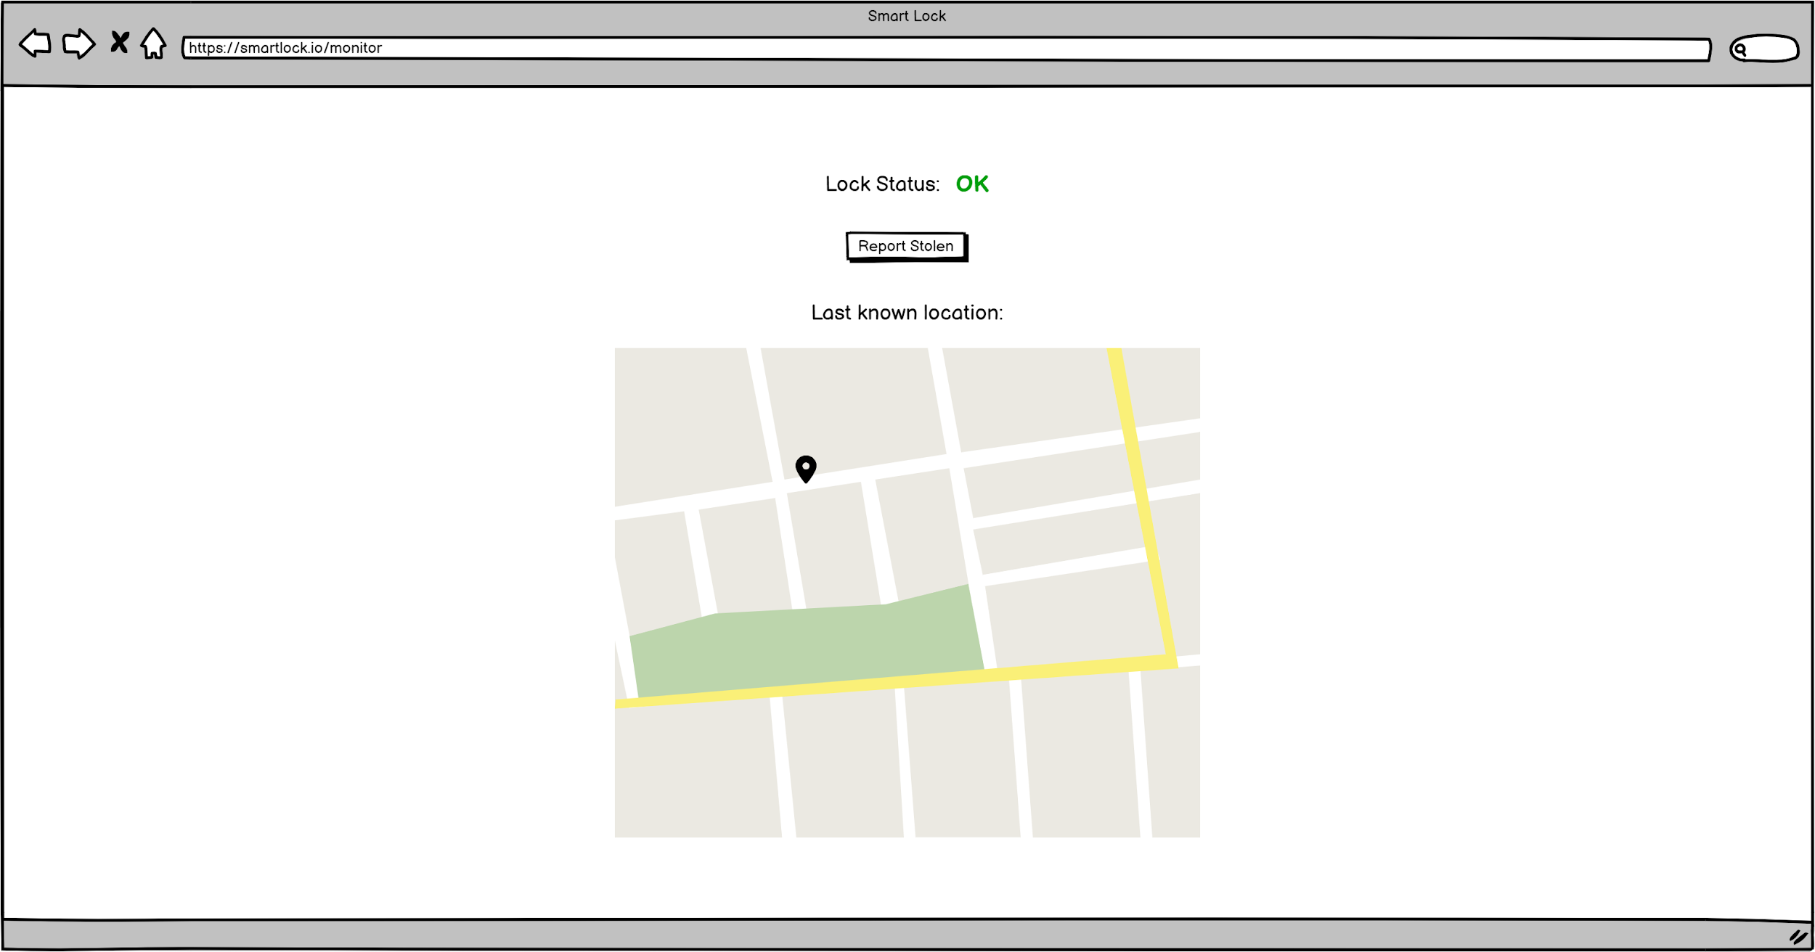
Lock Web Interface
Landing page
Setup page
Monitor login page
Monitor page

Slide 67
Communication Technology
The flow of data through the lock system routes one-way from the lock to the central web server to the user’s phone to the fob and each link uses a different technology to make use of the power available and provide range required for effective operation. We took into account that the size of the lock cannot be too big so we found compact ways to accomplish the data transferred between each of these stages of the flow of data.
Lock to Server: Global System for Mobile Communications (GSM)
Intellilock contains a microcontroller, GPS antenna and GPS module, i.e. the GPS component of Intellilock that will generate the current location information into packets of data. This would then be sent to the GSM so that it may be sent over to the web server.
Intellilock includes a GSM modem and antenna to send data to the server via the mobile network. This is the best solution we discovered through our research since satellite communications requires expensive, bulky hardware and lots of power for transmission. We also looked at ultra-wide band technology as used by Apple in the AirTag but realised that this wouldn’t work without a ubiquitous network of higher-powered devices to transmit the lock’s initial signal via satellite. We found that GSM is used in dog tracking collars which shows implementation in a compact, lightweight and low power device is feasible.
GPRS (General Packet Radio Service) is the communication that will be used for the transfer of GPS data as this is a simple packet oriented method. It utilises 2G/3G which is efficient for our lock due to the fact that the only data we need sent is the GPS data.
Therefore by the combination of these 3 areas, we are able to gather the location of Intellilock and communicate it to the server so that it may be processed further to be sent to the user’s mobile.

Slide 68
Communication Technology cont.
Server to Phone: SMS
We decided to use SMS to transmit messages from the server to the user’s phone since it each cheap and has good coverage across the country, including in many more remote areas where mobile data signals do not reach. It is also a simple technology to implement and the sending of messages could be subcontracted out.
Phone to Fob: Bluetooth Low Energy
Bluetooth Low Energy is a form of Bluetooth designed to be compact and energy efficient enough to maintain a bluetooth connection with the same range as the original variation in devices running with a single button battery for months or years. This technology is applicable as the idea is that the fob only displays a status light when the button in pressed within close range of the user’s phone, otherwise the status light is inoperative.
This Bluetooth connection would require an app on the user’s phone which accesses the text messages received from the server’s phone number (a feature allowed by iOS and Android) and transmit the status update to the fob via the Bluetooth connection. The app could also contain the same interface and features as shown on the web interface wireframes.

Slide 69
Alert Triggers & Location Tracking
Intellilock exists in one of two states: ‘normal operation’ or ‘theft mode’. Normal operation is the default and theft mode is triggered either manually or automatically by one or more of the following:
Excessive force on the locking cable when engaged
Cutting of the locking cable
Excessive forces on Intellilock’s housing (such as hammer strikes)
Manual reporting of loss/theft via the web interface (see monitor page)
Upon entering theft mode, the alerting process detailed on the next slide is initiated as the lock uses its low-power GPS receiver to determine its location which is sent to the central server for viewing by the lock owner on the web interface.
When looking at location detection technologies, we considered Bluetooth, Wi-Fi Direct and GPS. However, Bluetooth and Wi-Fi Direct have ranges that are too small for this use case (~30m and 30m-200m respectively). Therefore the remaining option is GPS. The system of satellites is free to use meaning no subscription or lifetime purchase cost are required to cover this but the limiting factor is energy since this lock must be a low-power device to avoid the inconvenience of constant charging.
As a result, the GPS location of the lock is only calculated by the GPS receiver and transmitted to the central server via GSM upon Intellilock being cut or the bike being reported stolen on the web interface (see the monitor page). Upon this trigger, the position of the bike is updated and transmitted every 2 minutes until the battery is drained or the theft mode of Intellilock is deactivated using both the fob that came with Intellilock and the web interface. The reason for requiring both of these forms of authentication to deactivate the position reports is that it is not inconceivable that the thief could obtain control of one of these. The primary reason the position reports can be deactivated is in case the user accidentally reports the bike as stolen or the theft mode is erroneously triggered by other stimuli.
This means that Intellilock is reusable in the event of theft or loss if the bike is returned to the user and Intellilock is in an undamaged state.

Slide 70
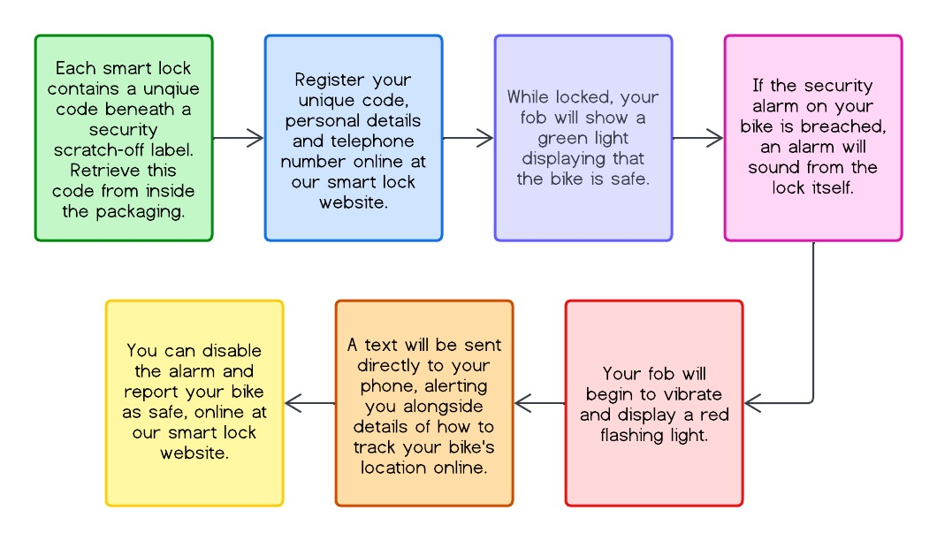
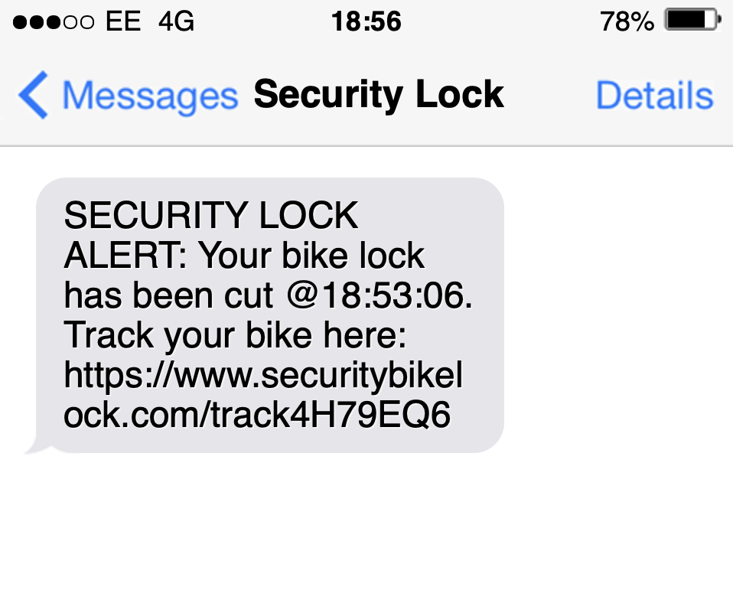
Lock Alerting
Process

Slide 71
Prototype Analysis
At this point we reviewed our hi-fi lock prototype design using the personas defined earlier and discovered some issues:
Intellilock requires charging too often to power the lights, speaker, fob reader, status light, gps receiver and fitting mechanism with a small battery
Jesika, Emily and Mikael cycle very frequently as part of their daily routine and it’s very inconvenient to have to remove Intellilock from the bike and charge it as often as all of these features would require.
There is not enough space for a sufficiently long lock cable
This is because Emily needs to lock her bike in various locations and so needs a long cable to ensure it will reach around any kind of fixed feature.
Needs to be waterproof - specifically the charging port is the issue in this respect
Emily and Mikael in particular will have situations requiring they cycle in the rain so that they can work
The locking cable needs to be replaceable in the situation that it is attacked and the bike is recovered
Emily, Alex and Jesika all have limited budgets and cannot afford to replace an expensive lock in the case of recoverable theft
We also showed the exported renders of the model to some of the users that viewed the Wizard of Oz prototype and they brought up the following practical points which are also relevant to our personas:
Intellilock is attackable via a screwdriver or similar being hammered through the charging port - destroying the internal electronics
This is an issue for Emily, Mikael, Jesika and Alex as it fundamentally compromises the security of the lock
There might not be enough space within Intellilock, along with all the other electronics, for sufficiently high-powered motors for the fitting mechanism
This is a purely practical point that renders the current design impossible, the redesign needs to account for the fact that heavy users such as Emily, Jesika and Mikael will at some points need to remove the lock for charging purposes.

Slide 72
Addressing the Design Issues
We had another group brainstorming session to come up with solutions to all of the problems discovered in the previous slide, here is what we came up with:
The bike requires charging too often
Remove all of the status lights, replacing them with a text when the battery level is low. The gps receiver and speaker only turn on when ‘alert mode’ is activated in the lock. The fitting motors will be removed.
There is not enough space for a sufficiently long lock cable
Move all of the electronics apart from the fob reader, out of the cable housing and into a redesigned, crescent shaped, fitting frame. Make the cable housing slightly larger.
Needs to be waterproof
Remove the charging port - the power-hungry features have now been removed so the lock can be battery powered.
The locking cable needs to be replaceable
Screws on the inside of the fitting mechanism hold the locking mechanism onto the fitting frame. This means the manufacturer can replace the fitting cable if the lock is RMA’ed which is a suitable solution since the cable should not get cut very often at all.
Intellilock is attackable via a screwdriver or similar being hammered through the charging port - destroying the internal electronics
The charging port has been removed, the lock housing is now uninterrupted and this vulnerability has been removed.
There is not enough space within Intellilock, along with all the other electronics, for sufficiently high-powered motors for the fitting mechanism
The fitting mechanism requires a full redesign, none of the previously considered ideas (shown in the previous QOC) work, new system described on the following slide. The front of the fitting mechanism is also to be made wider into a crescent shape to increase its volume to enable more components to fit inside.

Slide 73
Redesign of the Fitting Mechanism
We generated multiple ideas for a new fitting mechanism that is low-powered, secure against attack with portable tools, easy to remove by the user, compact, simple and will fit bikes of multiple sizes. We came up with the following, all of which only require a small amount of power to release internal locking pins to release (The figures are on the next slide):
Intellilock is made up of two parts - the front and back that push and lock together with internal pins. Two alternative types of join:
Halves meet on a flat edge with lock pins on the inside edge of the fitting frame so they would be reinforced by the bike frame if attacked by a screwdriver or similar (figs 1.1, 1.2, 1.3)
Halves meet in a ‘tongue and groove’ type way and pins point perpendicular to joining edges (figs 2.1, 2.2)
Handcuff ratchet system - two ratcheted bars hinge on one side of the fitting frame (which surrounds the front side of the bike) and ‘click into’ the other side of the fitting frame. (figs 3.1, 3.2, 3.3, 3.4)
Hinge and half system - a half and half system like the first one but there is a hinge on one side rather than pins on both sides (no sketches)
Crescent clip with manual bars for security only - fitting frame surrounds just over half of the bike frame and holds itself on the bike when pushed on. Bars similar to the original fitting concept prevent the lock from being pulled off the bike and are closed manually. (fig 4)
We carried out the adjacent QOC analysis to see which idea met our objectives and settled on the handcuff-style ratchet system for the next revision of the prototype. The sketches made in the ideation session and referred to above are displayed on the next slide.
 | low-power | secure | removable | compact | simple | multiple sizes
Inside Lock pin halves
Arrow head halves
Ratchet system
Hinge and half system
Crescent clip with security bars

Slide 74
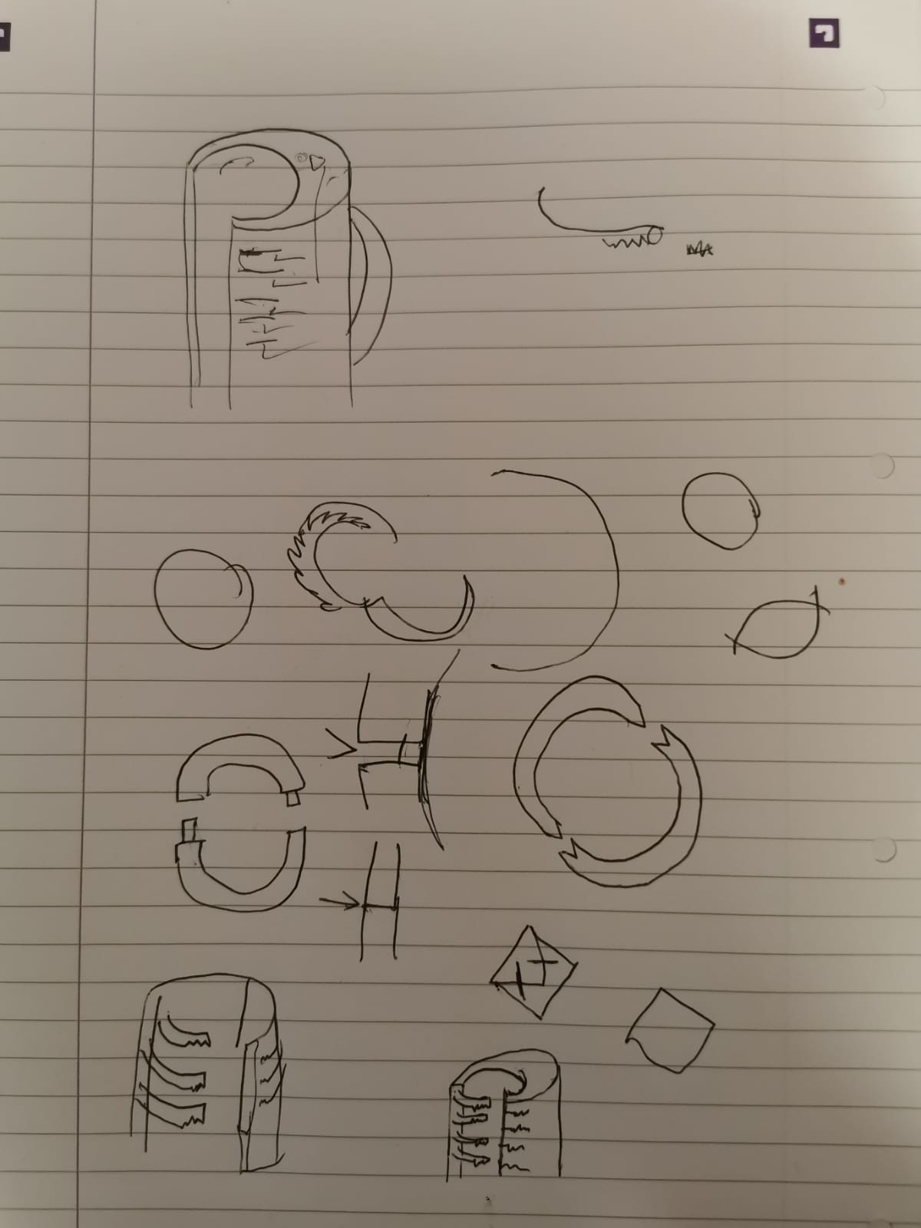
Redesign of the Fitting Mechanism Sketches
Fig 4
The ratchet fitting system we decided on will consist of two bars of similar style to the original fitting concept. However, they will hinge on one end of the fitting frame (which surrounds the front of the bike frame) and have teeth along the bottom of the bars (fig 3.1). The bars will independently swing into the other end of the fitting frame where they will run over a pin which holds the ratchet teeth in place. The further the bars are pushed into the frame, the tighter the ratchet holds.
The inside of the fitting frame and the bars will have rubber pads to prevent scratching of the bike and to provide a tighter fit. Holding the fob against the reader for 10 seconds will release the ratchet mechanism for 10 seconds allowing the user time to pull the ratchet bars out of the end of the fitting frame.
The ratchet system allows a range of motion of the fitting system while locked which caters for bikes of various sizes and smaller bike frames can be fixed onto with the bars in a kind of double crescent configuration (fig 3.4).
Fig 3.1
Fig 3.4
Fig 1.2
Fig 1.1
Fig 2.1
Fig 1.3
Fig 2.2
Fig 3.2
Fig 3.3

Slide 75





Final Model of Intellilock
The model was remade in accordance to the critiques, and utilises the redesigned fitting mechanism.
On the front of Intellilock you can see the:
Removal of the status lights
Removal of the charging port
Increased area for cable housing
On the back of Intellilock you can see:
Screws holding the lock to the fitting mechanism, allowing for repair work to be done on the lock interior
The redesigned fitting mechanism
The images below shows the various different light modes of the fob which corresponds to:
Yellow - Out of range/technical issue, Green - Safe, Red Flashing - Theft Mode
Front of Intellilock
Back of Intellilock

Slide 76
Usability Evaluation and Future Aims
We evaluate the usability of our product by 4 key points:
Effective - Intellilock provides the location detail to the biker effective by the use of a website and mobile updates. The lock itself is secure and contains countermeasures to deter any thieves and the design of the lock means that it can be securely attached to the bike for ease of store. The simple led on the fob is effective in informing the biker on Intellilock’s status.
Efficient - The biker only needs to install and pair their mobile with Intellilock so that the backend server can send out a message when it’s being broken into. There is no other hassle that the biker would need to manage as the lock is designed to provide this ease of use.
Learnability - We’ve used conventional website design so that the biker doesn't feel unfamiliar with the website. The attachment mechanism is shaped as a half cylinder so that the biker can understand how it would attach to the bike, i.e. by the bike frame.
Desirability - Intellilock ensures the bike is safe, that the biker receives updates so they can remain at ease so that they may focus on their job. This is shown by our persona Mikael as he doesn't want his bike to be stolen so with Intellilock, they don't have to constantly be worrying. The lock remains attached to the bike so bikers won't need to constantly remind themself to bring one when heading out and the fob can be attached to their keys.
Future improvements for Intellilock would be a larger battery capacity or a variant of the Intellilock with a built in battery like in the first hi-fi. However this would mean that Intellilock would be more expensive and the charging port would have to be reintroduced which had the flaw of being a weak point as described before. So would also need to counteract this by a protect charging port of some kind. UI display on the fob would be a quality of life upgrade as can mitigate the use of a phone however this is beyond the general modern technology. Finally a future advancement of Intellilock would be one which has a better ergonomic shape so that it is easy to install and has no way of accidentally hurting the biker.

Slide 77

Reflection and Teamwork Summary
The first thing we established as a team was a form of communication so that we could remain in touch outside of our usual meetings and to discuss various areas of our progress. We set up multiple regular meetings every week to inform one another on anything that we’ve done and to discuss our next steps. During these, various jobs were distributed and assigned to be completed before the next meeting. To ensure that we are kept up to date with everything, we used a variety of tools and apps such as:
WhatsApp and Discord - For informal discussions and organisation where we can chat and update each other of any plans and changes we’ve made or plan to make.
Trello - To help distribute tasks to everyone and to keep a checklist of what to do as well as a section holding the information of our next meeting, including notes on topics we want to discuss at that meeting. This also kept everyone up to date on the status of other people’s tasks that they may be relying on.
Google Drive - Includes Google slides, docs, questionnaire etc. Holds any documents and files we’ve produced, all the notes as well as the main slide deck. This was extremely useful as it provided a space that everyone can access and the ability to work together at the same time.
Balsamiq - Used for the basic wireframe for our lo-fi app to demonstrate and visualise the functionality. It was good for showing other users the idea and process of going through the app.
Blender - 3D modelling software for the Hi-Fi prototype of the bikelock to fully visualise our end product. This enabled us to account for any changes to improve the overall functionality of the whole lock.
Adjacent is a snapshot of part of our Trello board midway through the project.

Slide 78
Reflection and Teamwork Summary cont.
By keeping our meetings informal with a friendly atmosphere, we were able to discuss more openly about our opinions when we were discussing various ideas throughout the project.
After discovering the strengths and weaknesses within the team, the relative tasks were assigned accordingly. For example one of us was better at designing so they were assigned to do some of the sketches and the poster. Another had experience in Blender so took the lead on the hi-fi models of our product. Every task and assignment was put onto our Trello board and this way if someone was struggling with their work, we could notice this, discuss an alternative and re-assign accordingly. This means that the transitions through each stage of the UCD framework was smooth.
Our meeting notes were crucial so that nothing was forgotten and these were revisited often as a reminder to ourselves of what was discussed and what we should discuss next.
We enjoyed gathering information and researching the various areas within cycling to help us in generating our initial areas of interest. Through developing our ideas with various techniques and processes, Intellilock and SafeCycle were brought into fruition. If we had more time and resources then a physical working hi-fi of Intellilock is the next stage in development so that it may be tested and brought in as a new product for people who cycle.

Slide 79

Poster
This is the final design poster illustrating Intellilock and an extract of some of the stages involved in its development.

